Slide 1
Optimising the use of antibiotics in the management of urinary tract infections (UTI) in aged residential care

Slide 2
Agenda
Project overview and implementation
Module one: The problem and related interventions
Module two: Use a decision-support tool to check whether signs and symptoms meet criteria for UTI
Module three: Use of dipsticks for UTI
Module four: Urine sample collection, storage and reporting
Module five: Risk factors and ways to help prevent UTI
Module six: Process surveillance

Slide 3
Health Quality & Safety Commission
The Health Quality & Safety Commission (the Commission) works with clinicians, providers and consumers to improve health and disability support services (hqsc.govt.nz).
The Commission partnered with the aged residential care (ARC) sector to optimise the use of antibiotics for the treatment of UTI in long-term care facilities.
An evidence-based report for the project can be found here: https://www.hqsc.govt.nz/resources/resource-library/appropriate-medication-use-in-aged-residential-care/.

Slide 4
Project objectives
Reduce the use of urinary antibiotic prescriptions for residents whose symptoms do not meet clinical criteria for UTI.
Prevent and reduce UTI.
Strengthen capability for infection prevention and control.
Improve reporting and monitoring.
Increase staff knowledge and awareness on antibiotic use and UTI.

Slide 5
Antibiotic UTI project: How-to guide
Strategies and improvement ideas
Data collection template
Letter to prescriber
Decision-support tool
Educational material
Staff knowledge and confidence survey
Implementation checklist
Notes:
Prem

Slide 6
Implementation – engagement and buy-in
Steps for successful implementation of interventions
Create team:
identify project champion/lead
identify/create project team.

Slide 7
Implementation – engagement and buy-in
Steps for successful implementation of interventions
Create buy-in:
identify stakeholders
share project details with stakeholders to generate buy-in
share project information with staff and residents
communicate with prescriber and share materials.

Slide 8
Implementation – engagement and buy-in
Steps for successful implementation of interventions
Agree on process:
discuss the decision-support tool with prescriber
agree on the process of communication and documentation.

Slide 9
Implementation – prepare and establish baselines
Steps for successful implementation of interventions
Measurement:
use the data collection template or existing resident management system to collect data related to outcome, process and balancing measures
establish baseline
agree on an ongoing data collection plan
agree on the format and frequency of data reporting.

Slide 10
Implementation – prepare and establish baselines
Steps for successful implementation of interventions
Education:
run an education session for staff on UTI and the use of antibiotics.
Resources:
make the decision-support tool available
gather all the necessary resources.

Slide 11
Module one
The problem and related interventions

Slide 12
Antibiotics are not harmless
Unnecessary use of antibiotics can lead to:
antimicrobial resistance (AMR)
serious bowel infection (Clostridium difficile colitis)
thrush (yeast infection)
side effects such as diarrhoea and nausea
allergic reactions
harmful interactions with other medicines
impaired kidney function
increased risk for UTI
death of friendly bacteria in the gut (microbiome).
Notes:
Clostridium difficile colitis results from disruption of normal, healthy bacteria in the colon, often as a result of antibiotics. C. difficile can also be transmitted from person to person by spores. It can cause severe damage to the colon and even be fatal. Symptoms include diarrhoea, stomach pain and fever. Treatment includes antibiotics. Even when treated with antibiotics, the infection may come back. In rare cases, faecal transplant or surgery may be needed.

Slide 13
AMR
AMR happens when bacteria, viruses, fungi and parasites change over time (‘mutate’) and no longer respond to medicines. This makes infections harder to treat and increases the risk of disease spread, severe illness and death.
High number of bacteria. A few are resistant to antibiotics.
Antibiotics kill bacteria causing the illness, as well as good bacteria protecting the body from infection.
The resistant bacteria now have preferred conditions to grow and take over.
Bacteria can even transfer their drug resistance to other bacteria, causing more problems.

Slide 14
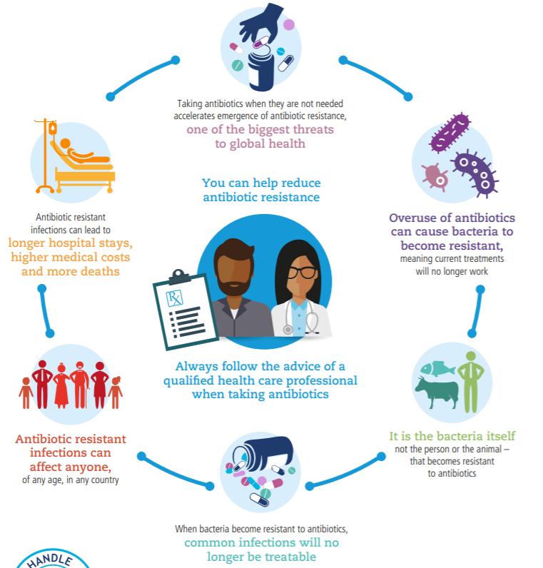
Antibiotic overuse puts us all at risk

Slide 15
Antibiotic overuse puts us all at risk
AMR is a global problem that affects everyone.
The New Zealand AMR action plan includes strategies to ‘keep antibiotics working’.
The Ngā paerewa Health and disability services standard will require ARC to monitor resistant infections.
Using antibiotics when they are not needed increases AMR.
AMR means many antibiotics will no longer work, even for common infections.
Antibiotic-resistant infections can lengthen hospital stays and increase medical costs and the number of deaths.

Slide 16
The size of the problem
AMR is an increasingly serious problem in Aotearoa New Zealand.^{1,2}
AMR may limit the effectiveness of future medical care.
Up to three-quarters of prescriptions for UTI in ARC are for residents who do not meet the criteria for UTI.³
Over half of antibiotic courses administered in ARC may be unnecessary or excessively broad spectrum.⁴
Data from process surveillance as part of this project indicated that around 30–40% of the antibiotics prescribed for UTI could have been avoided.
¹Royal New Zealand College of General Practitioners 2015; ²Thomas et al 2014; ³D’Agata et al 2013; ⁴Jump et al 2018

Slide 17
Key interventions
Use a decision-support tool to check whether signs and symptoms meet UTI criteria.
Only use dipsticks to rule out UTI, not to diagnose.
Only when UTI diagnostic criteria are met:
request or initiate empiric treatment
collect urine samples.
Notes:
This poster is available in the implementation guide

Slide 18
Key interventions
Ensure timely access to and follow-up of laboratory report.
Nurses check treatment is reviewed once culture and sensitivity results are available .
Track how UTI are diagnosed and treated (‘process surveillance’).
Conduct a staff education session about the impact of antibiotics and the proposed interventions.
Notes:
This poster is available in the implementation guide

Slide 19
Module two
Use a decision-support tool to check whether signs and symptoms meet criteria for UTI

Slide 20
Decision-support tool
The Commission has developed a decision-support tool that captures the pathway for residents with or without urinary catheter.
It was adapted from the McGeer UTI criteria¹ and the Ontario UTI assessment algorithm.
The algorithm is modified from the NZ frailty care guides, UTI, 2019.
It can be used in any health care setting.
The first section can be used to identify UTI signs and symptoms.
The second section is about treatment and follow-up.
¹Stone et al 2012
Notes:
The algorithm is modified from the NZ Frailty Care Guides, Urinary Tract Infection, 2019. It incorporates a review cycle from the Ontario programme’s decision support algorithm.

Slide 21
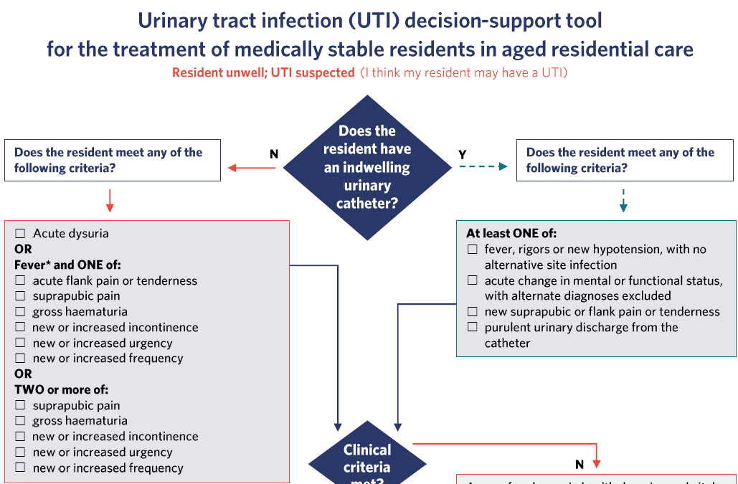
Decision-support tool
Clinical signs and symptoms

Slide 22
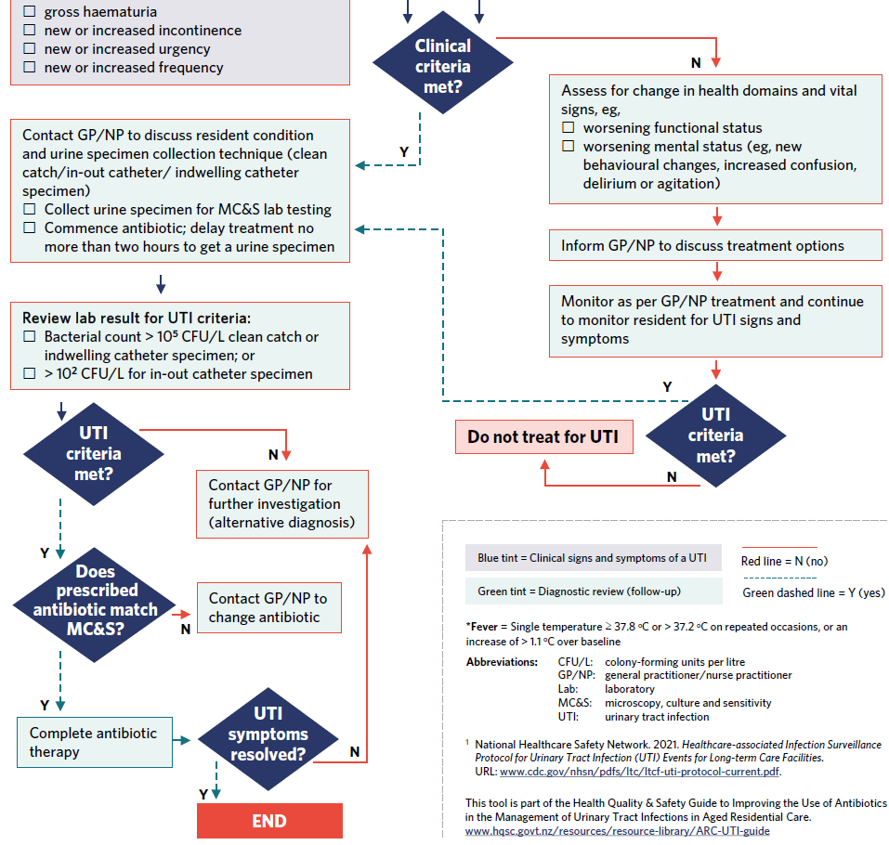
Decision-support tool (cont.)
Treatment and follow-up
References and legend

Slide 23
How to use it
Left side: primary pathway for someone without a urinary catheter.
Right side: primary pathway for someone with a urinary catheter.
Diamonds are decision points.
Check the symptoms match the clinical signs and symptoms.
Prescribers may start antibiotics empirically.
Once the laboratory test results are available, check the antibiotic.
If the results do not match the result or the antibiotic needs to be changed, contact the prescriber.
Notes:
The algorithm is modified from the NZ Frailty Care Guides, Urinary Tract Infection, 2019. It incorporates a review cycle from the Ontario programme’s decision support algorithm.

Slide 24
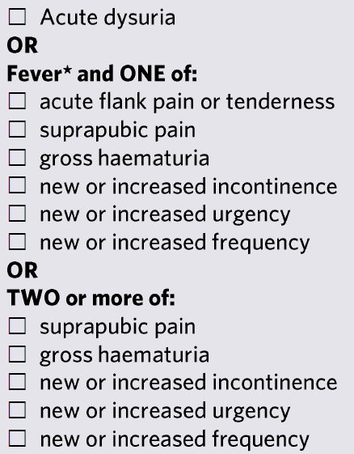
UTI symptoms
Common symptoms of UTI (infection in one or more of the urethra, bladder, ureters or kidneys):
bladder infection: cystitis and dysuria (pain or burning when passing urine), frequency, urgency and lower abdominal pain
kidney infection: flank pain (‘pyelonephritis’: pain in the upper abdomen, back or sides), nausea and vomiting, fever and possibly 'frank' or 'visible’ blood in the urine.
Symptoms in a resident with a long-term catheter may be more general, eg, fever, flank or pelvic pain.
If any UTI criteria are met, collect a urine specimen and inform the prescriber without delay.

Slide 25
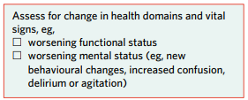
Non-specific urinary symptoms
UTI diagnosis relies on the criteria in this pathway.
Other changes to urine may co-exist but are not specific to a UTI. Urine may change for many reasons:
colour: food/drink, medication
smell: diabetes, dehydration, food, medications^{1,2}
cloudy: bladder debris, dehydration.¹
¹Jump et al 2016; ²Godbole et al 2020

Slide 26
Non-specific general signs and symptoms of deterioration
UTI diagnosis relies on the criteria in this pathway.
These include cognitive, behavioural, functional and physical changes:
confusion, stopping eating or drinking, reduced mobility or ADL status, falling or vital sign changes.
These are important signs of deterioration that need rapid investigation, but they have many potential causes.
If there are no specific UTI symptoms, investigate other causes of deterioration.

Slide 27
Residents with dementia or unable to communicate
Initial signs that ‘something is wrong’ may be cognitive, behavioural, functional or physical changes:
confusion, not eating or drinking, reduced mobility or decline in ADL status, falling or vital sign changes.
The diagnostic criteria for a UTI do not change, but detection is more challenging.
Observe and record any signs that can help make a correct diagnosis. Resident-specific history may be important.

Slide 28
Residents with dementia or unable to communicate
Look for signs and symptoms:
dysuria/urinary change
changes to urination (frequency, urgency, grimacing with urination)
increased or new urinary incontinence
distress with passing urine
suprapubic or flank pain
protecting or massaging the area of discomfort
reluctance to move
vocalisation or grimacing, agitation/restlessness.
Observe and record any signs that can help make a correct diagnosis. Resident-specific history may be important.

Slide 29
Situation, background, assessment, recommendation (SBAR)
SBAR provides a framework for communicating clearly about a resident’s condition.
Using SBAR will help remind nurses to check that the signs and symptoms meet the definition of a UTI before requesting general practitioner (GP) or nurse practitioner (NP) review.
It also reminds staff to check for other causes of symptoms and to document a plan of action.

Slide 30
Module three
Use of dipsticks for UTI

Slide 31
Asymptomatic bacteriuria (ASB)
ASB is when bacteria are present in the urine but the person has no symptoms; up to half of older people have ASB. It is harmless and doesn’t need to be treated.
Many UTIs are diagnosed based on a positive dipstick result.
Residents with a long-term urinary catheter will almost always have bacteria in their urine with or without symptoms.
ASB is often picked up via dipsticks because all bacteria (harmful or not) will produce a positive result.
Use of dipsticks often leads to antibiotics being prescribed ‘just in case’.

Slide 32
ASB
Treating ASB can lead to worse outcomes for the resident because antibiotics also kill ‘good’ bacteria that protect against more harmful bacteria.
Without this protection, the harmful bacteria can cause more severe infections.
Overusing antibiotics allows bacteria to develop defences (mutate) against antibiotics, making treatment less effective (AMR).
This means even simple infections are getting harder to treat, which is a problem for everyone.

Slide 33
Use of dipsticks
When a person is generally unwell and a dipstick is negative for leukocytes and nitrites, it is unlikely that the person has a UTI. In this situation, the dipstick result helps rule out UTI as a possible cause of symptoms.^{1,2}
When a person is generally unwell but has no UTI symptoms, a positive dipstick can cause diagnostic confusion (up to half of ARC residents have leukocytes and nitrites in their urine without symptoms^{3,4}) and delay a thorough investigation for the true cause of symptoms.
Only use dipsticks to rule out, not diagnose, UTI.
¹Devillé et al 2004; ²Bafna et al 2020; ³Best Practice Advocacy Centre New Zealand 2015; ⁴Givler and Givler 2022

Slide 34
Module four
Urine sample collection, storage and reporting

Slide 35
Collecting urine samples
Collect urine samples if signs and symptoms meet the UTI criteria.
Collect samples before commencing antibiotics.
Use clean catch or mid-stream urine technique, or an in-out catheter may be appropriate.
Do not collect samples from urinals, bedpans, continence products or catheter bags. This can contaminate the sample, which can lead to a false result.
Refrigerate the sample immediately – bacterial numbers continue to grow at room temperature, which can lead to false laboratory results.
Document signs and symptoms on the laboratory request form.
If a sample could not be collected, document the reason why.

Slide 36
Reading and responding to the laboratory report
A positive culture alone is not enough to diagnose a UTI because ASB is common in older adults.¹
Confirm diagnosis based on diagnostic criteria and positive laboratory result, and check antibiotic sensitivities:
bacterial count 10⁸ CFU/L with signs and symptoms
bacterial count 10⁵ CFU/L if urinary catheter in situ.
¹ Godbole et al 2020
Notes:
Check the criteria

Slide 37
Reading and responding to the laboratory report
Consult with GP or NP if:
antibiotic not commenced/prescribed
sensitivities do not match prescribed antibiotic
bacterial count does not match criteria
you have any other concerns
the patient continues to deteriorate.
Notes:
Check the criteria

Slide 38
Module five
Risk factors and ways to help prevent UTI

Slide 39
Risk factors for UTI
Older adults are more at risk of UTI because of the physiological changes of ageing. Other factors that increase the risk of UTI:
history of repeated UTIs
urinary incontinence
bowel incontinence, diarrhoea or constipation
loss of function due to a stroke or disease such as Parkinson’s
urinary catheter
uncontrolled diabetes
enlarged prostate
dementia
exposure to infections in the facility.

Slide 40
Preventing UTI
Cranberry supplements may have some benefit in recurrent UTI (although larger-scale trials are recommended).¹
Estrogen cream has been shown to be beneficial in recurrent UTI, but cream can cause local inflammatory response and application is invasive.²
If urinary catheters cannot be avoided, adhere strictly to infection control practices.
Encourage full bladder emptying using the double void technique (sit to urinate, stand, then sit again).
¹Sihra et al 2018; ²Best Practice Advocacy Centre New Zealand 2019

Slide 41
Preventing UTI
Assess and manage urinary incontinence with products and techniques.
Avoid dehydration – consider interventions such as fluid rounds.¹
Practice good hand hygiene – use the five moments.
The use of antibiotics is not recommended to prevent UTI as it can lead to antibiotic resistance.²
¹Lean et al 2019; ²Godbole et al 2020

Slide 42
Module six
Process surveillance

Slide 43
Process surveillance
Process surveillance is a way to track how suspected UTIs are managed:
what symptoms were identified?
was a dipstick rather than clinical symptoms used to diagnose?
was a urine sample collected; if not, why not?
was treatment reviewed once the laboratory result became available?
what was the outcome for the resident?

Slide 44
Key messages
Antibiotics are not harmless
Inappropriate use can lead to avoidable harm and contribute to AMR.
Use diagnostic criteria to assess for UTI.
Only collect urine samples when diagnostic criteria are met.
Collect and store urine samples correctly.
Stop using dipsticks to diagnose UTI (only to rule it out).
Only request treatment when diagnostic criteria are met.
Review treatment when the laboratory result is available.
Act on laboratory result: record and continue or contact GP/NP for stop or change.
Maintain process surveillance.

Slide 45
Sustaining improvement
To make sure we continue to improve, we will:
continue monthly reporting on UTI and antibiotic use
include ways to track the process in everyday systems (process surveillance)
include the topic as an agenda item for quality or infection prevention and control meetings
update policies and procedures
update staff and resident education/awareness resources
update staff orientation
appoint antimicrobial stewardship ‘champions’.

Slide 46
References
Bafna P, Deepanjali S, Mandal J, et al. 2020. Reevaluating the true diagnostic accuracy of dipstick tests to diagnose urinary tract infection using Bayesian latent class analysis. PLoS One 15(12): e0244870. doi: 10.1371/journal.pone.0244870.
Best Practice Advocacy Centre New Zealand. 2015. A Pragmatic Guide to Asymptomatic Bacteriuria and Testing for Urinary Tract Infections (UTIs) in People Aged Over 65 Years. Best Practice Advocacy Centre New Zealand. URL: https://bpac.org.nz/BT/2015/July/guide.aspx (accessed 4 April 2020).
Best Practice Advocacy Centre New Zealand. 2019. Menopausal Hormone Therapy: Where are we now? Best Practice Advocacy Centre New Zealand. URL: https://bpac.org.nz/2019/mht.aspx (accessed 27 August 2022).

Slide 47
References (cont.)
D'Agata E, Loeb MB, Mitchell SL. 2013. Challenges in assessing nursing home residents with advanced dementia for suspected urinary tract infections. Journal of the American Geriatrics Society 61(1): 62–6. doi: 10.1111/jgs.12070.
Devillé WL, Yzermans JC, van Duijn NP, et al. 2004. The urine dipstick test useful to rule out infections. A meta-analysis of the accuracy. BMC Urology. 4: 4. doi: 10.1186/1471-2490-4-4.
Givler DN, Givler A. 2022. Asymptomatic Bacteriuria. StatPearls. Treasure Island (FL): StatPearls.
Godbole GP, Cerruto N, Chavada R. 2020. Principles of assessment and management of urinary tract infections in older adults. Journal of Pharmacy Practice and Research 50(3): 276–83. doi: 10.1002/jppr.1650.
Jump RL, Crnich CJ, Nace DA. 2016. Cloudy, foul-smelling urine not a criteria for diagnosis of urinary tract infection in older adults. Journal of the American Medical Directors Association 17(8): 754. DOI: 10.1016/j.jamda.2016.04.009.

Slide 48
References (cont.)
Jump RLP, Crnich CJ, Mody L, et al. 2018. Infectious diseases in older adults of long-term care facilities: update on approach to diagnosis and management. Journal of the American Geriatrics Society 66(4): 789–803. doi: 10.1111/jgs.15248.
Lean K, Nawaz RF, Jawad S, et al. 2019. Reducing urinary tract infections in care homes by improving hydration. BMJ Open Quality 8(3): e000563. doi: 10.1136/bmjoq-2018-000563.
Royal New Zealand College of General Practitioners. 2015. Antibiotics and Antimicrobial Resistance: Avoiding a post-antibiotic era. URL: https://www.rnzcgp.org.nz/gpdocs/Newwebsite/Advocacy/05.2015-Antibiotics-and-antimicrobial-resistance-Policy-brief-1.pdf (accessed 8 April 2020).
Sihra N, Goodman A, Zakri R, et al. 2018. Nonantibiotic prevention and management of recurrent urinary tract infection. Nature Reviews Urology 15: 750–76. doi: 10.1038/s41585-018-0106-x.

Slide 49
References (cont.)
Stone ND, Ashraf MS, Calder J, et al. 2012. Surveillance definitions of infections in long-term care facilities: revisiting the McGeer criteria. Infection Control & Hospital Epidemiology 33(10): 965–77. doi: 10.1086/667743.
Thomas MG, Smith AJ, Tilyard M. 2014. Rising antimicrobial resistance: a strong reason to reduce excessive antimicrobial consumption in New Zealand. New Zealand Medical Journal 127(1394): 72–84.

Slide 50
Glossary
Antibiotic | A medicine that destroys or slows the growth of bacteria
Antibiotic resistance | When bacteria change in response to the use of antibiotics, making the antibiotic less or not at all effective
Antimicrobial | A product that destroys or slows the growth of micro-organisms, including viruses and bacteria
Antimicrobial stewardship | Improving the use of antimicrobials (including antibiotics) to improve patient outcomes, improve awareness of antimicrobial resistance and reduce the spread of infections caused by multidrug-resistant organisms
Infection prevention and control | An area of expertise that aims to prevent or control (limit) the spread of infections in health care facilities and the community
Multidrug-resistant organisms | Micro-organisms (mainly bacteria) that have developed resistance to one or more classes of antimicrobial medicines. They are often called ‘superbugs’
UTI | An infection in any part of the urinary system: kidneys, bladder, ureters or urethra

