Slide 1
National paediatric early warning system
Education for implementation
October 2022

Slide 2
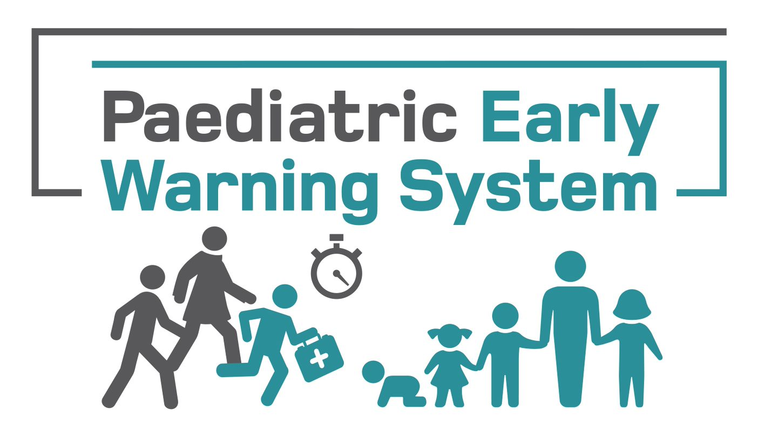
Learning outcomes
By the end of the session staff will be able to:
describe the components of a paediatric early warning system
distinguish between the four paediatric vital sign charts (PVSC) and the individual components making up each chart
use the national tools on the back of the PVSC to assess vital signs
describe steps within the escalation pathway in relation to the deteriorating tamariki
modify vital sign parameters in the modifications section (medical staff)
apply changes made in the modifications section of the PVSC

Slide 3
Abbreviations
PEWS – paediatric early warning system
PEW score – paediatric early warning score
PVSC – paediatric vital signs chart
Notes:
PEWS is a recognition and response system. It is collection of observations, generation of a PEW score, and response according to an escalation pathway.

Slide 4
Why we need a PEWS
The aim of the system is to improve the early recognition of and response to acutely deteriorating tamariki in hospital
Notes:
There is limited published evidence about the degree or extent of failures to recognise or respond to acute deterioration in tamariki in hospitals in Aotearoa New Zealand or internationally. However, use of paediatric early warning tools and a systematic approach to escalation and response to tamariki at risk of deterioration is widely recommended.
There have been HDC cases where adherence to a paediatric warning system has been recommended.
Case 18HDC01075 July 2021 - Patten of poor care of child with worsening symptoms – whānau concern section may have been helpful.
Case 18HDC02160 Feb 2021 - Hospital care of a three year old boy with pneumonia – non adherence to escalation pathway possible contributing factor.

Slide 5
don’t deteriorate suddenly, rather healthcare staff suddenly notice.
Patients don’t deteriorate suddenly, rather health care staff suddenly notice
Notes:
When thinking about a safe and timely recognition and response system, one could consider this idea.

Slide 6
Components of PEWS
PVSC
Clinical governance
Patient and whānau engagement
Measurement for improvement
Education
Clinical leadership
Mandatory escalation pathway
Notes:
What are the components of the Paediatric Early Warning system?
It is an interlinking system of…
effective clinical governance and leadership
age specific national paediatric vital sign charts with paediatric early warning score and localised escalation pathway (or electronic equivalent)
appropriate clinical and non-technical education
ongoing measurement for improvement
an escalation process for clinician and whānau concerns about deterioration in a tamariki
approaches to discussing and document share goals of care
All components are needed for effective implementation and sustainability

Slide 7
Recognition and response systems can save lives
Measure vital signs, escalate care and work together to provide a timely and appropriate clinical response
Health Quality & Safety Commission. 2017. Capabilities for recognising and responding to acute deterioration in hospital. ​Wellington: Health Quality & Safety Commission. URL: www.hqsc.govt.nz/our-programmes/patient-deterioration/publications-and-resources/publication/3528.
Notes:
This diagram shows how the recognition and the response parts of an early warning system fit together.

Slide 8
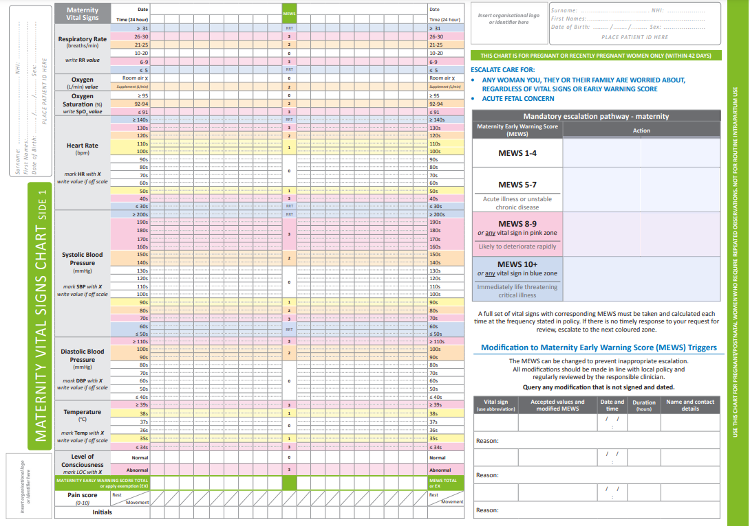
Background
EWS
MEWS
NOC/NEWS
Paediatric Society of New Zealand
Health Quality & Safety Commission
Notes:
The adult EWS and maternity MEWS have come before the PEWS as part of deteriorating patient work with the Health Quality & Safety Commission.
Newborn observation chart (NOC) NEWS was developed by ACC.
The Paediatric Society of New Zealand (PSNZ) did a stock take of what was in place around the country. There were some form of PEWS everywhere, but many different versions existed.
Most of the South Island were similar in the early days of PEWS.
There was widespread interest in National PEWS and due to this the PSNZ approached the Health Quality & Safety Commission for support to develop PEWS

Slide 9
Why we need a national PEWS
To provide equal access to an up-to-date PEWS
To provide one PEWS that is familiar to patients and staff who move between districts
To support the study of PEWS
Notes:
Moving to the same PEWS throughout the country was done to make sure that we were all working with the most up to date tools available, and to minimise the potential for the minor differences that existed around the country to adversely affect care where patients and staff move.
Tamariki in Aotearoa New Zealand are transferred between services within districts and around the country between hospitals. When transferring these tamariki, the variation in paediatric vital sign chart (PVSC) used and paediatric early warning scores assigned can make it harder for clinicians to accurately recognise and respond to deterioration.
A national set of four age-based PVSC would provide a ‘common language’ that would help to reduce risk and also benefit staff when moving from one place to another to work.
In addition, national charts make a much larger data set available to anyone wanting to research ways to improve the recognition of and response to unwell tamariki in Aotearoa New Zealand.
All respondents to a survey conducted by the Paediatric Society of New Zealand survey in 2017 (unpublished) supported the idea of national system and acknowledged the benefits of standardisation.
Endnotes
Roland D, Stilwell PA, Fortune P-M, et al. 2021. Case for change: a standardised inpatient paediatric early warning system in England. Arch Dis Child 106(7): 648‒51. DOI: 10.1136/archdischild-2020-320466.

Slide 10
Development process
PEWS working group
Testing from August 2021:
Starship oncology and general paediatric wards
Bay of Plenty District Health Board
Nelson Marlborough District Health Board
Notes:
The paediatric working group met from Dec 2019
Agreed on the parameters and scoring cutoffs for the chart
Agreed on the number of charts
Asked the Commission to design and test the charts
Focus groups held in what were then, Southern and MidCentral DHB’s. Wider sector consulted on focus group feedback.
Charts modified based on feedback for testing.
Testing was from August 2021 until May 2022

Slide 11
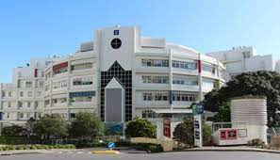
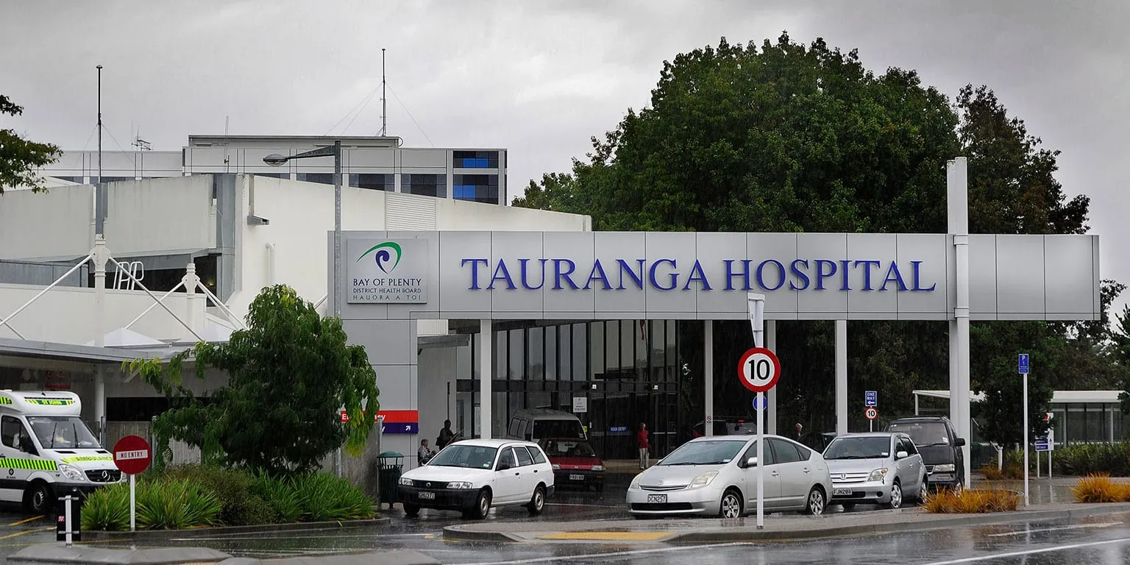
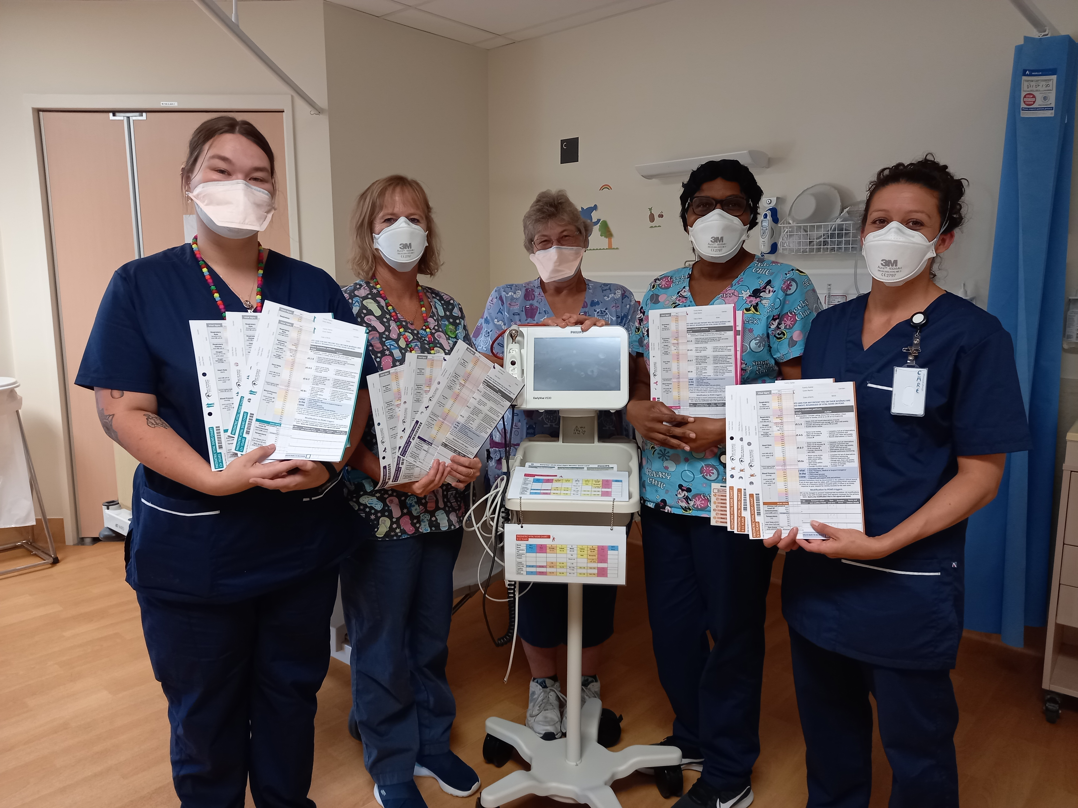
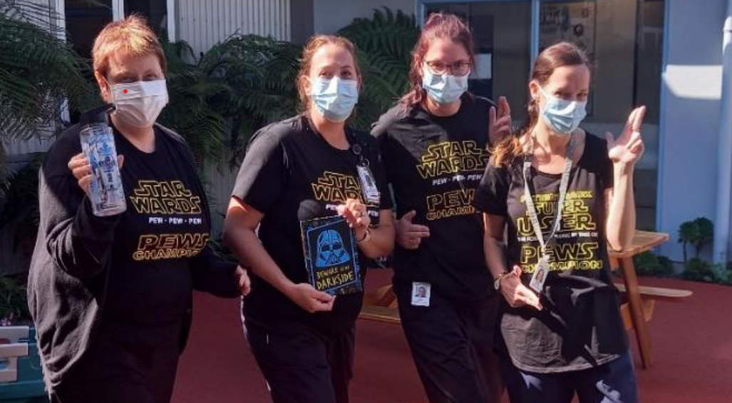
Notes:
With COVID-19 in the background and over an 11-month period project teams and staff at Starship, Tauranga, Whakatāne, Nelson and Wairau hospitals tested the draft national system.
It can not be underestimated the commitment, dedication and perseverance that has gone into this work from teams in the strained health environment.
All teams have gone through a process of understanding their current state, educating and preparing for implementation. Then having the draft charts live and auditing their use for 3 months.
Evaluation is now complete and teams continue to use the draft system prior to a national roll out.

Slide 12
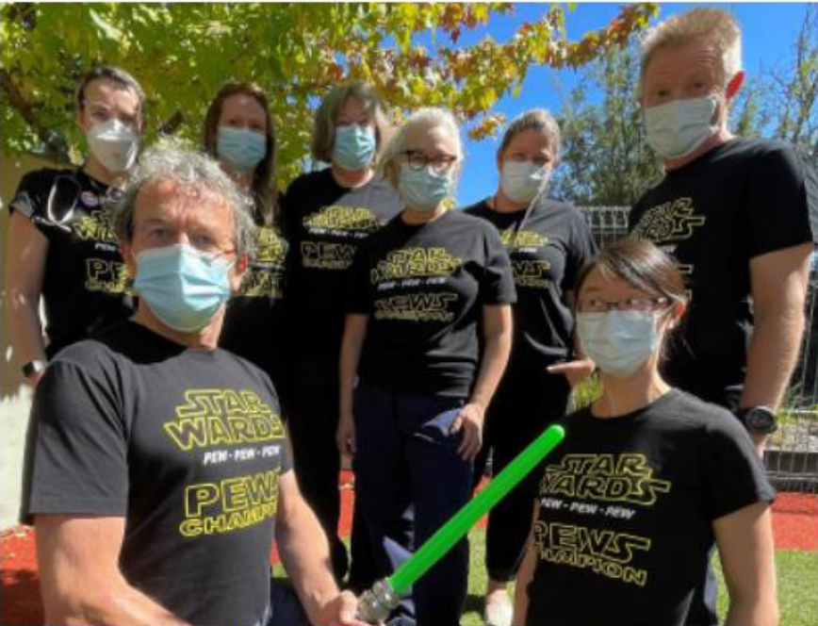
Notes:
Here is the Nelson crew in action at the start of testing. They are wearing matching t-shirts with their Wairau colleagues in the previous slide.

Slide 13
Notes:
This is one of the four charts designed using the physiological parameters and scoring, and then laid out with the human factors understanding that comes in part from the adult and maternity charts. The charts are designed to be recognizable as part of a suite of charts, but also distinct so that they are used correctly.
Space is at a premium, and this was the most challenging of all the four charts to lay out, with the expanded requirements for RR and HR ranges. As a consequence, this chart differs slightly from the others, with a respiration rate graphed in 10s rather than 5’s as on the rest. Otherwise, it is the same.

Slide 14
Paediatric vital signs charts and escalation pathway

Slide 15
Begin the PVSC for any tamariki who is assessed as requiring measurement and recording of vital signs
The physiology of tamariki alters as they age, impacting on the normal ranges for vital signs
There are four age-based PVSC, which must be used for the correct age group
Notes:
The charts and escalation pathway are designed currently for use in hospital settings in Aotearoa.
Intensive care and high dependency units usually have their own specific charts. The PVSC can be used in these settings, if so ensure the same parameters and scoring cut-offs for each vital sign should be used.
Before a tamariki is transferred from an intensive care unit or high dependency unit to a ward area, chart the most recent set of vital signs on an age appropriate PVSC and include a plan to address any ongoing abnormalities in a set timeframe.
The newborn observation chart (NOC), incorporating the Newborn Early Warning Score (NEWS), was developed for use in the immediate post-birth setting. It is for the maternity ward setting only and not the paediatric ward. When a tamariki is admitted to the paediatric ward under 28 days of age, they go on the PVSC for tamariki aged 0‒11 months.

Slide 16
Notes:
The four charts are differentiated by age groupings with physiologically determined vital signs, indicating upper and lower limits of that age group.
The Bedside PEWS developed by Parshuram 2009 form the basis of the charts. That system uses five charts with a 0-3 month and 3 -11 month separated out. The national charts have combined these age groups to a 0-11 month.
Starship have been using this combined lowest age group, informed by evidenced based vital sign parameters (Bonnifide 2013).
Starship found in audits that the latter still captured the unwell infant under three months of age.Symbols and colours are used to further differentiate between charts and to stand out from adult EWS, MEWS and NOC NEWS.

Slide 17
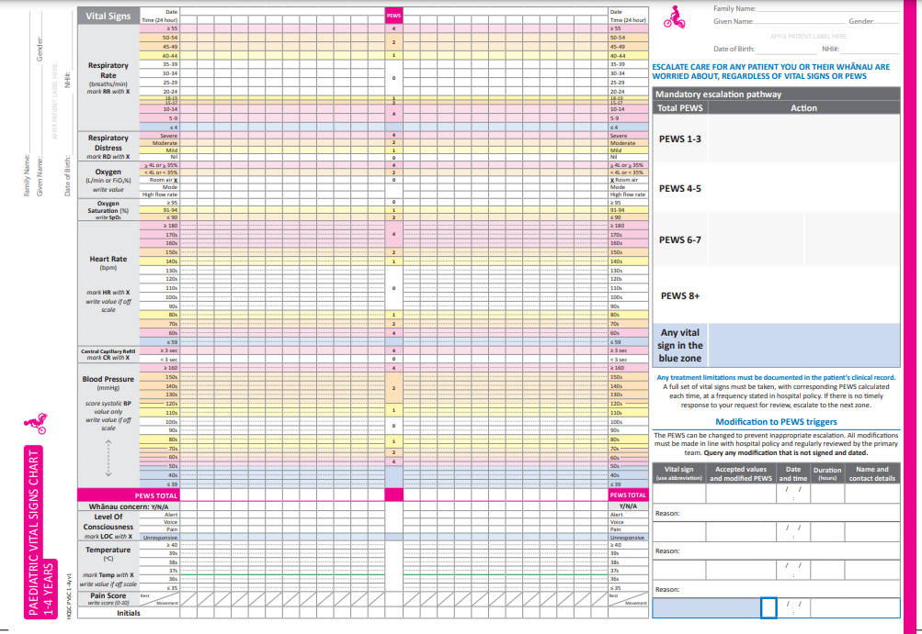
Recording vital signs: scoring area
Mandatory escalation pathway
Total PEWS score
Modifications box
Recording vital signs: non-scoring area
Notes:
Recording vital sign scoring area. These are the vital signs that generate the PEW score
This is where the score is added together and recorded.
Individual parameters are added together to give a total PEW score written here.
As above
The next section is the area where non-scoring vital signs are recorded.
As above
Here is the mandatory escalation pathway which the total PEW score is matched to and directs the clinicians to seek intervention from the appropriate clinician in an appropriate timeframe.
As above
The modifications box is where vital sign limits generating scores can be adjusted for a set time. Local policy will determine who able to sign off on these, eg, SMO or senior registrar.

Slide 18
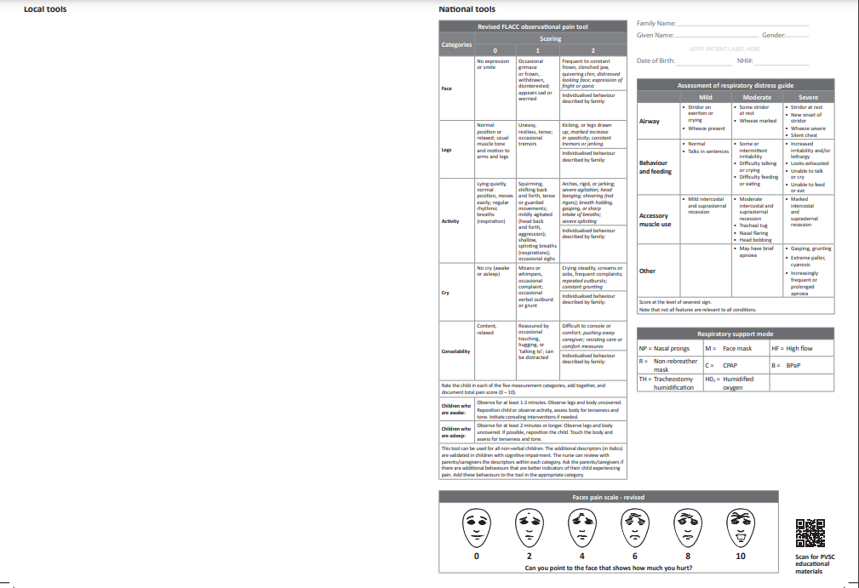
Local tools editable section
National tools
Notes:
The back of the chart contains supporting key’s and guides for consistent completion of the front.
There is a national assessment of respiratory distress guide and a key to respiratory support delivery methods.
There are also three objective pain scale tools, to support the accurate assessment of pain in tamariki.
These are contained on the national tools side (the right side)of the back and are not editable. The right hand side is fully editable and you will be able to decide as a team what you want to include there. For example your team may like a pressure injury assessment, phlebitis score or sedation score.
The QR code will link to the Commission website taking staff to user information.

Slide 19
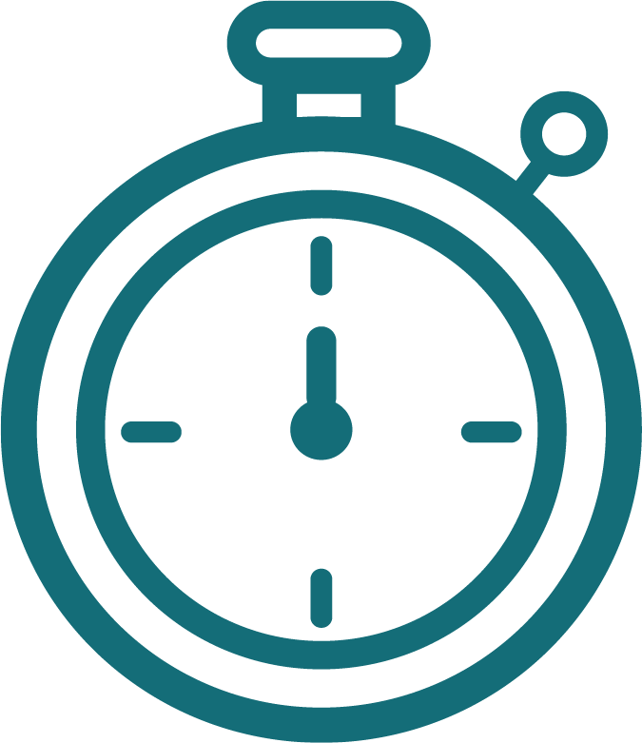
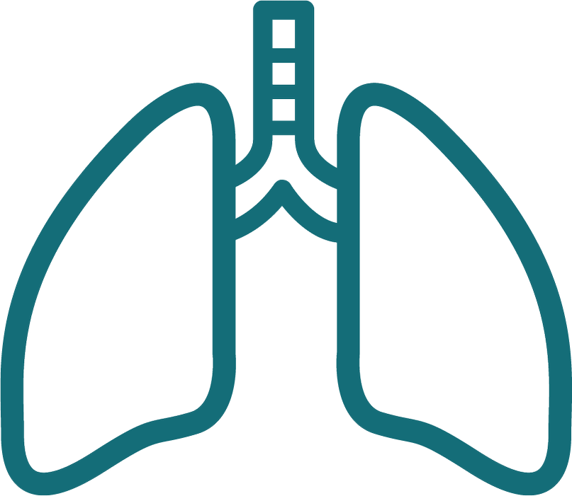
The seven scoring vital signs
Systolic blood pressure
Respiratory rate
Central capillary refill
Respiratory distress
Heart rate
%
Oxygen
Oxygen saturation
Notes:
The seven vital sign parameters that generate a score are:
the respiratory rate
the use of supplemental oxygen
the assessment of respiratory distress
oxygen saturation
heart rate
central capillary refill, note that the chart is specific about central capillary over peripheral as it is more accurate measure of perfusion
the blood pressure is scored by the systolic blood pressure reading

Slide 20
Non-scoring vital signs
Whānau concern
Level of consciousness
Temperature
Pain
Notes:
The non scoring vitals are:
Whānau concern
Level of consciousness
Temperature
Pain

Slide 21
The PEWS: a calculated score​
Each vital sign parameter has coloured zones associated with a score​
​The scores for each of the seven vital sign parameters are added together to give a total PEWS​
​The total PEWS is used to trigger action
Notes:
Each vital sign parameter has coloured zones that are associated with a score.
Staff will need to be vigilant around any changes here. Scores may be different that is 0 1, 2, and 3 is now 0, 1, 2 and 4 on the national charts. This is the scoring system used in the research based Bedside PEWS and the commission’s testing.
Also colour schemes may have changed. Ensure that staff are aware of any changes to what they are used to currently.

Slide 22
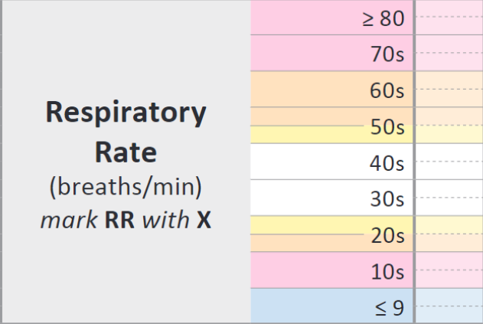
Respiratory rate
Notes:
Each row of the scoring area for respiratory rate represents a range associated with severity of abnormality. Note that the vital sign parameters vary between charts so pay careful attention to ensure the correct score is generated.
Remember that it is most accurate to obtain a respiration rate by counting respirations for 60 seconds.

Slide 23
Respiratory rate (example taken from 12+ years PVSC)

Slide 24
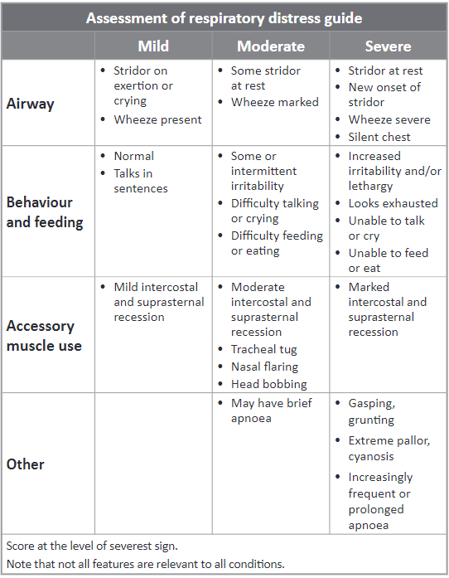
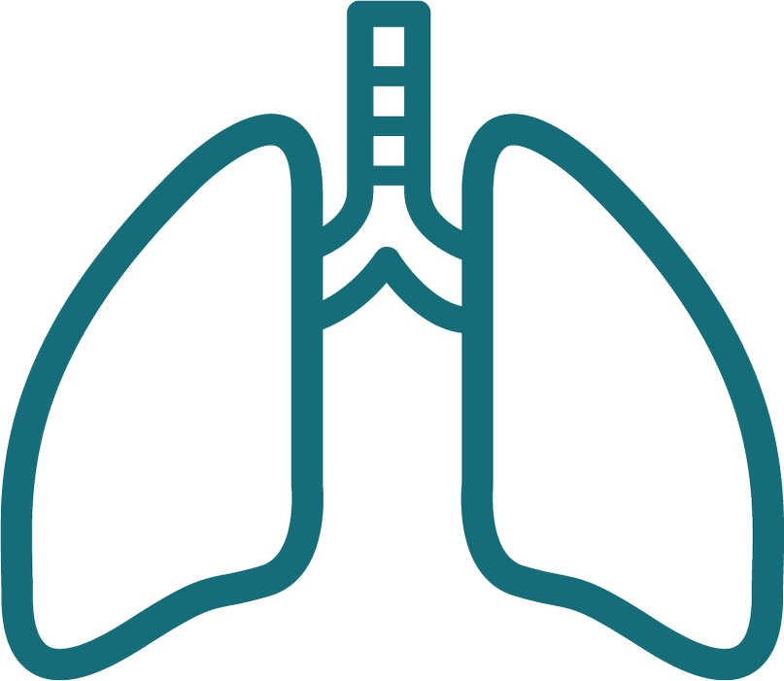
Respiratory distress
Notes:
Assess the level of respiratory distress using the ‘Assessment of respiratory distress guide’ on the back of the chart, which is based on a tool developed by the Royal Children’s Hospital Melbourne. It is the same across all four age-based PVSC and is scored at the level of the most severe sign.
Focus groups and wider sector feedback showed a clear preference for a national guide in this area. Evaluation in testing was positive. Interpretation of respiratory distress varied between clinicians and current guides in use. With the inclusion of a national guide there is consistency to how respiratory distress is measured and scored.

Slide 25
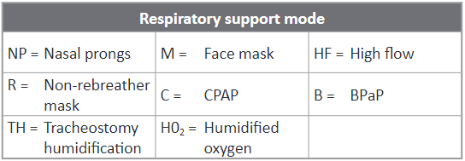
Oxygen
Notes:
Record the mode of oxygen delivery using the abbreviations from the ‘Respiratory support mode’ panel on the back of the chart.
Tamariki receive a variety of oxygen therapies and modes of respiratory support. The challenge is to provide a format that captures information correctly and accurately reflects the oxygen therapy in use. The oxygen score is based mainly on the FiO₂, that is an increasing oxygen requirement indicating a deterioration.
In some tamariki, for example, receiving nasal prong oxygen, the flow rate is varied but the FiO₂ remains unchanged at 100%.
In another example, a tamariki may have high flow oxygen therapy in place, in this the flow rate is stable and the FiO₂ is varied.
This information can be recorded on the PVSC to generate a score for the oxygen parameter, and by recording the numerical value on the chart, trends in the amount of respiratory support needed is visible.

Slide 26
A tamariki on no respiratory support.
This parameter scores 0.
A 7 kg tamariki on high flow therapy with an Fi0₂ requirement of 28%.
This parameter scores 2.
Notes:
When a tamariki is receiving high flow oxygen therapy the weight-based flow rate is recorded in the high flow row. This allows the correct flow rate to be confirmed.
The numerical value of the FiO₂ being delivered while on high flow can be recorded in either one of the two top boxes in the oxygen section, as appropriate.
We have not allocated space to record the pressure (in cmH₂O) being delivered to tamariki on CPAP (continuous positive airway pressure therapy), although know that this may be varied during treatment. This is because we believe it is uncommon for tamariki to frequently receive CPAP outside a higher acuity area, where there is likely to be a different chart in use and also due to space restraints on the chart.
If you do use the chart with CPAP decide as a team where you will annotate cmH₂0
The user guide contains more examples. Please refer to these.
Have a think of how you would score some examples of respiratory support in your setting. You make like to discuss this now and check for shared understanding among staff.

Slide 27
A 7 kg tamariki on high flow therapy with an Fi0₂ requirement of 21%.
This parameter scores 2.
Please note that 21% in this context is not referring to room air. The tamariki is on high flow therapy and requires respiratory support.
A tamariki receiving 5 L/min of oxygen via a mask.
This parameter scores 4.
Notes:
It is important that staff do not refer to 21% FiO₂ as room air in this context as it can be confusing as to where to mark on the chart. This is because if a tamariki is needing high flow therapy it needs to be acknowledged that this tamariki is requiring support with their breathing.
Room air is marked when the tamariki is receiving no respiratory support whatsoever.

Slide 28
Continuous positive airway pressure
Notes:
If tamariki are receiving CPAP in the ward setting, the PVSC can be adapted to record settings and generate a score. Do this by changing the name of some of the rows to reflect what you need to record on CPAP. CPAP generates a score based on the FiO2. Record this on the chart in the same way you would for tamariki on high flow. The positive end expiratory pressure (PEEP) is measured in cmH2O and can be recorded in the ‘mode’ row. Cross out ‘mode’ and write ‘Pressure cmH2O’. The CPAP flow is measured in litres per minute and can be recorded in the ‘high flow rate’ row. Cross out ‘high’ and write CPAP (see Figure 10).

Slide 29
Oxygen saturation
%
Document the numerical value for oxygen saturation in the relevant box of the scoring area

Slide 30
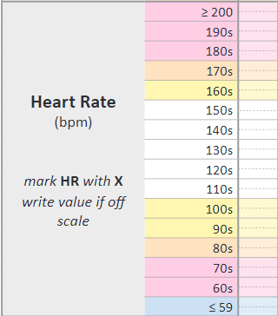
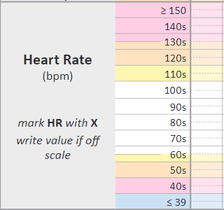
Heart rate
Notes:
The next slide shows how to document in the heart rate section.
This slide shows the wide range of parameters between the 0-11 month chart and the 12+ chart. It is important that users ensure they are using the correct age group for the tamariki.

Slide 31
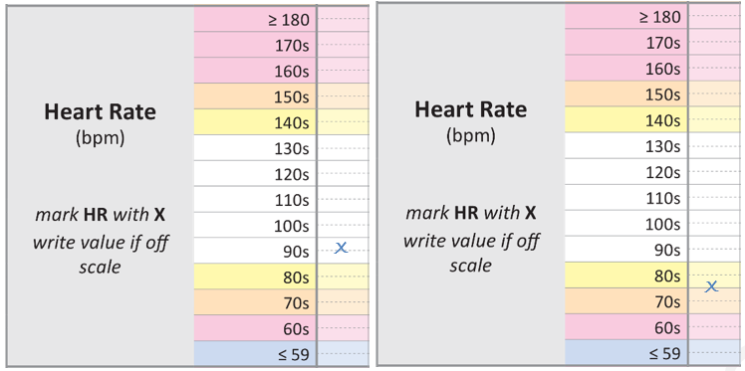
Notes:
Document heart rate by placing an ‘X’ in the relevant box of the scoring area.
Each row of the scoring area for heart rate corresponds to a numerical range of 10 (eg, a heart rate in the 70s, 80s, 90s).
In this way, you can clearly identify the relevant coloured zone if the heart rate value falls exactly on the line between zones (eg, a heart rate of 80 beats per minute is within the 80s range so scores within the yellow zone).

Slide 32
Central capillary refill
X
Notes:
When looking at skin perfusion as a marker of cardiovascular status, the most accurate assessment is made by determining central capillary refill.
This is obtained by pressing a finger on the central chest, holding for 5 seconds and releasing. The white blanched area should fully regain colour within 3 seconds.
The observation is marked with an ‘X’ according to the time taken.

Slide 33
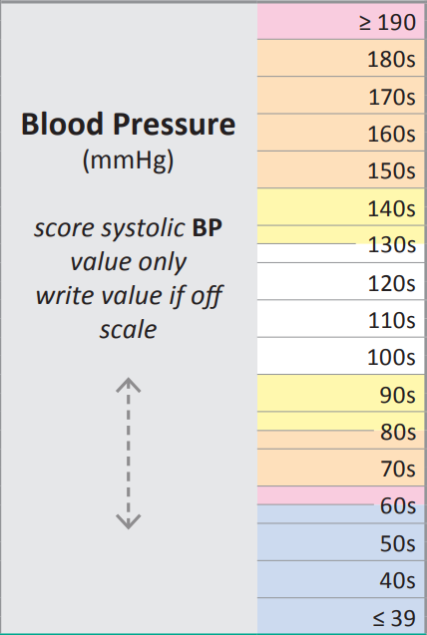
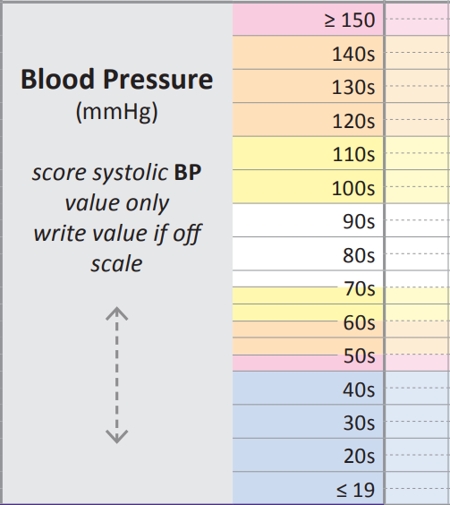
Blood pressure
Notes:
The systolic is the measurement used to generate a score for this vital sign. Document both systolic and diastolic on the chart as this is important clinical information. An example can be seen on the next slide.
It is also very important that the correct size cuff is used when taking a tamariki’s blood pressure. For staff not used to working with tamariki then they may require extra education around cuff size assessment and practical hints around successfully obtaining the BP of the tamariki.

Slide 34
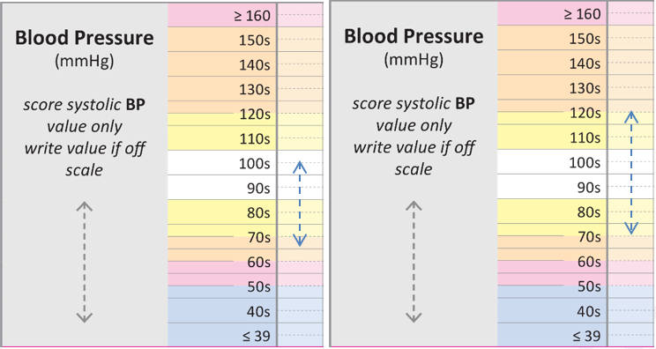
BP = 105/70, white zone, score 0 BP = 125/75, orange zone, score 2
Notes:
Measure blood pressure using an appropriate size of cuff for the tamariki and document the size on their care plan.
Each row of the scoring area for blood pressure corresponds to a numerical range of 10 (eg, a systolic blood pressure in the 90s, 100s, 110s).
At times coloured zones change in the middle of a row as in one of these examples, where the zone change is 125. That is, 124 is in the yellow and 125 is in the orange. If the observation plots on the line, score according to the colour above.
If a reading is beyond the range of the chart, write the measured value on the chart.

Slide 35
Modifications box
Notes:
Some patients have vital signs that generate an elevated PEW score, but don’t necessarily represent an increased risk of deterioration, because they are NORMALLY ABNORMAL for that tamariki. To make sure care isn’t escalated unnecessarily, the score that vital sign generates can be modified.
This example shows a tamariki with cyanotic congenital heart disease. As a result a lower saturation level is normal for them. It is important that this is still measured but altered to reflect the tamariki’s physiological condition.
The modifications box shows what parameter is being modified, how the scores are redefined, from when and for how long the modification applies, and who made the modification.
The second example is from a tamariki with bradycardia related to cardiovascular fitness.

Slide 36
Modifications
Shouldn’t be used to stop an unwell tamariki continuing to generate an elevated PEW score
Usually only made to one parameter at a time
Relevant to all staff using the charts
Should be made following local procedure
Usually be at the direction of the SMO
Notes:
There are a number of important things to know about modifications.
The first is that they shouldn’t be used to stop escalation in the situation where an unwell tamariki is continuing to generate a high PEW score. This should be managed by an assessment that provides an understanding of why the tamariki is unwell, and a plan that describes clearly the circumstances in which a further review should be sought, and what abnormal observations may be tolerated.
Usually only one parameter should be modified. Making modifications to multiple parameters increases the risk of failing to detect a deterioration.
As modifications are about how a patient is looked after they are relevant to all staff using the charts, and their presence should be clearly communicated.
Each organisation needs to have a policy about how modifications are used, and it would be uncommon for them to be able to be made without the knowledge and approval of the SMO responsible for the tamariki.

Slide 37
Modifications
Notes:
It is also possible to modify the response to PEWS in the context of a tamariki receiving end of life care.
This field is editable to have the local terminology printed here eg, End of life care plan or Te Wa Aroha (allow a natural death).

Slide 38
Whānau concern
Notes:
This section is to recognise the importance of clinicians listening to whānau concern.
Y = Yes N= No A = absent
This section requires staff to check in with whānau as to whether they have any concerns about their tamariki’s condition. Asking regularly gives whānau the opportunity to speak up and voice concern. Sharing the PVSC with whānau as part of the admission and orientation process, and when completing observations, supports communication, helps understanding and encourages partnership.
If there is concern, mark with a Y on the chart. Escalation of this concern can occur, even if the other observations and the total PEW score are normal. Staff may find that with listening to the concern, explanation or further discussion alleviates it. Document detail in the progress notes, including any action taken because of the concern being raised.
If there is no concern mark with an N.
If whānau members are absent mark with an A. This can then act as a reminder for other staff to check in with whānau when they return.

Slide 39
Level of consciousness
Notes:
Assess level of consciousness using the alert, voice, pain or unresponsive (AVPU) scale.
Document your assessment by placing an ‘X’ in the relevant box of the scoring area.
If the tamariki is asleep this can also be noted. Once you have assessed the tamariki and determined them to be sleeping normally, annotate ‘Asleep’ on the chart within the alert section of ‘Level of Consciousness’.
An example of this is when you enter the room you see a baby stir to the noise but not wake fully.
It is important to assess a tamariki closely and not assume they are sleeping.

Slide 40
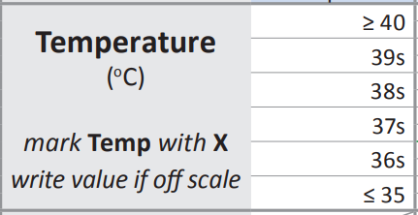
Temperature

Slide 41
Pain
Notes:
Record pain on the PVSC to help interpret abnormal vital signs and manage the pain of the tamariki effectively.
The PVSC includes three pain scoring tools: the Numerical rating scale, Faces pain scale-revised and the revised FLACC observation pain tool. The score is documented at rest and with movement.
The tool used depends in part on the age of the tamariki. The age reflects the required cognitive ability of tamariki to be able to use the numeric and faces tool. The tool being used for an individual tamariki can be documented in their care plan.

Slide 42
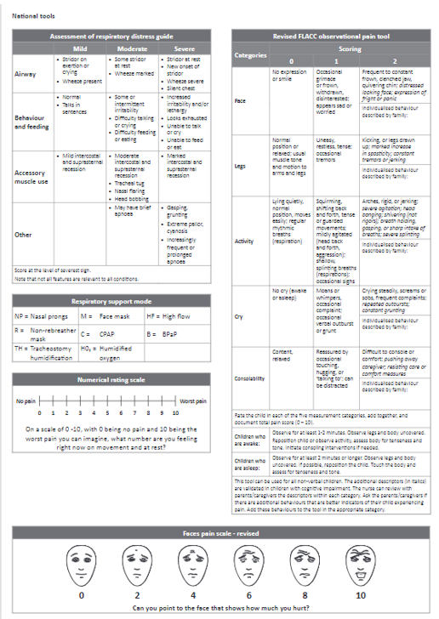
Notes:
Participants will need to look at paper or electronic copies to support this slide.
Many clinicians will be familiar with the FLACC observational pain tool, but note the revised version is included here. This is an objective tool that has been validated for use in non-verbal and cognitively impaired tamariki. Therefore, it can be used both for a four-month-old baby and a seven-year-old tamariki with global developmental delay, for example.
Hicks CL, von Baeyer CL, Spafford P, et al. 2001. The Faces Pain Scale - Revised: Towards a common metric in pediatric pain measurement. PAIN 93: 173‒83.
Malviya S, Vopel-Lewis T, Burke C, et al. 2006. The revised FLACC observational pain tool: improved reliability and validity for pain assessment in children with cognitive impairment. Pediatric Anaesthesia 16: 258‒65.

Slide 43
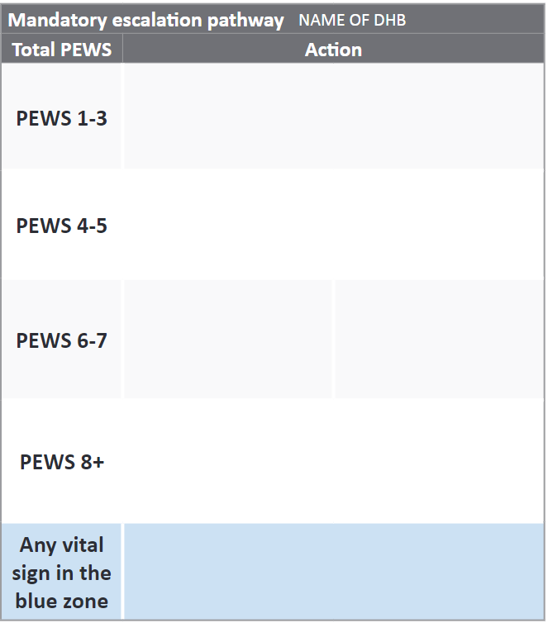
Escalation pathway
Local escalation steps
3
4
Local escalation steps
Notes:
The local escalation pathway was developed with the MDT, it was tested with case files to check it reflected the escalation needed and response available within our hospital setting. (Please add in your site specific explanation of your pathway.)
Note: This slide needs edited to include your mandatory escalation pathway once developed. Then education to staff is specific to your site.

Slide 44
Partial set of observations
Mark with a plus+
3+
4
4
Still apply to the escalation pathway
This should be an exception
Notes:
The PEW score total is most accurately assessed with a complete set of vital signs.
However it needs to be acknowledged that at times this is neither clinically possible or desired. In these circumstances it is very important that the score is still totalled and recorded in the PEW score total row.
The escalation pathway is still to be followed regardless whether it is a partial or full set of observations.
The score will be marked with an plus, signalling that this is an incomplete set of observations and in fact the score may be higher.

Slide 45
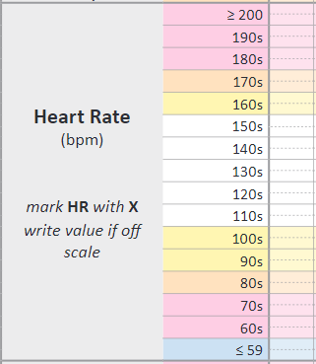
Rapid response team calls
If any of the tamariki’s vital signs fall into the blue rapid response team (RRT) zone, it is a mandatory requirement for you to make a RRT call immediately
​
[Insert details of your local RRT calling process] ​
​
x
Notes:
If any of the tamariki’s vital signs fall into the blue Rapid Response Team (RRT) zone, it is a mandatory requirement for you to make a rapid response team call immediately.
That rapid response team will look different on different sites depending staff structures. In some areas this will be a large team in regional areas this may be one person.
The RRT letters are editable to what is the local code such as 777, code blue etc.

Slide 46
Questions
What are the differences between the new chart and what we currently have?
How do we educate users of the charts to any changes?
Notes:
Note: This slide can be edited to have questions specific to your education.

