Slide 1
Using the New Zealand maternity vital signs chart
Women’s deterioration: recognising and responding together

Slide 2
Content
Introduction
Maternity vital signs chart (MVSC)
Vital signs
Modifications to calling criteria
Calculating maternity early warning system (MEWS) scores
Escalation pathway
Documentation

Slide 3
Recognition and response systems save lives
In the general adult population a recent Dutch study showed a nationwide recognition and response system reduced cardiac arrests in hospital by 40 percent and mortality by 20 percent¹.
Detect deterioration early and take action
Growing evidence supports use of a maternity chart to facilitate earlier recognition and intervention for deterioration in pregnant women^{2–4}.
The Maternity Vital Signs Chart (MVSC) reflects the physiology of pregnant and recently pregnant women.
Using the national system will improve processes and outcomes
Implementing a standardised approach to clinical deterioration offers benefits to women, clinicians, and the system as a whole^{5–7}.

Slide 4
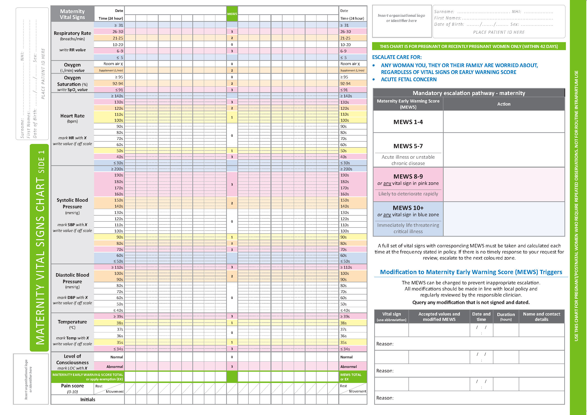
The MVSC and early warning score provide a safety net for women who acutely deteriorate while in hospital.
Maternity early warning system (MEWS) scores are calculated from vital sign measurements and increase as vital signs become increasingly abnormal.
The MEWS score triggers an escalating clinical response so that clinicians with the right skills can intervene and manage the woman’s deterioration in an appropriate timescale.

Slide 5
Recognition and response systems can save lives
Measure vital signs, escalate care and work together to ensure a timely and appropriate clinical response.
Health Quality & Safety Commission. 2017. Capabilities for recognising and responding to acute deterioration in hospital. URL: https://www.hqsc.govt.nz/our-programmes/patient-deterioration/publications-and-resources/publication/3528

Slide 6
When to use the chart
Any pregnant woman,
or recently pregnant (≤ 42 days) woman, who is assessed
or admitted requiring
repeated vital signs
This chart is not to be used for routine intrapartum care
Notes:
In the rare circumstance that a woman is identified with pre-existing or emerging concerns during labour, the MVSC may be used as an adjunct to the partogram eg known cardiac condition or emerging sepsis.

Slide 7
Maternity vital signs chart
Document vital signs and calculate the MEWS score
Determine what actions to take in response to a woman’s deterioration
Document total MEWS score or EX (exemption)
Individualise MEWS score triggers to prevent inappropriate escalation
Document pain score
Record your initials
Notes:
Overview on the entire chart
Introduce the three main sections of the chart.
Discuss usage information: Actions to be taken in response to the woman’s deterioration are agreed locally by each DHB and depend on the resources available at that particular site.
patient labels
folding of paper
documentation using graphical symbols rather than numbers (human factors research indicates graphing improves recognition of trends over time)
specify any required information about additional parameters used in your hospital.

Slide 8
What if the woman has an undisclosed pregnancy?
The MVSC should be used in this situation because of the physiological changes that occur during pregnancy, however care should be taken to ensure the woman’s pregnancy is not disclosed by mistake to family and whānau members or visitors.
Your DHB will have specific advice on this, however using a sticker to cover the ‘maternity’ wording on the chart and keeping the vital signs chart within the main body of clinical notes are some of the ways you can do this.

Slide 9
Recognising deterioration
Deterioration can be detected using a calculated total MEWS score derived from eight vital sign parameters, or by a single vital sign parameter in a coloured zone that indicates abnormality.
The actions corresponding to the trigger indicating the most severe level of deterioration must be taken.
Notes:
For example if a woman scores a total of 4 but has a vital sign in the blue zone then this must be acted on immediately as anything in the blue zone warrants escalation.

Slide 10
The MEWS score
Level of
consciousness
Respiratory
rate
Temperature
Need for supplemental
oxygen
Diastolic blood pressure
Oxygen
saturation
Systolic blood pressure
Heart rate
Notes:
Eight vital sign parameters are used to calculate the total MEWS score
Blood pressure is separated into the systolic and diastolic as each of these parameters on their own might trigger a response.

Slide 11
The MEWS score trigger: a calculated score
Maternity early warning score colour key
0 | 1 | 2 | 3 | RRT: rapid response team
Each vital sign parameter has coloured zones that are associated with a score.
The score for each of the eight vital sign parameters is added together to give a total MEWS score.
The total MEWS score is used to trigger action.
Notes:
RRT does not generate a number but an immediate response. RRT is an umbrella term for the emergency response team for each unit.

Slide 12
Single parameter triggers
Maternity early warning score colour key
0 | 1 | 2 | 3 | RRT: rapid response team
Pink
Blue
Any single vital sign falling into a pink or blue zone triggers action
The actions corresponding to the total MEWS score or single parameter trigger indicating the most severe level of deterioration must be taken
Notes:
Any vital sign in a pink or blue zone triggers that level of response regardless of the total MEWS score.

Slide 13
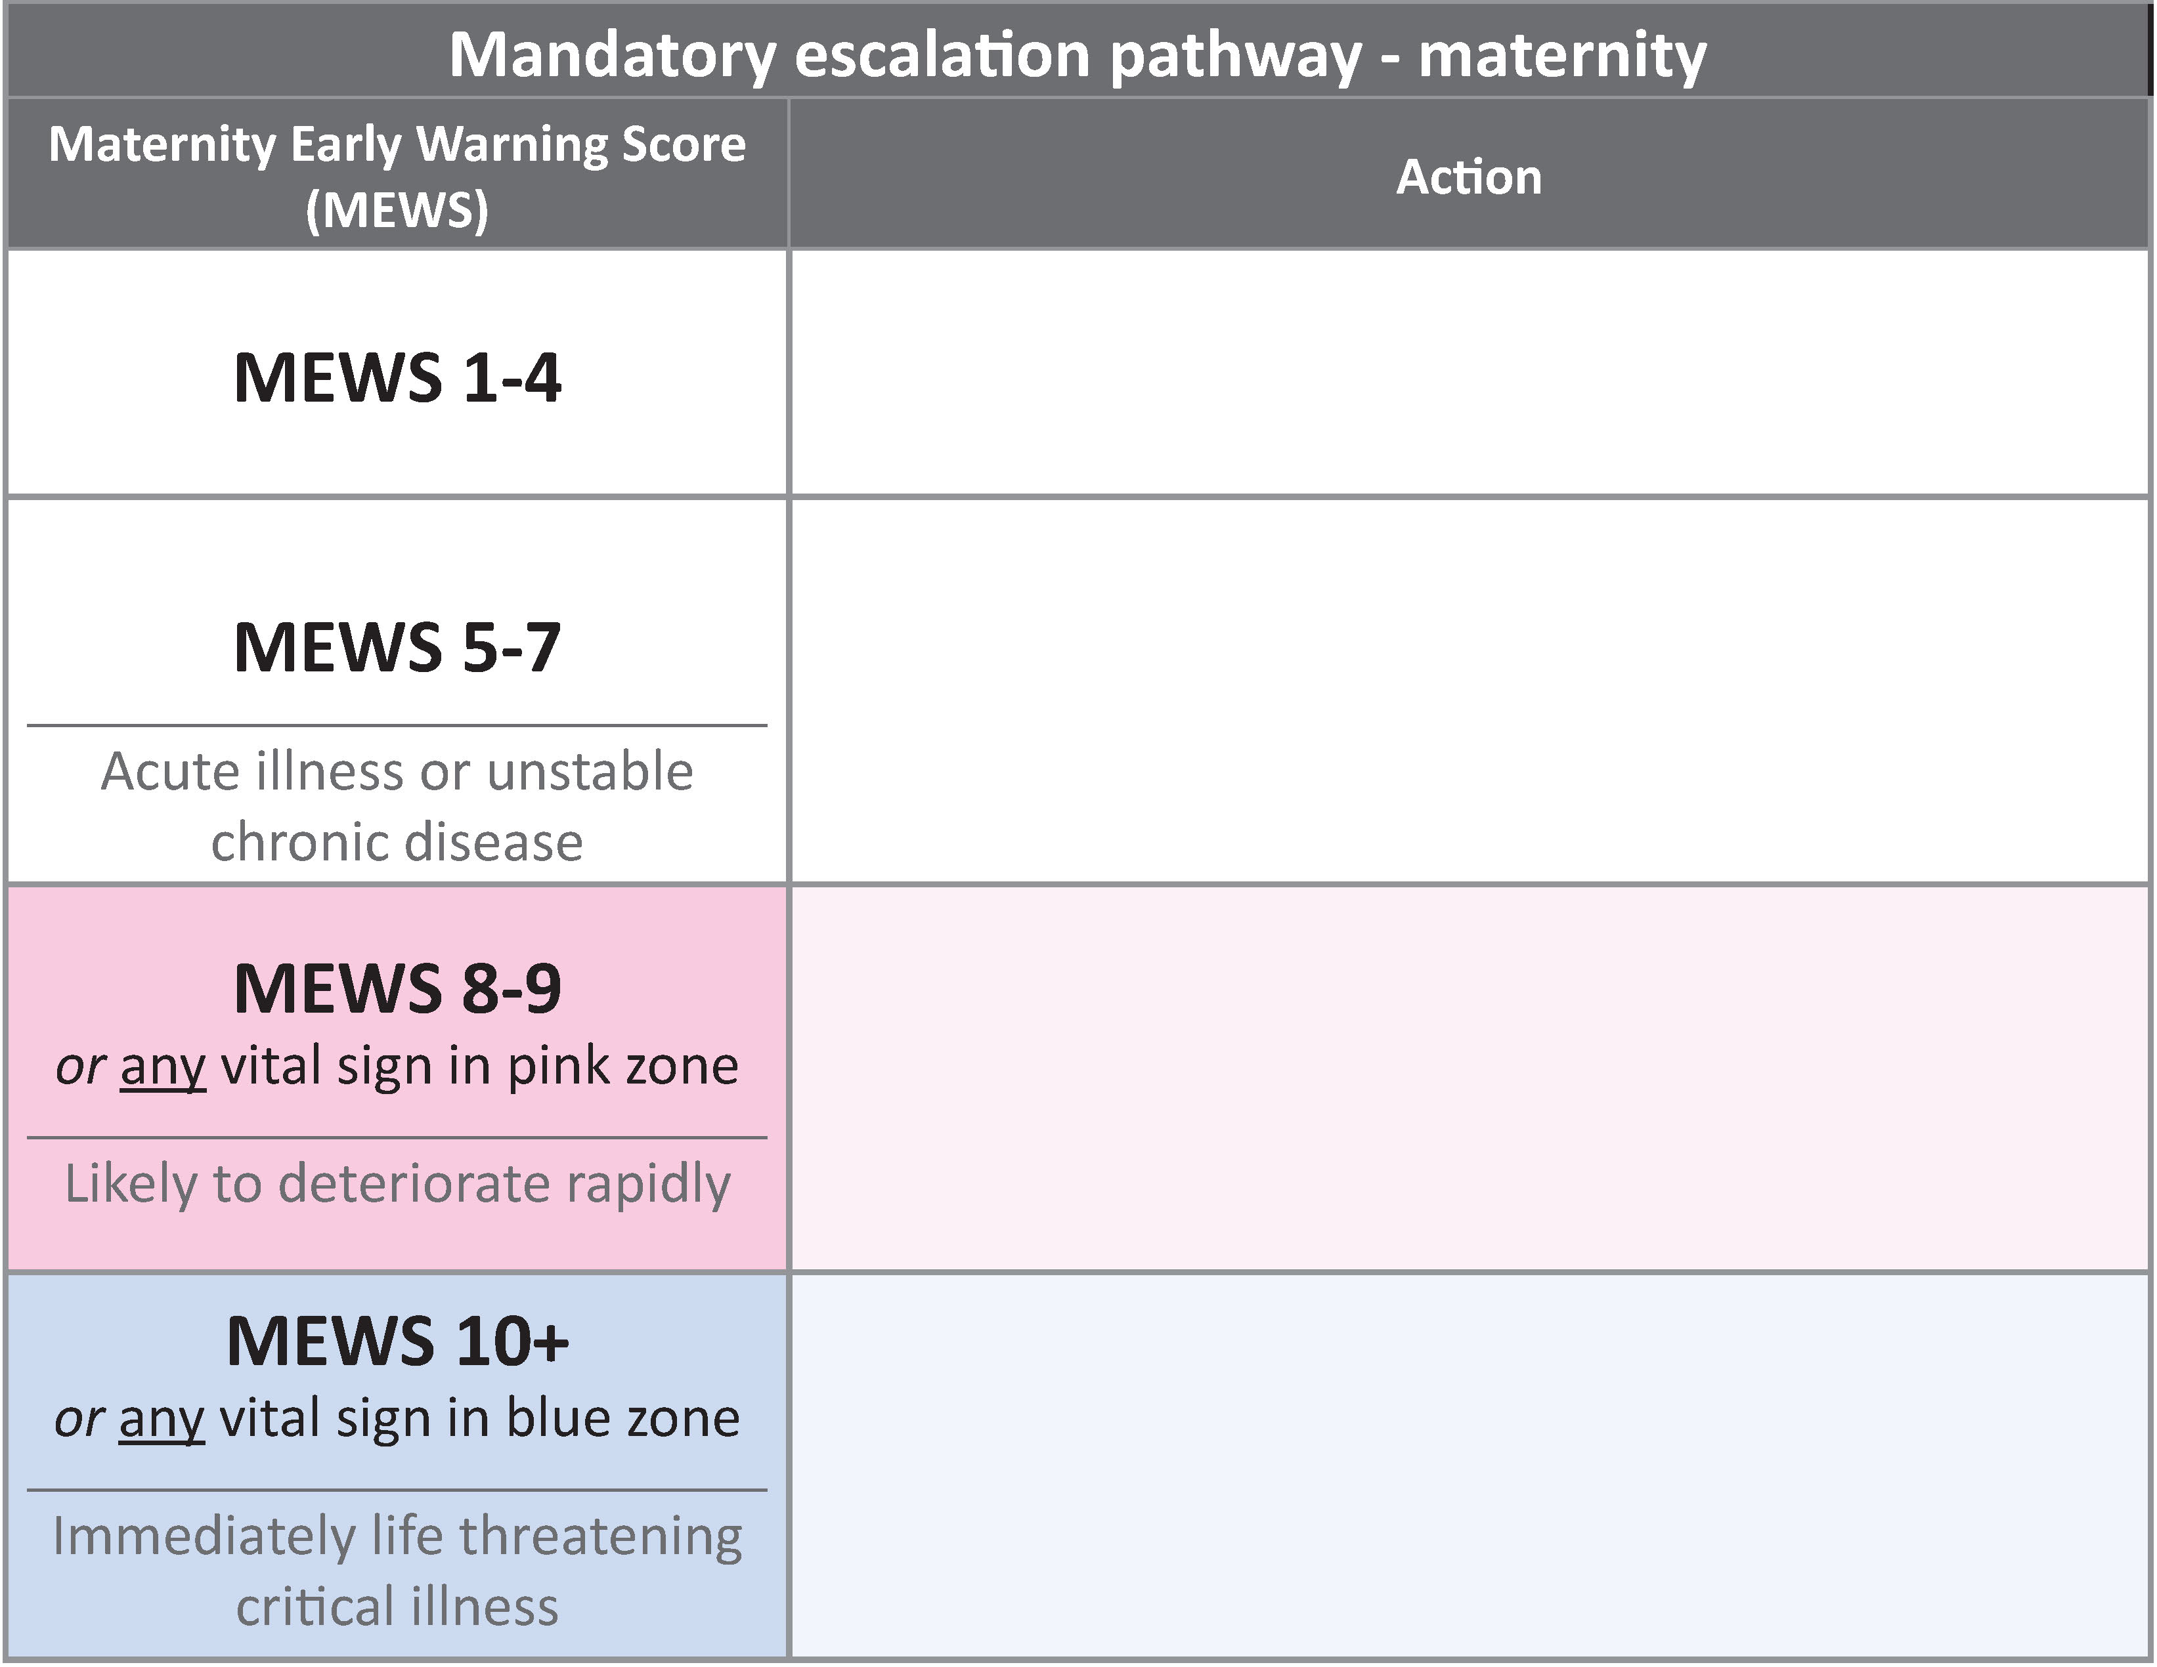
Example – refer to the chart
If the woman’s level of consciousness was abnormal and the total MEWS score was 6 what action would you take?
[Insert graphic of your local escalation pathway here]
Notes:
This is where you will need to insert a picture of your own local escalation pathway.

Slide 14
Example – response
X
Maternity early warning score colour key
0 | 1 | 2 | 3 | RRT: rapid response team
Pink
Blue
Abnormal LOC is in the pink zone so triggers the pink action, even though total MEWS score is only 6
Notes:
Stress that the highest level of response should be taken – in this example “pink” is greater than MEWS=6. Conversely, if MEWS is 10 or more this elicits a blue escalation even if no parameters are themselves in the blue zone.

Slide 15
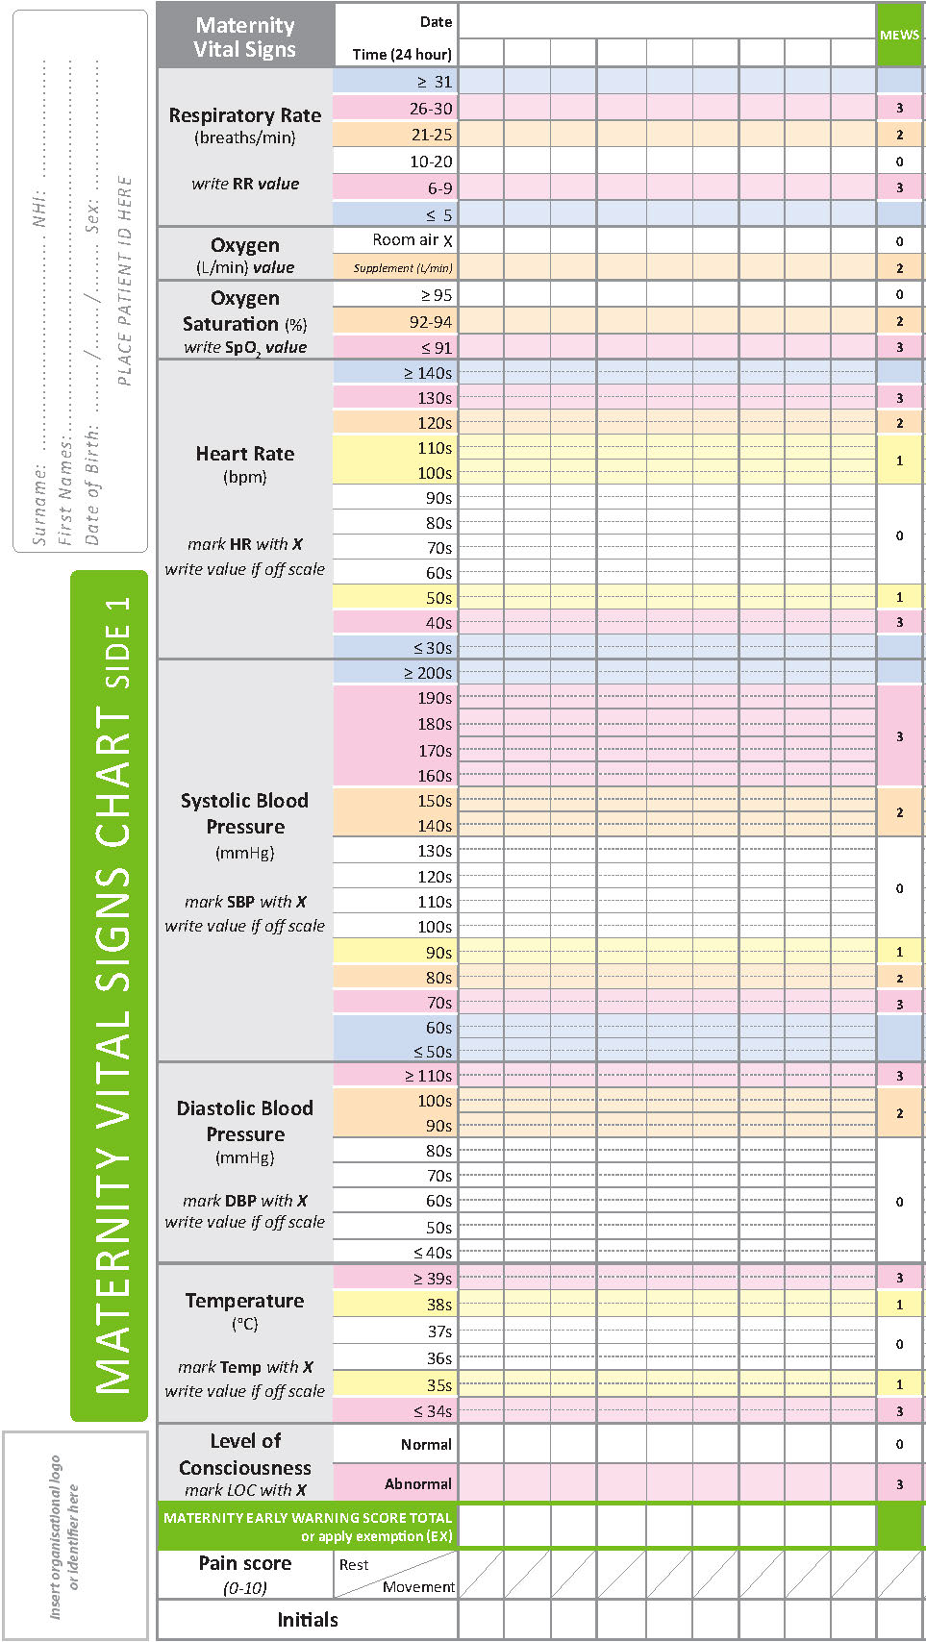
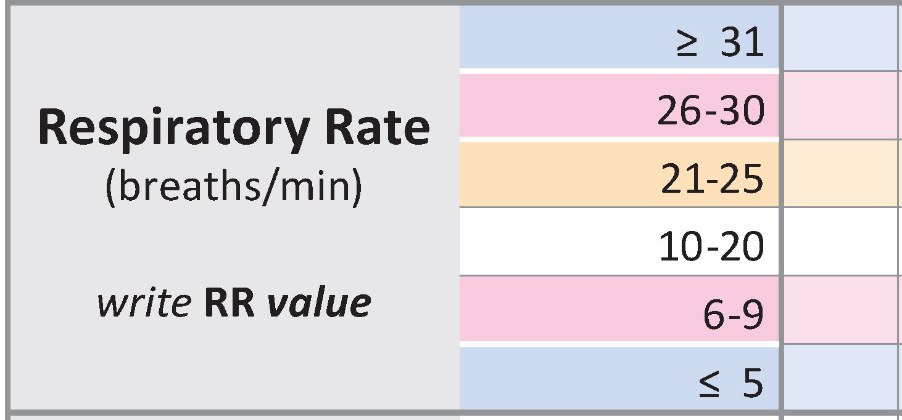
Rapid response team calls
If any of the woman’s vital signs fall into the blue Rapid Response Team (RRT) zone or the total MEWS score is 10 or more, it is a mandatory requirement for you to make an RRT call immediately
[Insert details of your local RRT calling process here]
Stay with the woman until help arrives
!
38
Notes:
‘RRT’ may be replaced with a locally relevant acronym or number (for example, ‘777’ or ‘MET’).

Slide 16
Monitoring
A complete set of vital signs and the total MEWS score must be calculated in accordance with local policy.
[Insert local policy requirements here]
The frequency of vital sign monitoring should be increased or decreased according to the clinical needs of the woman, and should be part of the action plan made by the reviewing clinician.
Escalate care for any woman that you, they or their family or whānau are worried about regardless of vital signs or MEWS score, or for acute fetal concern.

Slide 17
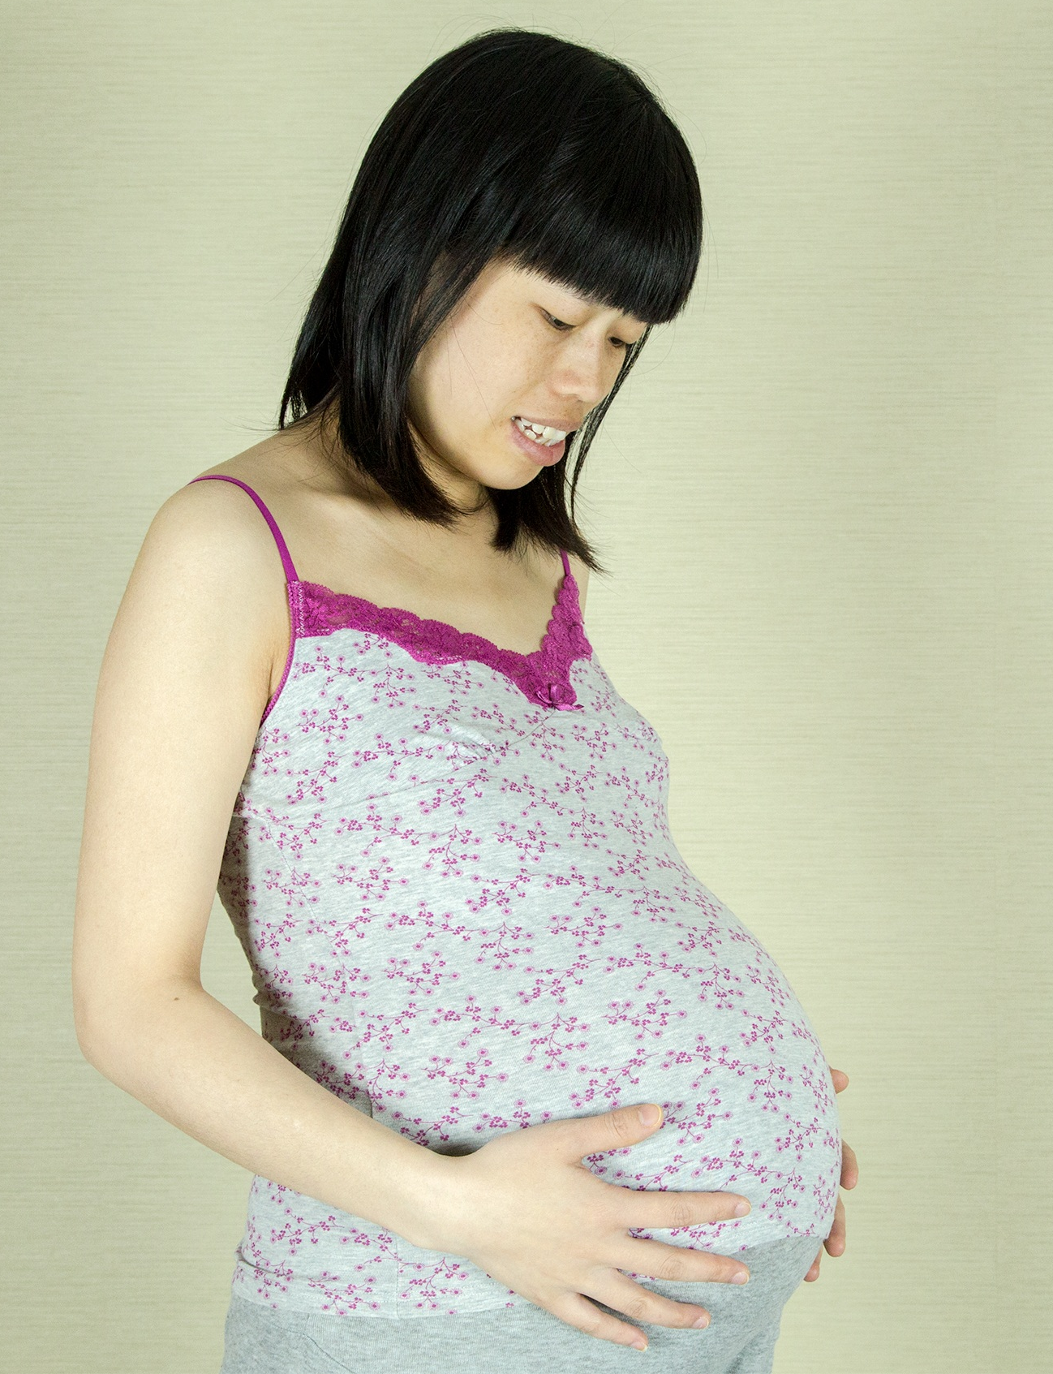
Case example
Ms W is a 35-year-old G3P1 admitted 10 days ago with a history of spontaneous rupture of membranes at 32 weeks’ gestation and is now feeling ‘unwell’.
She has been draining clear liquor for the last few days; it is now pink.
She has completed a course of oral antibiotics.
image by pedroserapio on Pixabay
[Consider editing these slides to use a local case example]

Slide 18
Respiratory rate
Ms W’s respiratory rate is 22 breaths per minute.
Ms W’s respiratory rate is in the orange zone.
The MEWS score is 2 for this parameter.
22
Notes:
Respiratory rate parameters are different on the MEWS to a standard Early Warning Score used in the general adult population.

Slide 19
Increased respiratory rate is
one of the earliest indicators
of acute deterioration
Decreased respiratory rate
may indicate narcosis or neurological depression
Measure respiratory rate accurately: count over a full minute
Look for other signs too:
increased work of breathing
positioning
added sounds
use of accessory muscles
pursed lips
difficulty speaking

Slide 20
Supplemental O₂
X
Ms W is not having supplemental oxygen administered.
This is in the white zone so the MEWS score is 0 for this parameter.
Women who require supplemental oxygen to maintain their oxygen saturations are recognised as being at risk of acute deterioration. Remember that if a woman is on any supplemental oxygen they will score 2, regardless of how much is being given.
Except in emergencies, all oxygen must be prescribed, regularly reviewed, and targeted to oxygen saturation levels.
If the woman doesn’t need it, remove it.
Maternity early warning score colour key
0 | 1 | 2 | 3 | RRT: rapid response team

Slide 21
O₂ saturation
96
Ms W’s measured oxygen saturation is 96%.
This is in the white zone so the MEWS score is 0 for this parameter.
Make sure the woman’s nail and skin is cleaned of anything that might impair the pulse oximeter reading (eg, nail polish).
Decreased oxygen saturation can indicate deteriorating lung or heart function. If oxygen saturation is low, you need to take action!
Maternity early warning score colour key
0 | 1 | 2 | 3 | RRT: rapid response team

Slide 22
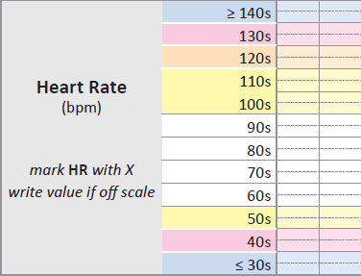
Heart rate
Ms W has a heart rate of 124.
This is in the orange zone so the MEWS score is 2 for this parameter.
X
It is best practice to manually feel (palpate) the pulse rather than relying on automated equipment. Palpation provides additional information about regularity and strength of the woman’s pulse.
Heart rate can be an important indicator for acute deterioration but normal heart rates can vary with age, level of activity, and some medications.
Maternity early warning score colour key
0 | 1 | 2 | 3 | RRT: rapid response team

Slide 23
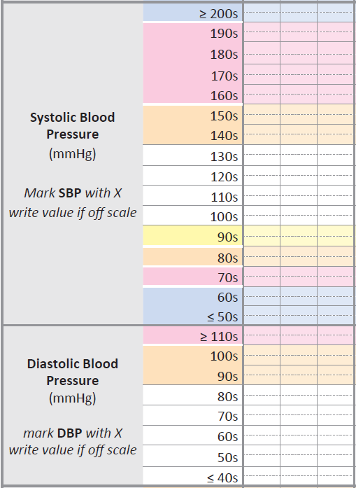
Systolic blood pressure
Ms W has a systolic blood pressure of 90 mmHg.
This is in the yellow zone so the MEWS score is 1 for this parameter.
Note that all readings in the 90s are in the yellow zone, including 90 (89 would be in the orange zone).
X
Maternity early warning score colour key
0 | 1 | 2 | 3 | RRT: rapid response team
Notes:
Emphasise that each coloured row is for 10 numbers – in this case 90s – so 90-99 all fall within the yellow zone; 89 would be orange.

Slide 24
Diastolic blood pressure
Ms W has a diastolic blood pressure of 50 mmHg.
This is in the white zone so the MEWS score is 0 for this parameter.
X
Maternity early warning score colour key
0 | 1 | 2 | 3 | RRT: rapid response team

Slide 25
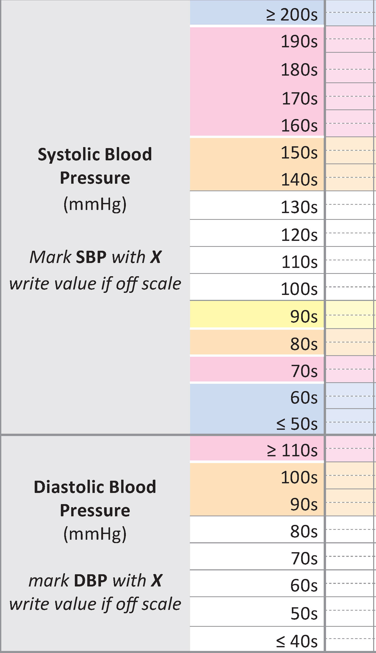
Systolic/diastolic blood pressure
Note that systolic and diastolic blood pressures are recorded in separate rows of the chart.
This allows them to have their MEWS scored separately.
You can join the systolic and diastolic blood pressures with a dotted line, if you wish.
X
X

Slide 26
High blood pressure (hypertension) can be caused by a variety of conditions including hypertensive
disease in pregnancy,
pain and agitation.
Low blood pressure (hypotension) may indicate acute deterioration and can be caused by a variety of conditions including sepsis, hypovolaemia, anaphylaxis, amniotic fluid embolism
or high epidural block.
Normal blood pressure may vary with age, posture, and level of fitness.
The correct cuff size is crucial for accurate blood pressure measurement:
An appropriate size cuff for the women must be used, and this size documented so the next clinician will use the same size cuff.

Slide 27
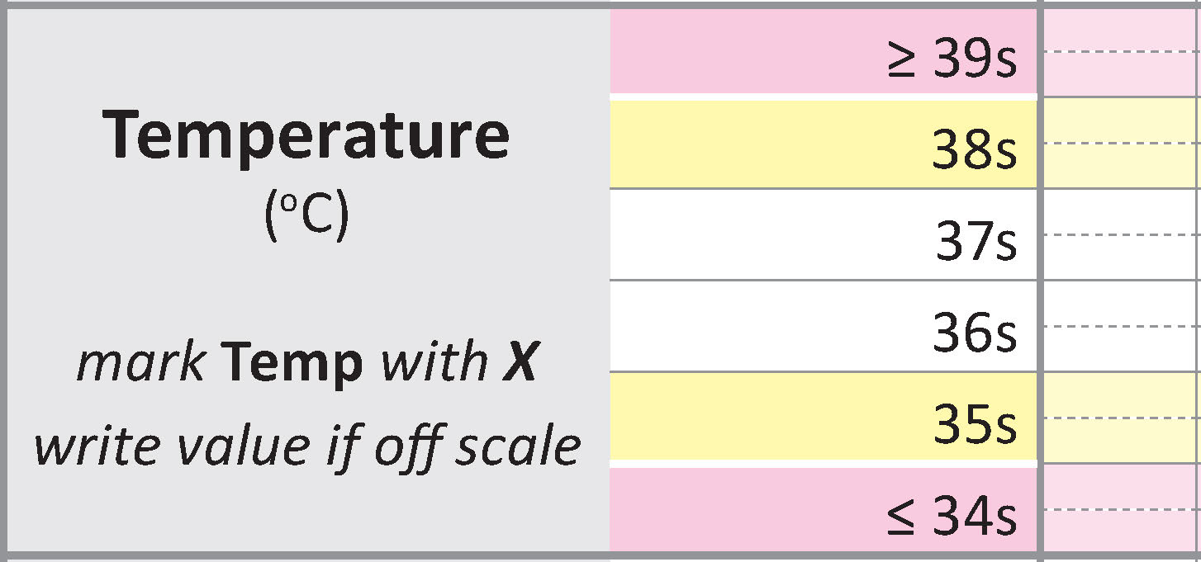
Temperature
Ms W’s temperature is 36.3°C.
This is in the white zone, so the MEWS score is 0 for this parameter.
X
High temperature (hyperthermia)
can indicate sepsis, inflammation, brain injury, or a reaction to
certain types of drugs.
Low temperature (hypothermia)
can indicate sepsis
or endocrine derangement.
Document the mode of temperature measurement eg, oral, tympanic, axilla, so the next clinician will use the same mode.
Maternity early warning score colour key
0 | 1 | 2 | 3 | RRT: rapid response team

Slide 28
Level of consciousness
Ms W has a normal level of consciousness
This is in the white zone so the MEWS score is 0 for this parameter.
X
Decreased level of consciousness may be a late sign of deterioration. It can be an indicator of narcosis, sepsis,
low blood pressure,
low blood glucose or
neurological events.
An abnormal level of consciousness is almost always a sign of deterioration in an otherwise well woman, so this is a single parameter trigger requiring immediate action.
Maternity early warning score colour key
0 | 1 | 2 | 3 | RRT: rapid response team
Notes:
Mention that:
You need to rouse the woman to assess this – if she wakes normally from sleep and is alert on waking, this is “Normal”
If a woman has low clinical risk, an otherwise normal set of observations and does not need to be woken to record a full set of vital signs, then document this in the clinical record.
Good information re assessment of LOC on the Factsheet for clinicians FAQ pg3/4

Slide 29
Modifications: changing calling criteria
There may be situations where clinically stable women have vital signs in the ‘abnormal’ zone.
The MEWS score for a vital sign can be modified to prevent inappropriate escalation.
Review any modifications before calculating the total MEWS score.
Query any modification that is not signed and dated
HR
MEWS=0 if 50−59, 1 if 40−49, 3 if <40
20/3/19 11:30
Until
discharge
D. Ramoray #2611
Long distance cyclist: 50−59 = normal HR for her

Slide 30
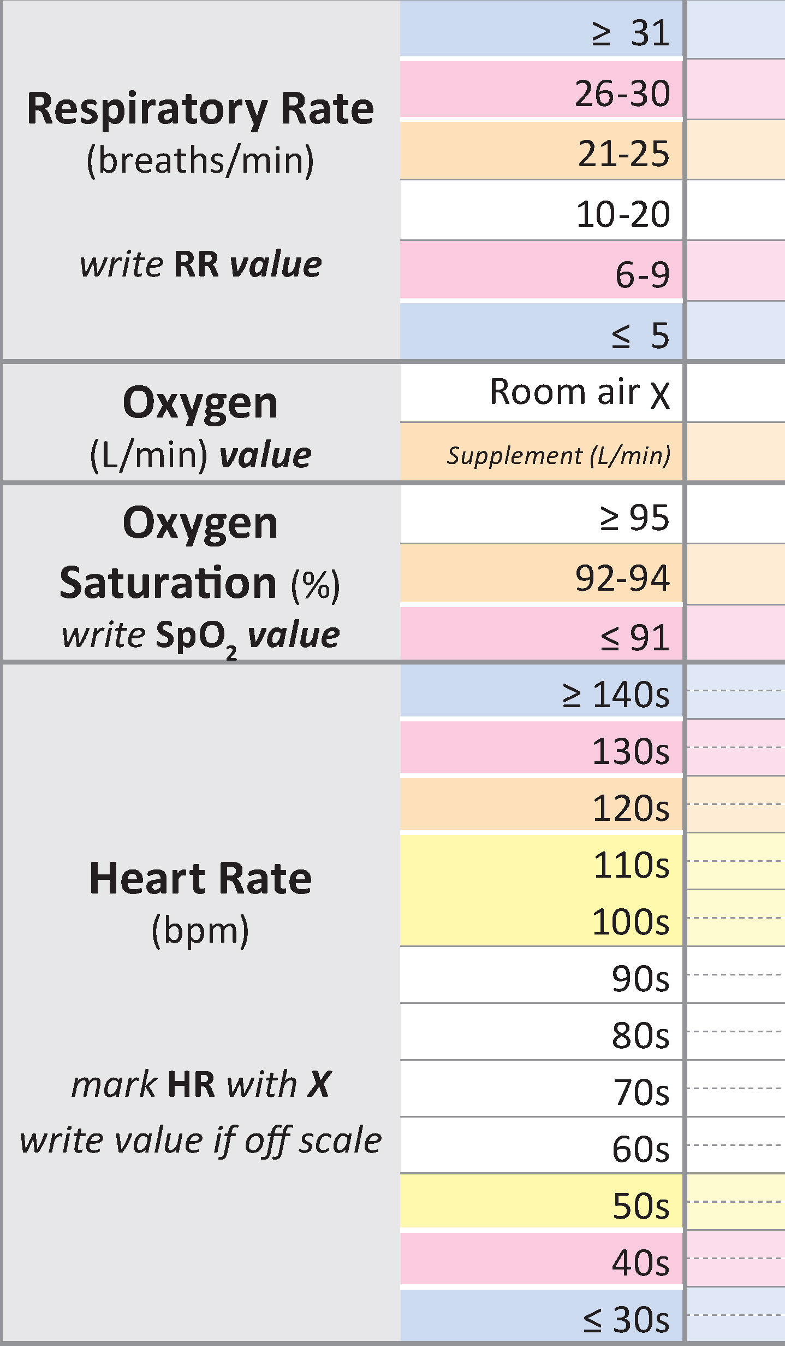
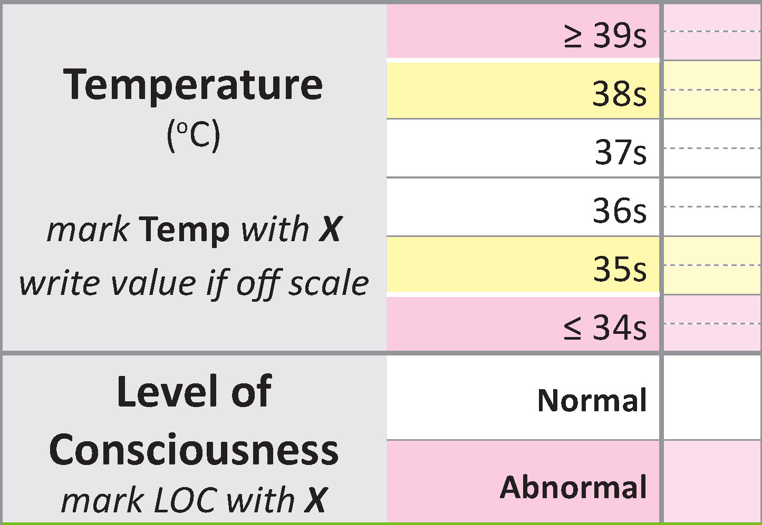
Calculate the total MEWS score
22
X
96
Ms W has a total MEWS score of 5 with no recordings in the pink or blue zone.
96
X
X
X
5
X
X
Maternity early warning score colour key
0 | 1 | 2 | 3 | RRT: rapid response team

Slide 31
Escalation
If total MEWS score is 1 or more, or if a single parameter is in the pink or blue coloured zone, you must act.
The next step in the process is to use the mandatory escalation pathway to identify what action to take.
Regardless of MEWS score, escalate care for:
acute fetal concern
clinician concern
concern from woman or her family and whānau.
Notes:
When care is escalated due to concern, an appropriate clinical response is required irrespective of total MEWS score.

Slide 32
Escalation pathway
The escalation pathway describes the mandatory actions you must take when MEWS score thresholds are reached
[Insert your local escalation pathway here
and demonstrate what you would do for Ms W.
Total MEWS score=5 with no pink or blue single parameter triggers, so action is in MEWS score 5−7 level]

Slide 33
Escalation pathway
Notes:
The escalation pathway has 5 levels – MEWS 0 which reflects normality, and is a very good shorthand for writing “all is well”.
The other 4 levels of escalation are written here, and you will need to work to develop these pathways locally.

Slide 34
Primary unit
Manage pain, fever or distress
Repeat observations. Discuss increased observation frequency with colleague
Consider discussion with lead maternity carer (LMC)
Request clinical review by LMC within 60 minutes
Discuss transfer to secondary unit
Increase frequency of observations to q30 mins
Document plan including intervention, escalation and review timeframe
Contact woman’s support person
Request immediate review by LMC
Discuss need for transfer with secondary unit
Prepare for transfer to secondary unit
Continue observations q15 min
Ensure woman’s support person informed
Call 111 to arrange immediate transfer to secondary unit
Notify secondary unit of emergency transfer
Stay with the woman, prepare for transfer
Support airway, breathing and circulation and provide manual uterine displacement if still pregnant
If LMC not present, call for immediate attendance
Notes:
Within the implementation documents there are more detailed instructions on how to map out the appropriate actions for each level of abnormality at each stage, but these are some generic examples which illustrate what you might do in a primary unit…

Slide 35
Secondary or tertiary unit
Manage pain, fever or distress
Discuss increased observation frequency with charge midwife/nurse
Consider discussion with team house officer if concerned
Team house officer and charge midwife/nurse review within 30 minutes
Document plan including intervention, escalation and review timeframe
Increase observation frequency to at least q30 mins
Consider discussion with registrar (or SMO if no registrar) if concerned
Team registrar charge midwife/nurse review within 20 minutes
Document plan including intervention, escalation and review timeframe
Increase observation frequency to at least q15 mins
Consider discussion with SMO if concerned
Notify Lead Maternity Carer
Call Rapid Response Team, stating ‘adult and obstetric emergency’
Stay with the woman
Support airway, breathing and circulation and provide manual uterine displacement if visibly pregnant
Inform SMO, parent team and Lead Maternity Carer (LMC)
Notes:
…and in a secondary or tertiary unit.
Any questions?

Slide 36
Exemption from scoring
If a woman does not require all vital signs to be taken, annotate ‘EX’ in the score total box. It is acceptable in the following situations:
regular repeated blood pressure recordings, such as every 15 minutes following antihypertensive administration
women who require repeated respiratory rate observations following intrathecal opioid administration or those on a patient-controlled analgesia pump.
It is important that all vital signs are recorded on the same chart. The total MEWS score box should never be left blank.
EX
Exemptions (EX) are only to be used in maternity wards.
Single parameter escalations (in pink or blue zones) still apply when using ‘EX’ as the score.
Notes:
Exemptions (EX) are only to be used in Maternity wards

Slide 37
Documentation and communication
[Example of MEWS escalation sticker]
The clinician who undertook the observations should initial the very bottom of the chart. The initials should match those already identified with a full name and designation within the body of the clinical notes.
[Insert local documentation and communication requirements here eg, sticker in the notes, ISBAR etc]
Don’t forget to talk with the woman, family and whānau about what is happening and what the ongoing plan of care will be.
Notes:
Remember to document factors that affect ability to generate a MEWS score such as staffing below MERAS safe staffing standards for audit purposes.

Slide 38
Questions?

Slide 39
References
1. Ludikhuize J, Brunsveld-Reinders A, Dijkgraaf M, et al. 2015. Outcomes associated with the nationwide introduction of rapid response systems in the Netherlands. Critical Care Medicine 43(12): 2544−51. 2. Mackintosh N, Watson K, Rance S, et al. 2014. Value of a modified early obstetric warning system (MEOWS) in managing maternal complications in the peripartum period: an ethnographic study. BMJ Quality and Safety 23: 26−34. 3. Shields L, Wiesner S, Klein C, et al. 2016. Use of maternal early warning trigger tool reduces maternal morbidity. American Journal of Obstetrics & Gynecology 214(4): 527.e1−6.
4. Isaacs R, Wee M, Bick D, et al. 2014. A national survey of obstetric early warningsystems in the United Kingdom: five years on. Anaesthesia 69: 687–92.
5. Royal College of Physicians. 2012. National Early Warning Score (NEWS). Standardising the assessment of acute- illness severity in the NHS. London: RCP.
6. Green M. 2013. Between the Flags program interim evaluation report. Sydney: Clinical Excellence Commission.
7. Moore D, Poynton M. 2015. Business case for investing in a quality improvement programme to reduce harm caused by clinical deterioration. Wellington: Sapere Research Group.

