Slide 1

An introduction
Shared goals of care

Slide 2
What are shared goals of care?
‘Shared goals of care are when clinicians, patients, families and whānau explore patients’ values, the care and treatment options available and agree the goal of care for the current admission, if the patient deteriorates.’
Notes:
Currently variation across New Zealand
Some patients are receiving unwanted or unwarranted care

Slide 3
Why shared goals of care?
There is variation across New Zealand
Some patients are receiving unwanted or unwarranted care
Discussion:
Can you think of a relevant case/incident/ complaint in your organisation related to goals of care?

Slide 4
Principles
Shared goals of care principles:
should happen close to admission
are facilitated by an appropriate clinician
include those the patient wishes to have with them
have cultural safety as an essential component
take place in an environment that maintains patients’ privacy and dignity
are clearly documented.
Notes:
Discuss current process and what you would propose is changed

Slide 5

Principles
Shared goals of care are supported by governance systems, organisational culture and resourcing.
Patients, whānau and clinicians are supported before, during and after the discussion.
Notes:
Discuss current process and what you would propose is changed

Slide 6








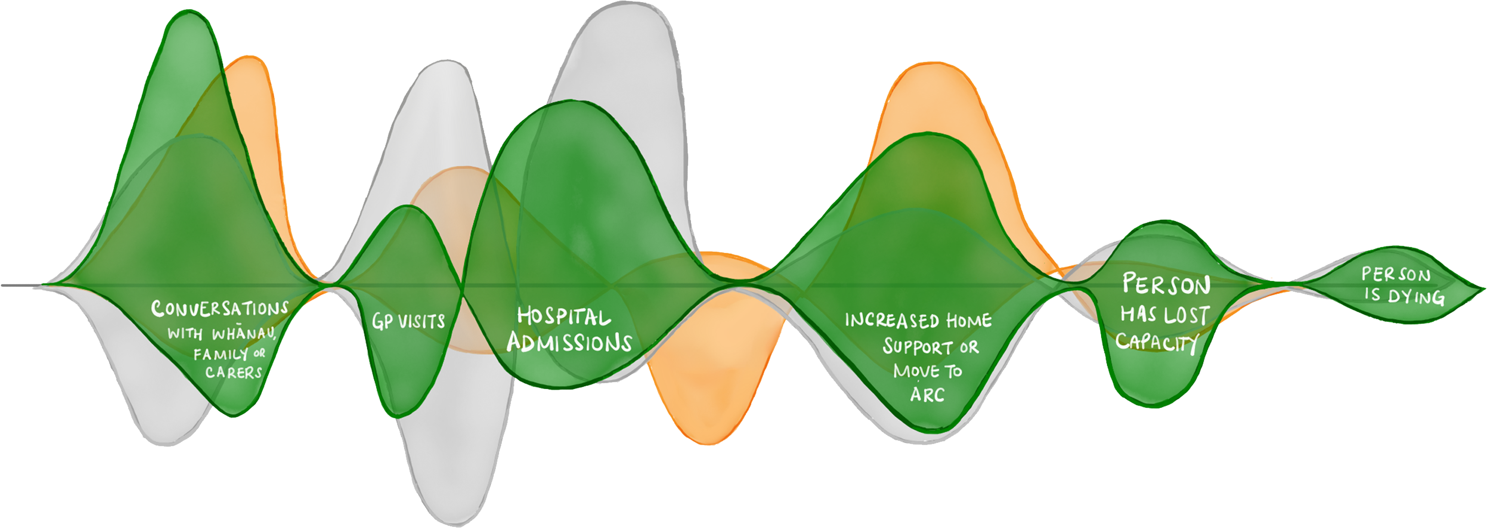









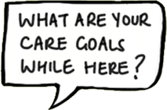
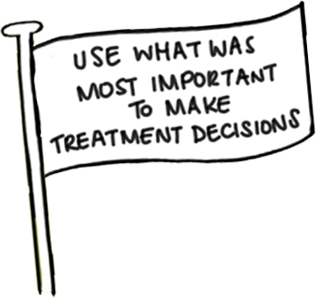

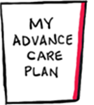


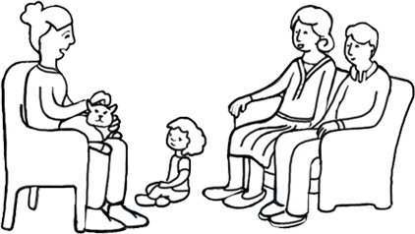


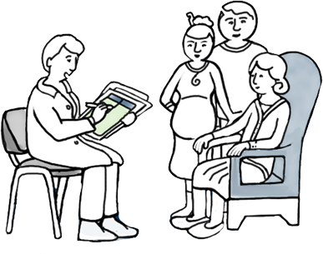



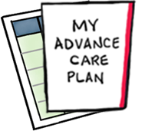

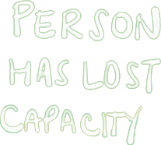












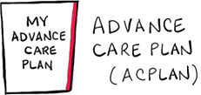
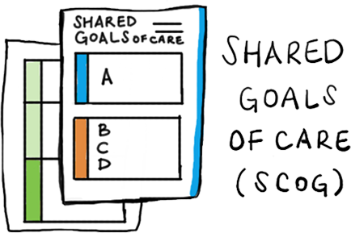







Notes:
What often practitioners' find most confusing about shared goals of care is where it sits with advance care planning and advanced directives.
Advance care planning is an overarching process that allows patients to explore their future health and their wishes particularly referencing treatment wishes when they can no longer voice their own thoughts. The process of advance care planning may or may not result in the completion of an advance care plan, or it may simply result in a conversation with whānau or the health care team as to what these preferences may look like. Advance care plans are enduring but patients are encouraged to review and update these periodically…
Shared goals of care is a similar process to advance care planning in that it places patients and their needs at the centre of the conversation but relates to an episode of care- which at this stage we are referring to hospital care but also may relate to admission to aged residential care.

Slide 7
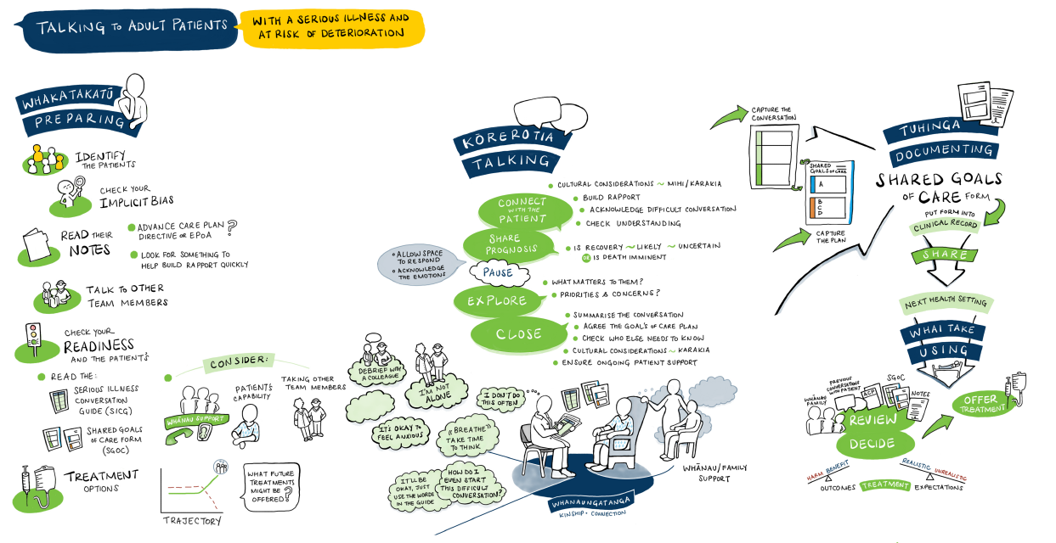
Approach to shared goals of care

Slide 8
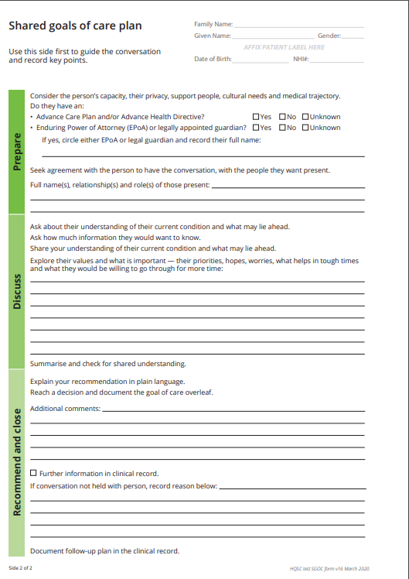
The discussion
Includes people important to the patient.
Patients have asked that staff who spend the most time with them be able to start, add to and continue the discussion about shared goals.
Facilitated by an appropriate clinician.
Supported by members of the multi-disciplinary team.
Notes:
The SGOC decision is usually made by a senior clinician (usually registrar or senior medical officer), however in some organisations this may be another staff member.
It is important that the SGOC decision is shared with others caring for the patient and the SGOC information is included in the discharge summary

Slide 9
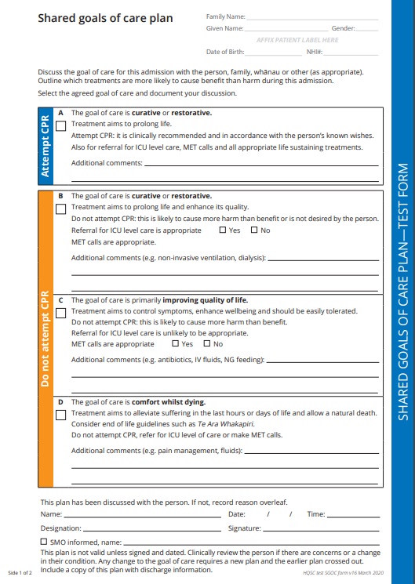
The decision
A shared decision is made.
Documented clearly, only one box ticked.
Medical review if condition changes.
New form needed if the decision changes.
Notes:
The SGOC decision is usually made by a senior clinician (usually registrar or senior medical officer), however in some organisations this may be another staff member.
It is important that the SGOC decision is shared with others caring for the patient and the SGOC information is included in the discharge summary

Slide 10
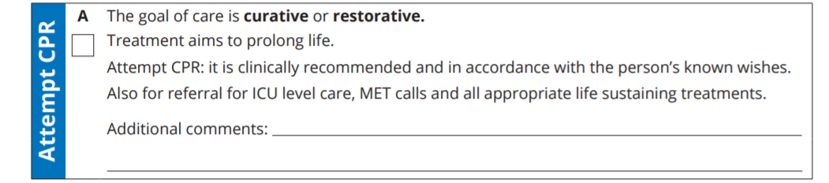
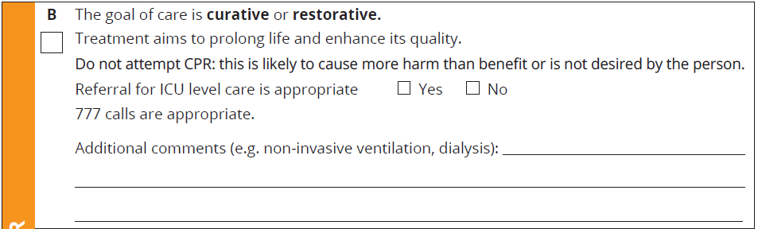
Option A or B
Notes:
Nationally it is advised that the wording of A, B, C and D options is consistent
It is recommended that a relevant patient scenario is discussed. This would clarify which option (ABCD) is most appropriate for the scenario presented
For example
Select goal of care ‘A’ where the expectation and shared goal is for the patient to recover and when full resuscitation and any other appropriate life-sustaining treatments are recommended and appropriate.
A shared goals of care discussion that results in goal of care ‘A’ being selected may be straightforward and brief if the patient, family and whānau understand the clinical situation and would like full treatment, should the patient deteriorate. This may be able to be discussed on a ward round.
resented.
Select goal of care ‘B’ where the expectation and goal are for the patient to recover. However, if the patient was to deteriorate, cardiopulmonary resuscitation (CPR) should not be attempted as it is unlikely to be successful, is likely to cause more harm than good, or the patient does not want it regardless of the outcome. Other treatment may be appropriate such as intensive care unit (ICU) referral, non-invasive ventilation, dialysis etc.
An example where ‘B’ may be appropriate would be an older person in reasonable health, who had future goals or ambitions for which they were prepared to accept a material burden of treatment to return to their previous level of independence.

Slide 11
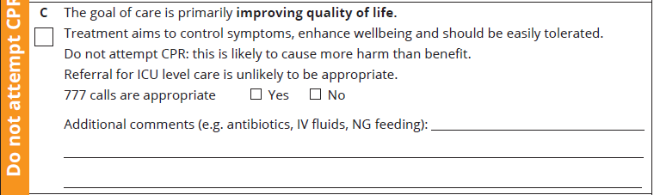
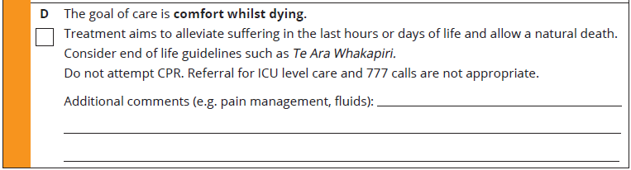
Option C or D
Notes:
Nationally it is advised that the wording of A, B, C and D options is consistent
It is recommended that a relevant patient scenario is discussed. This would clarify which option (ABCD) is most appropriate for the scenario presented
For example:
You would select goal of care ‘C’ where treatment is primarily aimed at improving quality and controlling symptoms. In this case, ICU referral is unlikely to be appropriate, however treatments such as antibiotics, intravenous (IV) fluids, nasogastric feeding, etc may be needed. Treatments should be provided after considering whether the benefit of the treatment will enhance wellbeing and would be easily tolerated by the patient. CPR should not be attempted as it would cause more harm than good.
An example where ‘C’ may be appropriate would be a frailer, older person who is conscious that they are possibly in the last years of their life and who would nevertheless want treatment that could return them to their previous level of independence. Many people in this situation want whatever time they have to be as good as possible. Management of the ups and downs of chronic health conditions is important, but they might not want more onerous treatments to be considered.
Select goal of care ‘D’ when the patient is dying. End-of-life guidelines, such as Te Ara Whakapiri [https://www.health.govt.nz/publication/te-ara-whakapiri-principles-and-guidance-last-days-life] should be considered with the aim of alleviation of suffering and allowing natural death. CPR, referral to ICU or 777 calls should not to be attempted

Slide 12
Support
Resources:
www.hqsc.govt.nz/our-programmes/patient-deterioration/workstreams/shared-goals-of-care
https://www.hqsc.govt.nz/our-work/advance-care-planning/talkingcovid/
For advice, contact your organisation’s patient deterioration programme lead.
Notes:
Add any ideas/scenarios from the workshop

