Slide 1


Sepsis / Mata Whakatoake Raise the Flag
Sepsis education for staff

Slide 2
Learning outcomes
Define sepsis and septic shock
Discuss the pathophysiology of sepsis
List the risk factors for developing sepsis
Discuss the ‘sepsis six’ resuscitation bundle
Demonstrate the use of the sepsis pathways
Discuss post-sepsis syndrome and recovery from sepsis

Slide 3
Sepsis definitions

Slide 4
Sepsis definitions
For health professionals
Sepsis is a life-threatening organ dysfunction caused by a dysregulated host response to an infection
Septic shock is a subset of sepsis where profound circulatory, cellular and metabolic abnormalities increase mortality
For the public
Sepsis is a life-threatening condition that arises when the body's response to an infection injures its own tissue and organs
The Third International Consensus Definitions for Sepsis and Septic Shock (Sepsis-3). PMCID: PMC4968574.
"Merinoff symposium 2010: sepsis"-speaking with one voice. PMCID: PMC3022986.
Notes:
Note – neither definition refers to sepsis as an infection. Sepsis is a response to an infection, not the infection in itself.

Slide 5
Sepsis definitions
The word sepsis comes from the Greek word “sepo”, which means “I rot” (4).
Current terms to describe sepsis: sepsis, suspected sepsis, septic shock
Retired terminology: Severe sepsis, blood poisoning, SIRS and septic shower (3) (5) (6)
Blood poisoning is not an accurate description of sepsis, and the two terms should not be used interchangeably or used when describing sepsis to patients and whānau. (1)
Notes:
Purpose of critical language:
Stronger association of the condition - Calling it for what it is 'sepsis' appose to referencing the underlying infection. Or 'grey' non-specific terminology
The term 'blood poisoning' is often interpreted as an infection and internationally there has been a purposeful move away from this descriptor
The use of a common language to improve communication between health professionals and at handovers between areas and staff shift change overs (for example - 'this patient has/had suspected sepsis/ resolved sepsis')
To improve communication between healthcare workers and patients/whanau - accuracy of labeling a diagnosis (or suspected diagnosis) of sepsis. Particularly important when supporting recovery from sepsis, identifying post sepsis syndrome and if there are external factors e.g. ACC that need the diagnosis of suspected sepsis / sepsis / septic shock. It also ensures the patient understands all clinical problems encountered.
The use of language suitable to educate the well public about the condition.
Improve the recognition of clinical change, e.g. from treating an infection to sepsis resuscitation, & identify criteria and thresholds which intervention is recommended
Provision of criteria to determine accurate information for clinical coding and audit inclusion / exclusion
To streamline the shift in mental model and approach to the clinical situation and treatment.
Retired terminology:
Severe sepsis – we have moved away from referring to sepsis as a gradient. Sepsis is a medical emergency that requires an immediate response. Referencing perceived levels of severity can alter response.
Blood poisoning – is not an accurate description of sepsis and the two terms should not be used interchangeably.
SIRS – although there is a SIRS response during a sepsis event, a SIRS response is not specific to sepsis and can occur in other conditions, for example pancreatitis, post trauma and post-operatively. A SIRS response from other causes is not due to a systemic infection, potentially presenting the opportunity to recognized the severity of the clinical condition and altering treatment actions.
Septic shower – although a SIRS response is part of the sepsis syndrome other conditions can cause a SIRS response e.g. trauma, post surgery. The SIRS response in sepsis is driven by an underlying infection, this is a key difference. The continuum of the sepsis syndrome does not self terminate without treatment, a SIRS response from other causes can.

Slide 6
Pathophysiology

Slide 7
Pathophysiology
Sepsis results from a dysregulated host (immune) response to an infection.
The immune system can be broadly described as having three main components – physical, chemical (innate or cellular) and adaptive.
The chemical or innate (cellular) component refers to cytokines (pro-inflammatory mediators), which are responsible for regulation and activation of inflammation (part of the normal immune response).
Notes:
Immune system components – this discussion will focus on physical and chemical

Slide 8
Pathophysiology
The physical immune system includes structures such as the endothelium, mucosae and skin
A healthy state depends on the integrity of these components

Slide 9
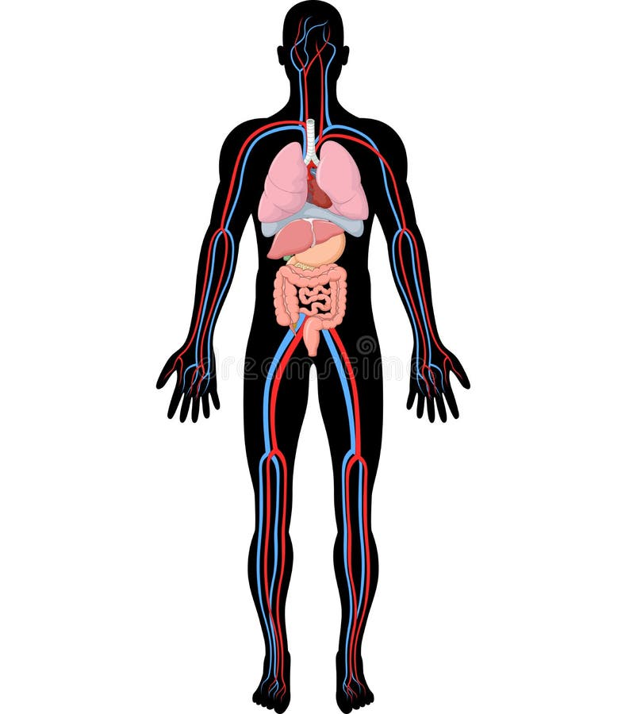
Characteristics
BRAIN: compromised blood-brain barrier allows inflammatory cytokines and cells to enter the brain. Vascular injury, clotting and septic encephalopathy lead to clinical changes, eg altered level of consciousness
LUNGS: capillaries become more permeable and oedematous.
Fluid floods the alveoli,
impairing gas exchange
LIVER: impaired hepatocyte clearance causes cholestasis and interrupts other liver function
GUT: the lining becomes permeable,
leading to bacterial translocation, gut
injury and worsening systemic inflammation
KIDNEYS: Acute kidney injury caused by cytokine and immune mediated microvascular and tubular dysfunction
COAGULOPATHY: leads to impaired peripheral and central blood flow and ischaemia
Notes:
Many of the characteristics of sepsis result from the endothelium being compromised, affecting other organs. This can lead circulatory and endothelial failure, resulting in the recognisable characteristics of sepsis. Eventually it will lead to multi-organ failure.
BRAIN: Sepsis can compromise the blood brain barrier, which allows inflammatory cytokines and cells to enter the brain. Vascular injury, clotting and septic encephalopathy lead to clinical changes, eg altered level of consciousness. Sepsis can cause encephalopathy which may range from mild impairment to coma. Delirium is common and associated with worse long-term outcomes and long-term cognitive deficits.
ENCEPHALOPATHY: signs -> mild impairment to coma.
NERVOUS SYSTEM: responds to local and systemic cytokines -> vagal stimulation -> altering the immune response
DELERIUM: common and associated with worse long-term outcomes and long-term cognitive deficits
LUNGS: capillaries in the lungs will become more permeable and edematous and the fluid can flood the alveoli. This impairs gas exchange, leading to the increased respiratory rate and new oxygen requirement that you see in sepsis.
GUT: the lining will become permeable in the setting of a hyper-cytokinemia -> bacterial translocation -> gut injury and activate pancreatic enzymes -> worsening systemic inflammation
LIVER: sepsis impairs hepatocyte clearance which causes cholestasis and interrupts other liver function
KIDNEYS: Acute kidney injury can result from cytokine and immune mediated microvascular and tubular dysfunction. A significant reduction in urine output is a red flag for sepsis.
COAGULOPATHY: impaired blood flow -> coagulopathy and ischemia

Slide 10
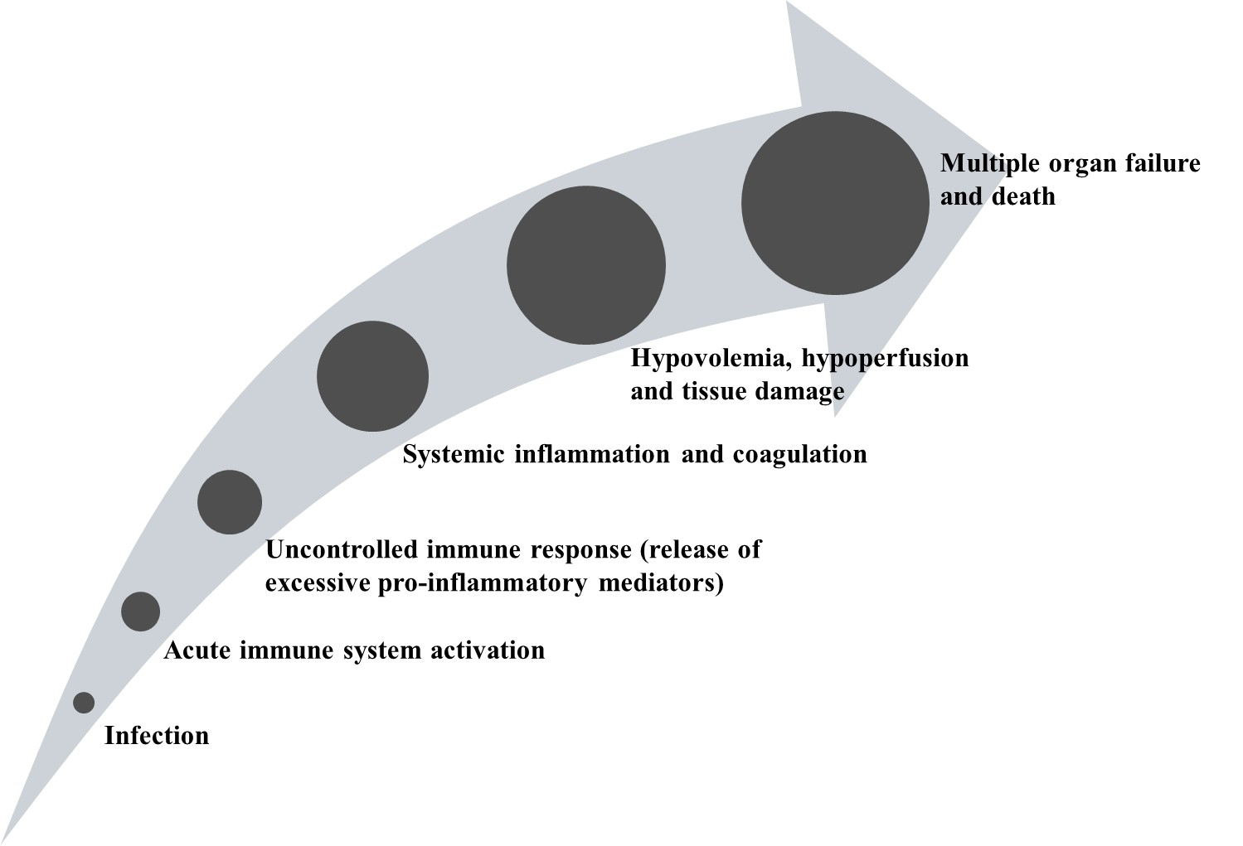
Pathway from infection to sepsis
Reproduced with permission from Sardinha et al 2013
Notes:
The cascade of doom:
Dot 1 & 2 - Indicate progression of an infection at a local point, to a systemic infection, for example a bacteremia or viremia (pre-sepsis)
Dot 3 - The onset on sepsis – a dysregulated immune response and excessive release of pro-inflammatory mediators (Increased cytokine (e.g. TNFα, Interleukin 6) and DAMP release, oxidative stress and endothelial dysfunction, primarily from the degradation of the glycocalyx protein in the endothelium.
The Glycocalyx protein matrix at the site of the endothelium, act as a gatekeeper preventing circulatory pro-inflammatory mediators (cytokines) and other immune cells from being imposed on the endothelium.
Therefore, degradation of the glycocalyx matrix leads to endothelial inflammation and damage (inflamed, dilated & porous vessels -> interstitial oedema -> organ damage)
As a compensatory mechanism, this phase will be met with immuno-suppression response including lymphocyte apoptosis (death of a cell), cellular reprogramming and an expression of T cell and MDSC (myeloid derived suppressor cells). The effective combination of the acute inflammatory phase and compensatory mechanisms = immunoparesis.
Dot 4 & 5 – Systemic inflammation and coagulation.
In response to the endothelial damage there will be an increased leukocyte adhesion and a shift to a procoagulant state. If there is exhaustion of the clotting DIC will ensue. Widespread tissue factor expression, fibrin deposition and impaired anticoagulation will lead to disseminated intravascular coagulopathy (DIC).
Depleted endothelial integrity will also lead to a compromised Blood Brain Barrier function and oedema of the interstitial space of the lung and alveolar dysfunction. It is also responsible for other organ dysfunction and death.
Dot 6 – This stage is an exacerbation of Dots 4 & 5. From the bedside this represents late clinical finding of sepsis + (now) shock, for example hemodynamic instability and signs of circulatory failure + a hyperlactatemia (high serum lactate). These signs would translate to Red Flag Sepsis criteria on the sepsis pathway. There would likely be other findings on further investigation e.g. high bilirubin & a coagulopathy + evidence of (or multi) organ failure.
IN SHORT -> Sepsis is a pro-inflammatory, endothelial dysfunction syndrome.

Slide 11
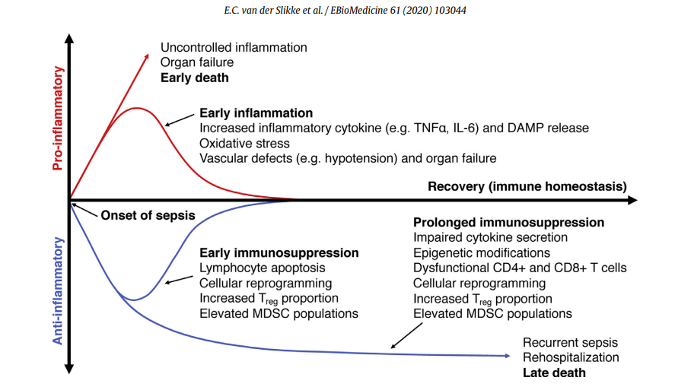
Image from van der Slikke et al (2020), used under the CC BY license http://creativecommons.org/licenses/by/4.0/
Notes:
Demonstration of the previous slide and stages of the sepsis cascade & highlights the longevity of consequences of an acute event (& PSS)
Acute onset inflammatory phase – dysregulation of the inflammatory process -> endothelial dysfunction and damage -> systemic inflammation and further tissue damage
Compensatory phase – early immunosuppression, in an effort to halt the dysregulated immune response. This shift to compensation creates a phase of immuno-paresis
Prolonged immunosuppression OR immune homeostasis
The prolonged immunosuppression phase that follow the acute onset or pro-inflammatory phase and immunoparesis, is responsible for morbidities and late stage mortality resulting from the index sepsis event.
This late phase can be attributed to the underlying aetiologias of Post Sepsis Syndrome
Resulting from this systems can be affected:
Pathways:
damage to cell proteins, lipids, DNA, impair mitochondrial function
Widespread thrombosis -> DIC
Metabolic:
Damaged mitochondria
ATP levels drop
A generalized reduction in cellular energy -> retained tissue oxygen tension -> exacerbated organ dysfunction -> more kidney & hepatic dysfunction, encephalopathy, lung injury and epithelial permeability
Catabolism -> muscle mass loss (apoptosis)
Compensatory phase
Is not passive

Slide 12


Sepsis from the bedside
Red and amber flags on the sepsis pathway can indicate acute deterioration
Observation | Indication
A systolic blood pressure at or below 90 mmHg or down 40mmHg below patient’s normal | A loss of endothelial integrity
Responds to voice only or unresponsive | Compromise of the blood brain barrier and is affected by cytokines and fluid (early septic encephalopathy)
Cool and mottled skin | Compromise of peripheral vasculature and impending loss of cardiac function
Temperature less than 36ºC | Temperature changes can be an adaptive or maladaptive response. Not everyone will have a high temperature with an infection or sepsis.
Notes:
LOW TEMPERATURE – in the context of sepsis is associated with higher mortality rates & can be a maladaptive or adaptive response
Not everyone will have a raised temperature with sepsis or infection. Temperature can also be augmented by the use of common medications e.g. Paracetamol.
Further detail in slides of the Sepsis Pathways

Slide 13
Special considerations
Number augmentation
Some common medications can normalise vital sign numbers and potentially mask signs of deterioration
Serum lactates
A raised serum lactate in the context of serious infection or sepsis has both statistical and clinical significance
Cryptic sepsis shock
A state of shock where the lactate is 4 or more with relative haemodynamic stability (SBP 90mmHg or more)
Pre-hospital treatment or treatments in another area of the hospital
If the person received IV fluids in PACU or the ambulance
Notes:
Diagnosis of sepsis requires recognition of a deteriorating state in the context of suspected or confirmed infection (see Pathways) and critical thinking. .
Number augmentation;
The Pathways require some objective information from taking vital signs, however, are not dependent on EWS scoring alone. There are other clinical indicators or trends that can be present in a septic patient, even with 'relatively normal numbers.’
for example, anti pyretic drugs (e.g. Paracetamol) can cause a normothermia, Beta-blocker drugs can mask a tachycardia
For example, the effect of medications or treatments received, or normal physiological compensation.
For example, observing an initial response to IVF administration by way of an increased systolic BP. This intervention might provide some temporary resolution, e.g. look at, what are the trends doing form the next four hours? You do not have to wait for an EWS trigger to observe the need for further IVF.
Serum lactates – in both venous and arterial samples;
A normal lactate is less then 1.0 mmol/L.
A lactate of 2-3.9 indicates a state of shock – is associated with a mortality of 7%. In children a high lactate is a late sign of sepsis. Children with a lactate of 4 or more need immediate review by a senior clinician / SMO
A lactate of 4 or more indicates – is associated with a mortality of 27%. Any adult with a lactate of 4 or more should receive aggressive resuscitation regardless of their BP. These patients should be treated in the ICU unless there are limitations in treatment.
There are some other causes of a hyperlactaemia or inadequate oxygen delivery to tissue – trauma, seizures, an adrenalin infusion, some medications such as metformin. In the context of suspected serious infection or sepsis a hyperlactatemia should be attributed to the sepsis appose to other causes.
Lactate clearance – lactate clearance of at least 10% at a minimum of 2 hours after resuscitation initiation is a valid way of monitoring response to treatment
Cryptic shock;
Seen in people who will typically compensate physiologically for longer – children, young, healthy individuals
Pre-hospital or Pre-area treatment;
The use of critical language helps clinicians handover relevant details of a patient and help receiving clinicians understand what specific treatment (and clinical concerns) are relevant.
For example – '
'patient A has received 2L IVF & antibiotics on route to the hospital for suspected sepsis'
'patient B being handed over to the ward from ED – patient B has received the Sepsis 6 with a total of 3L IVF + ** antibiotics for a presentation of sepsis secondary to....'

Slide 14
Critical language
Critical language ensures all clinicians are thinking along the same lines in terms of potential diagnoses
During handovers, refer to a resolved sepsis event as resolved sepsis to ensure the event is detailed in all relevant clinical information
The diagnosis of sepsis or suspected sepsis should be carried through the entire admission and included in discharge summaries
‘Mr M is looking very unwell and we suspect an infection. He has signs of red flag sepsis’
Notes:
Clinical Tip:
If a patient has had a sepsis event, it is key to clearly identify that diagnosis.
For example,
Correct -> 'Mrs A had sepsis secondary to a Group A Strep (GAS) cellulitis. - provides all relevant clinical information for take over of care or recovery
Incorrect -> 'Mrs A has a cellulitis.' - provides partial information and references the underlying infection, however omits potentially important information for take over of care of recovery (Post sepsis syndrome). Also will impact diagnostic information needed by outside sources, e.g. ACC, insurance companies etc.

Slide 15
Using critical language
“Mrs A has a cellulitis”
“Mrs A has sepsis secondary to a Group A Strep (GAS) bacteraemia from a cellulitis”
Notes:
Scenario – Mrs A is unwell with sepsis that was caused by cellulitis.
'Mrs A has a cellulitis. What could be some of the problems with this statement? - provides partial information and references the underlying infection, however omits potentially important information for take over of care of recovery (Post sepsis syndrome). Also will impact diagnostic information needed by outside sources, e.g. ACC, insurance companies etc.
'Mrs A had sepsis secondary to a Group A Strep (GAS) cellulitis. - provides all relevant clinical information for take over of care or recovery.

Slide 16
Risk factors and burden

Slide 17
Risk factors
Children and neonates
Adults older than 60 years
Pregnant or recently pregnant (up to 42 days after pregnancy)
Māori or Pacific ethnicity
Socio-economic disadvantage
Previous sepsis event
Recent trauma, surgery or hospital admission
Immunosuppressed people
Chronic medical conditions
Notes:
The very young & neonates – immature immune systems.
Older – pre-existing co-morbidities and frailty
Pregnant & post-partum – down regulated immune system a part of the normal homeostatic changes with pregnancy
Māori or Pacific ethnicity – 2-3x more likely to present with sepsis. This is inline with other countries data reflecting indigenous populations. The reasons seen to be related to demographics and socio economics appose to 'genetics,' evidenced when considering hospital length of stay and survival at discharge.
Socio economic disadvantage – over crowding, access to health care are two of the barriers
Previous sepsis event – after an index sepsis event there is a higher risk of future events at any point in the individual's lifetime
Recently discharged form hospital or recent indwelling device e.g. peripheral IV line
Immunosuppressed people
Sepsis can happen to anyone – a high index of suspicion is required for patients who have a suspected or confirmed infection who is not improving despite treatment, or clinically deteriorating. Also be mindful of patients who have re-presented to the ED in the last 48 hours.

Slide 18
Burden
Sepsis (directly and indirectly) accounts for 20 percent of global deaths in the health care setting (8)
Sepsis is the leading preventable cause of maternal death
75 – 80 percent of people with sepsis present to hospital via the emergency department (8)

Slide 19
Burden
Hospital acquired sepsis has a mortality rate of greater than 40 percent and increases length of stay (10)
The average cost of a hospital admission for sepsis is $10,000 (9)
Approximately 50 percent of people who survive sepsis will develop post-sepsis sequelae / post-sepsis syndrome (PSS) (11) (12)
Readmission rates increase over time after an index sepsis event
Notes:
Readmission rates:
Contribute to further costs in addition to the monetary burden of the admission of the initial sepsis event
Readmission rate in the 30 days post discharge – 27%
Readmission rate at 90 days post discharge – 40%
Readmission rate at 1 year post discharge – 63%
Long Term mortality: Depending on severity of the initial sepsis event
1 year 7-43%
5 years 82%
The reasons are heterogenous – half are attributed to new infection or a cardiac event. New organ damage resulting from the initial sepsis event come under the umbrella of Post Sepsis Syndrome (PSS). PSS is discussed later in this session
Recurrent sepsis rates at any future point after an index event are 35% vs. 4% for those who have not had sepsis before. Thus making sepsis a risk factor for future sepsis events.

Slide 20
Pathways

Slide 21
Early recognition and treatment
Studies in the United Kingdom have shown that people who received resuscitation within one hour of sepsis being recognised had a 20 percent mortality rate, compared with 44 percent for those who did not (8)
Best practice includes the timely administration of broad-spectrum antimicrobials within one hour of presentation (11–13), based on evidence of a 7.6 percent decrease in survival rate with every hour’s delay in administering antibiotics
https://www.ncbi.nlm.nih.gov/pmc/articles/PMC5112724/

Slide 22
Sepsis is a medical emergency
Sepsis is a medical emergency that requires a timely co-ordinated, interdisciplinary approach to minimise harm
It requires a shift in mental model and approach
Sepsis should be a differential diagnosis when treating a patient with an infection that is not improving or deteriorating

Slide 23
Sepsis is a medical emergency
If a person has suspected or confirmed infection and is not improving or deteriorating
until they respond positively to treatment
Recognise
Resuscitate
Investigate
Notes:
The mental model and approach is the same as for example an acute myocardial infarction of stroke
Shift in mental model and approach: Sepsis is a medical emergency
Sepsis resuscitation (Sepsis 6) requires a different mental model approach compared with the approach to an infection with no indication of sepsis:
Sepsis: recognise Red Flag Sepsis (in context of suspected of confirmed infection) -> resuscitate (sepsis 6) -> investigate (full septic screen and investigations) -> reassess
Infection: recognise -> investigate -> treat
This mental model approach can be likened to the approach taken for a cardiac arrest: recognise -> resuscitate -> investigate

Slide 24
Sepsis pathway: Recognise
Could it be sepsis?
Does the person have risk factors for sepsis?
Is the presentation consistent with suspected or confirmed infection?
Do they look sick?
Is the early warning score 5 or more or 3 or more in one single parameter?
Assess for red or amber flags

Slide 25
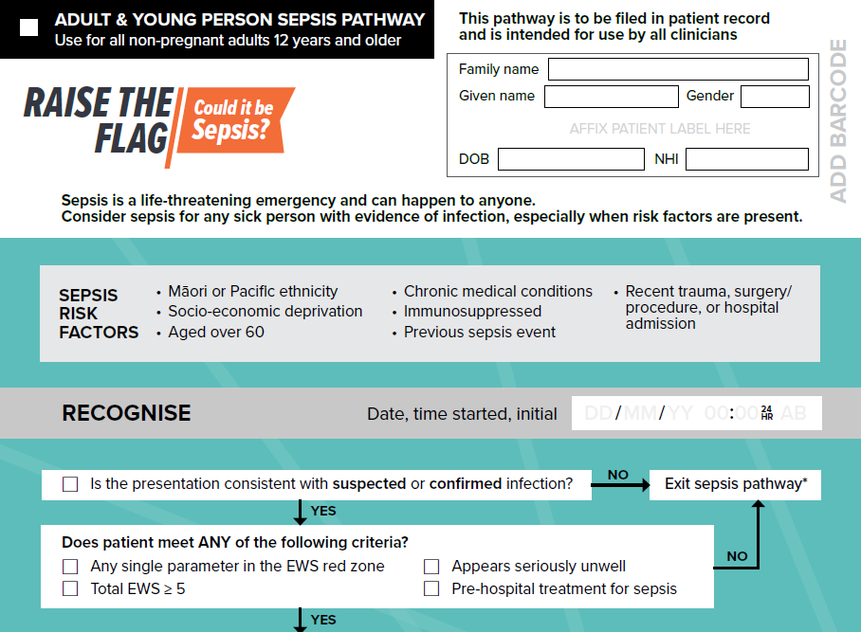
Sepsis pathway: Recognise

Slide 26
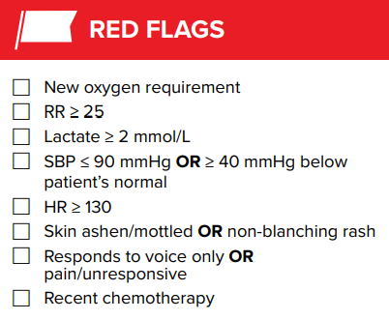
Notes:
Red Flag criteria: Indicate sepsis or septic shock in the context of a suspected or confirmed underlying infection.

Slide 27
One red flag in the context of suspected or confirmed infection?
Start sepsis six immediately

Slide 28
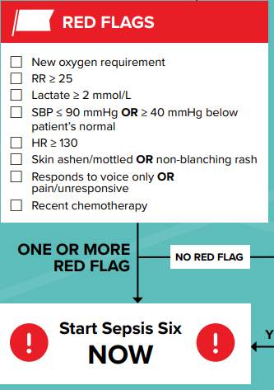

Slide 29
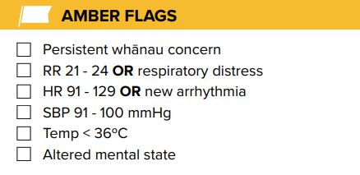
Notes:
Amber Flags -> Indicates either clinical deterioration due to an infection, or a person not responding to treatment of an infection

Slide 30
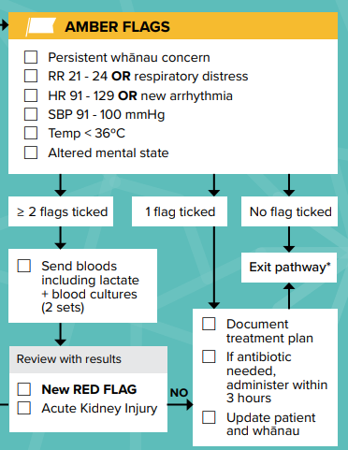


Slide 31
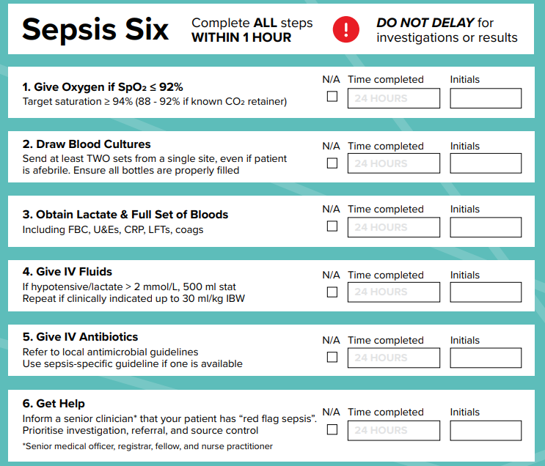
Notes:
Treatment and resuscitation of sepsis requires full implementation of the Sepsis Six.
Do not delay for investigations or results.
All steps need to be completed in any order.
A 'senior clinician' is a Registrar, SMO or Nurse Practitioner

Slide 32
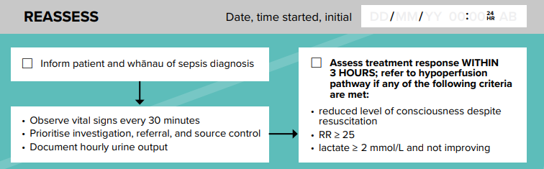
Notes:
After initial recognition of suspected or confirmed sepsis, it is now time to arrange for further investigations, or what is commonly referred to as a 'full septic scree,' arrange referrals and investigations.
Is there evidence of hypo-perfusion?
- Lactate 2 to 3.9mmol/L and not improving -> this patient is still at risk of deterioration. Document plan and review at 3 hours.
- SBP less than 90mmHg OR Lactate 4 or more -> Refer to higher acuity area HDU/ICU and proceed to the hypoperfusion pathway.
NOTE: Cryptic shock is where there is a lactate 4 or more with relative haemodynamic stability. Often seen in the young and those better able to compensate.
NOTE: The hypoperfusion pathway should be administered by a MET/Resus team, ICU team or ED SMO. Use of rescue vasopressors on the ward is not advocated without input from a team from an area where is would normally be given.

Slide 33
Clinical considerations
No single vital sign or set should be interpreted on its own. Subtle trends in vital signs and clinical assessment can be the biggest clue to deterioration
Recognition of sepsis is not dependent on an early warning score. Clinical assessment and critical thinking are equally important
There are factors to consider in different population groups. For example, people who are pregnant will often have a lower blood pressure. Children tend to compensate physiologically for longer (think cryptic shock)
Notes:
No vital sign 'number' should be interpreted on its own;
Example – a fluid bolus can offer temporary improvement of vascular filling. However, it does not necessarily address the underlying cause of the problem.
Example – giving paracetamol can bring a high temperature to a normothermic state. However, it does not treat the underlying cause. It is a symptom control measure.

Slide 34
Recovery and post-sepsis syndrome

Slide 35
Post-sepsis syndrome
Post-sepsis syndrome (PSS) is an umbrella term used to describe the long-term effects of an acute sepsis event
It describes the new physical, medical, cognitive and psychological deficits or disease that are a result of the acute sepsis event (13)
Approximately 50 percent of sepsis survivors will have PSS features
PSS can occur after sepsis OR sepsis + shock, so not exclusively people admitted to the ICU
The average time for recovery is 18 to 24 months
Some survivors will never return to their baseline level of functioning
Notes:
https://www.ncbi.nlm.nih.gov/pmc/articles/PMC10546999/#:~:text=Around%2075%25%20of%20sepsis%20survivors,cognitive%20diagnosis%20after%20hospital%20discharge.&text=Only%20half%20of%20the%20sepsis,two%20years%20after%20hospital%20discharge

Slide 36
Post-sepsis syndrome
Approximately 1/3 of survivors will be readmitted within 90 days. This increases to half of those over the age of 50
Sepsis survivors have a higher risk of having a future sepsis event (35 percent) than people who have never had sepsis (4 percent) (13)
Sepsis or suspected sepsis should be well documented in clinical notes and discharge summaries
This allows continuity of care and transition to the community setting, for example GPs, physiotherapists, psychologists and occupational therapists in the community setting
Notes:
https://www.ncbi.nlm.nih.gov/pmc/articles/PMC10546999/#:~:text=Around%2075%25%20of%20sepsis%20survivors,cognitive%20diagnosis%20after%20hospital%20discharge.&text=Only%20half%20of%20the%20sepsis,two%20years%20after%20hospital%20discharge.
The high number of sepsis survivors who go onto suffer longer term consequences highlights the need for sepsis or suspected sepsis to be well documented in clinical notes and discharge summaries. This allows continuity of care and transition to the community setting, for example GPs, physiotherapists, psychologists and occupational therapists in the community setting

Slide 37
Pathophysiology of Post-Sepsis Syndrome
Sepsis leads to a long-term low-grade inflammation, prolonged immuno-dysregulation and mitochondrial dysfunction which increases the risk of new infections and cellular damage (13)
Organ damage resulting from the acute event, disruption to cellular pathways and apoptosis of immune and structural (e.g. muscle) cells contribute to long lasting damage
Notes:
Examples of underlying aetiologia of PSS features:
Physical – muscle wasting after a catabolic state, apoptosis of muscle cells, nerve damage, limb loss due to necrosis
Cognitive – residual cerebral inflammation (post septic encephalopathy), micro-vascular damage and toxicity.
Medical – exacerbation of existing co-morbidities, new organ disfunction, endothelial damage, tissue and nerve damage resulting from the index sepsis event
Psychological – Emotional response to surviving a life-threatening event, a 'chemical' impact and damage to other systems e.g. endocrine, nervous systems. Physical disability can affect mental health. Acute stress disorders can precede PTSD. PTSD is a well documented sequelae of sepsis.
The burden cost and functional impact of PSS is not yet well researched in NZ. Often the impact and costs shift from the health care system to the social and education systems.

Slide 38
Key messages

Slide 39
Key messages
Sepsis is a medical emergency
Use of critical language – calling it for what it is: Sepsis
There is an acute phase and longer-term impact of sepsis
Sepsis can be hiding in the numbers – recognition requires ongoing assessment and critical thinking
Sepsis or resolved sepsis should be carried through each handover for the duration of admission, and listed in discharge summaries alongside the underlying infection

Slide 40
References
Bpac. 2018. Sepsis: recognition, diagnosis and early management. https://bpac.org.nz/guidelines/4/
Czura, C. J. 2011. "Merinoff symposium 2010: Sepsis"-speaking with one voice. Molecular Medicine 17(1-2): 2-3. https://doi.org/10.2119/molmed.2010.00001.commentary
Markwart, R., H. Saito, T. Harder, et al. 2020. Epidemiology and burden of sepsis acquired in hospitals and intensive care units: a systematic review and meta-analysis. Intensive Care Medicine 46: 1536–1551. https://doi.org/10.1007/s00134-020-06106-2
Huggan, P. J., T. A. Helms, V. Gibbons, K. Reid, H. Hutchins, and I. Sheerin. 2021. Counting the cost of major infection and sepsis in New Zealand: An exploratory study using the National Minimum Data Set. The New Zealand Medical Journal 134(1528): 10-25. https://pubmed.ncbi.nlm.nih.gov/33444303/
Markwart, R., H. Saito, T. Harder, S. Tomczyk, A. Cassini, C. Fleischmann-Struzek, F. Reichert, T. Eckmanns, and B. Allegranzi. 2020. Epidemiology and burden of sepsis acquired in hospitals and intensive care units: A systematic review and meta-analysis. Intensive Care Medicine 46(8): 1536-1551. https://doi.org/10.1007/s00134-020-06106-2
Sardinha, J., M. Kelly, and C. Lehmann. 2013. Targeting the endocannabinoid system to treat sepsis. Signa Vitae 8: 9-14. https://doi.org/10.22514/SV81.052013.1
Sepsis Alliance. 2023. Post-sepsis syndrome. https://www.sepsis.org/sepsis-basics/post-sepsis-syndrome/
Sepsis Alliance. 2023. What is sepsis? https://www.sepsis.org/sepsis-basics/what-is-sepsis/

Slide 41
References (cont.)
Singer, M., C. S. Deutschman, C. W. Seymour, M. Shankar-Hari, D. Annane, M. Bauer, R. Bellomo, G. R. Bernard, J. D. Chiche, C. M. Coopersmith, R. S. Hotchkiss, M. M. Levy, J. C. Marshall, G. S. Martin, S. M. Opal, G. D. Rubenfeld, T. van der Poll, J. L. Vincent, and D. C. Angus. 2016. The Third International Consensus Definitions for Sepsis and Septic Shock (Sepsis-3). JAMA 315(8): 801-810. https://doi.org/10.1001/jama.2016.0287
Singer, M., C. S. Deutschman, C. W. Seymour, M. Shankar-Hari, D. Annane, M. Bauer, R. Bellomo, G. R. Bernard, J. D. Chiche, C. M. Coopersmith, R. S. Hotchkiss, M. M. Levy, J. C. Marshall, G. S. Martin, S. M. Opal, G. D. Rubenfeld, T. van der Poll, J. L. Vincent, and D. C. Angus. 2016. The Third International Consensus Definitions for Sepsis and Septic Shock (Sepsis-3). JAMA 315(8): 801-810. https://doi.org/10.1001/jama.2016.0287 News-Medical. n.d. History of sepsis. https://www.news-medical.net/health/Sepsis-History.aspx
Thompson, K., B. Venkatesh, and S. Finfer. 2019. Sepsis and septic shock: Current approaches to management. Internal Medicine Journal 49(2): 160-170. https://doi.org/10.1111/imj.14199
van der Slikke, E. C., A. Y. An, R. E. W. Hancock, and H. R. Bouma. 2020. Exploring the pathophysiology of post-sepsis syndrome to identify therapeutic opportunities. EBioMedicine 61: 103044. https://doi.org/10.1016/j.ebiom.2020.103044
van der Slikke, E. C., L. F. E. Beumeler, M. Holmqvist, A. Linder, R. T. Mankowski, and H. R. Bouma. 2023. Understanding post-sepsis syndrome: How can clinicians help? Infection and Drug Resistance 16: 6493-6511. https://doi.org/10.2147/IDR.S390947
Walland, K. M., C. Howard, O. Paul, and P. J. Huggan. 2023. Raise the Flag I: The impact of a sepsis quality improvement programme on delivery of a sepsis resuscitation bundle at a tertiary hospital in New Zealand. The New Zealand Medical Journal 136(1587): 75-84. https://doi.org/10.26635/6965.6311

