Slide 1
Surgical Site Infection: the Case for Change

Slide 2
Outline
This ‘Case for Change’ webinar will discuss:
the burden of surgical site infections (SSIs)
the impact on patients and healthcare systems
the need for a national programme to reduce SSIs
the Surgical Site Infection Improvement (SSII) programme framework
the benefits of verifiable information
continuous improvement and practice change
‘Open for better care’ and the SSII programme

Slide 3
What is an SSI?
A surgical site is the incision or cut in the skin made by a surgeon to carry out a surgical procedure
An SSI occurs when bacteria from the patient’s skin, other parts of the patient’s body, or the environment enter the incision made by the surgeon and multiply in the tissues.

Slide 4
SSIs represent a significant burden
As well as the considerable personal impacts on patients (including pain, prolonged recovery, reduced quality of life, loss of well-being and potential loss of income) SSIs have important and costly effects on the health system

Slide 5
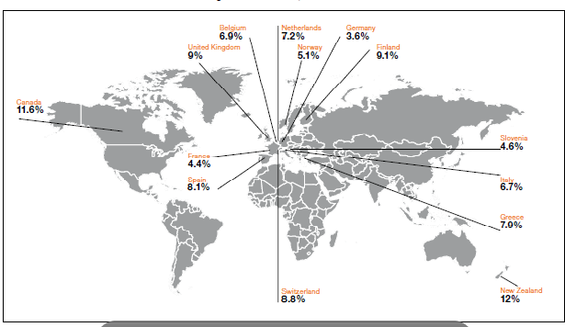
Prevalence of HAI in high income countries 1995-2010

Slide 6
The impact of SSIs
SSIs can result in:
Extended hospital stays
Pain, discomfort and impaired mobility
Readmission and further surgery
Long-term antibiotics
Significant increases in hospital costs
Potential disability
Death

Slide 7
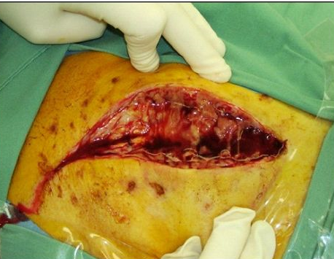
Risks and hazards of SSI
Risks and hazards of SSI differ between
surgical procedures:
Joint replacement
Infection is rare but consequences are considerable
Caesarean section
While incidence of infection is higher,
the management of the infection is
usually less complex.

Slide 8
SSI Audio Visual
(2 mins: 59 secs)
http://www.hqsc.govt.nz/our-programmes/infection-prevention-and-control/publications-and-resources/publication/1163/

Slide 9
The financial costs of SSIs
The costs to the health sector are significant:
A patient with an SSI costs approximately twice the amount of a patient without an SSI (Broex, 2009)
The mean length of stay for patients with a hip SSI is two to three times that of patients without an SSI (Coello et al, 2005; Jodra et al, 2006) at an average cost of NZ$1000 per day (Roy et al, 2003)
A 2005 Auckland hospital study found the excess cost per episode of mediastinitis following cardiac surgery was NZ$45,000 and average excess length of stay was 32 days
A 2011 Sapere research paper estimated the cost to the health system of a hip or knee SSI at approximately NZ$21,000

Slide 10
The personal costs of SSIs
SSIs can be devastating for patients, family and whānau and for those caring for the patient
Prolonged recovery and reduced quality of life, as well as loss of income and sense of well-being for patients and families/whānau are all part of the broader impact that SSIs can have on health outcomes

Slide 11
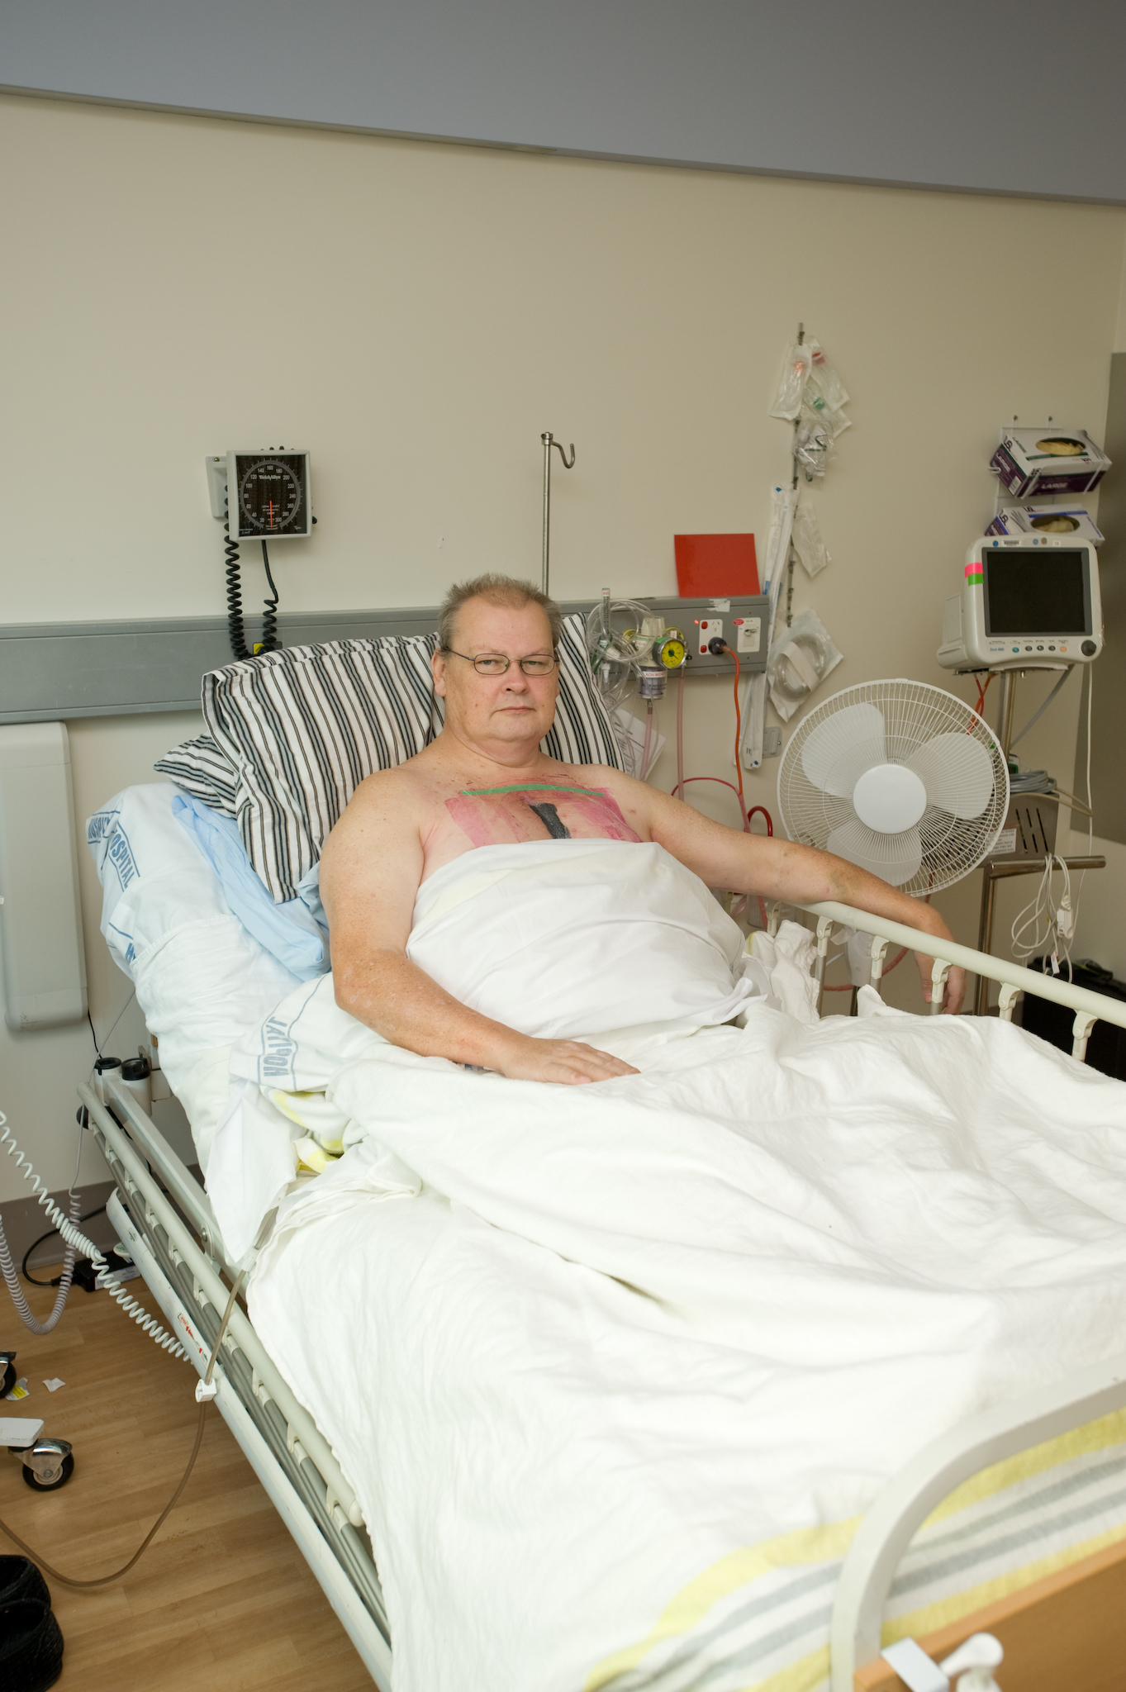
Patient story
Notes:
Ian Collis had cardiac surgery in mid-2013. Surgery went well and he was discharged home five days later. During a visit to his GP the following week he was noted to be unwell with a temperature of 40ºC. He was then transferred to Auckland City Hospital and a diagnosis of post-sternotomy mediastinitis was made – a deep infection involving the tissue around the surgical wound.
To treat this infection he required surgical debridement and washout on two occasions and a prolonged course of antibiotics. He failed to respond to the initial treatment course and required further surgery and a longer course of antibiotics. He was in hospital for 12 weeks and will require plastic surgery to repair the area of tissue loss in his chest.
This infection has had a significant impact on his family. He is the main income earner; his job has been held open for him but he has used up his entire annual leave and sick leave entitlement during his extended hospital stay.

Slide 12
Reducing the harm of SSI
International and local research provides clear evidence about key interventions to keep patients safe
Effective leadership, improvement tools and resources, evidence-based measurement and reporting to key stakeholders all support multidisciplinary teams to reduce SSIs

Slide 13
SSII Programme
Collaboration between the Health Quality & Safety Commission and Auckland and Canterbury DHBs as lead agencies for the national SSII programme
The programme will generate verifiable information that supports practice change and improvement
The programme will support and encourage consistent use of evidence-based interventions across the sector to reduce SSIs and improve patient safety

Slide 14
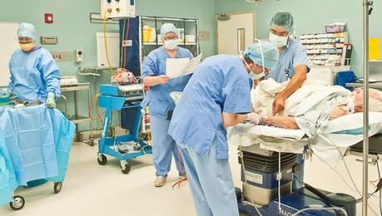
A staged approach
First stage: hip and knee replacement procedures
Second stage: coronary artery bypass graft (CABG)
Third stage: caesarean sections

Slide 15
The goal of the SSII
programme
25 percent reduction in SSI rates through the implementation of best practice
This will be achieved through quality improvement strategies

Slide 16
International approaches
Germany Krankenhaus Infections Surveillance System (KISS)
Netherlands PREventie van ZIEkenhuisinfecties door Surveillance (PREZIES)
Switzerland Swiss Nosocomial Infection Prevention (SNIP) Programme
Japan Japanese Nosocomial Infection Surveillance (JANIS)
Belgium National Surveillance of Infections in Hospitals (NSIH)
UK Nosocomial Infection National Surveillance System (NINSS)
South America International Nosocomial Infection Control Consortium (INICC)
Australia Victorian Healthcare Associated Infection Surveillance (VICNISS)
Healthcare Infection Surveillance Western Australia (HISWA)
Centre for Healthcare Related Infection Surveillance & Prevention (CHRISP)
Tasmanian Infection Prevention & Control Unit (TIPCU)

Slide 17
DHB engagement
The SSII programme was initially trialled in eight development site DHBs from March – June 2013
After the eight DHBs had tested, refined and improved the data collection processes, the programme was rolled out nationally in July 2013 using a ‘buddy’ system
All 20 DHBs are now collecting data on hip and knee replacement procedures using consistent definitions

Slide 18
National, regional & local focus
Nationally: to measure the burden of SSIs, understand trends and support evaluation of interventions; evaluate and support SSI reduction initiatives and policies on prevention and control of SSI;
Regionally: to enable consistent data collection and reporting with opportunities for sharing of best practice and lessons learned;
Locally: improving quality, data transparency and reliability; more accurate and timely feedback to clinicians supporting improved practice, reduced infection rates and better patient outcomes

Slide 19
Framework for improvement
Assess
Design
Construct
Implement
Collect
Continuous improvement of clinical practice
The programme will create an environment of continuous improvement, encouraging health care providers to collaborate and create initiatives to reduce SSIs through consistent application of best practice
1 Identify issue
Clinically Driven, Evidence Based and Improvement Focussed
4 Collaborate to find inspiring answers
Collate
Act
Practice Change
5 Win work
Analyse
Study
Continuous Improvement
Do
Report

Slide 20
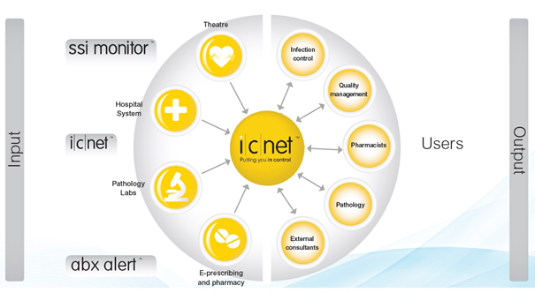
Data collection: ICNet NG

Slide 21
Improvement interventions
Closing the gap between knowledge and practice
Focused interventions include:
giving patients the right antibiotic at the right dose at the right time
using appropriate skin preparations before surgery
clipping rather than shaving the surgical site.

Slide 22
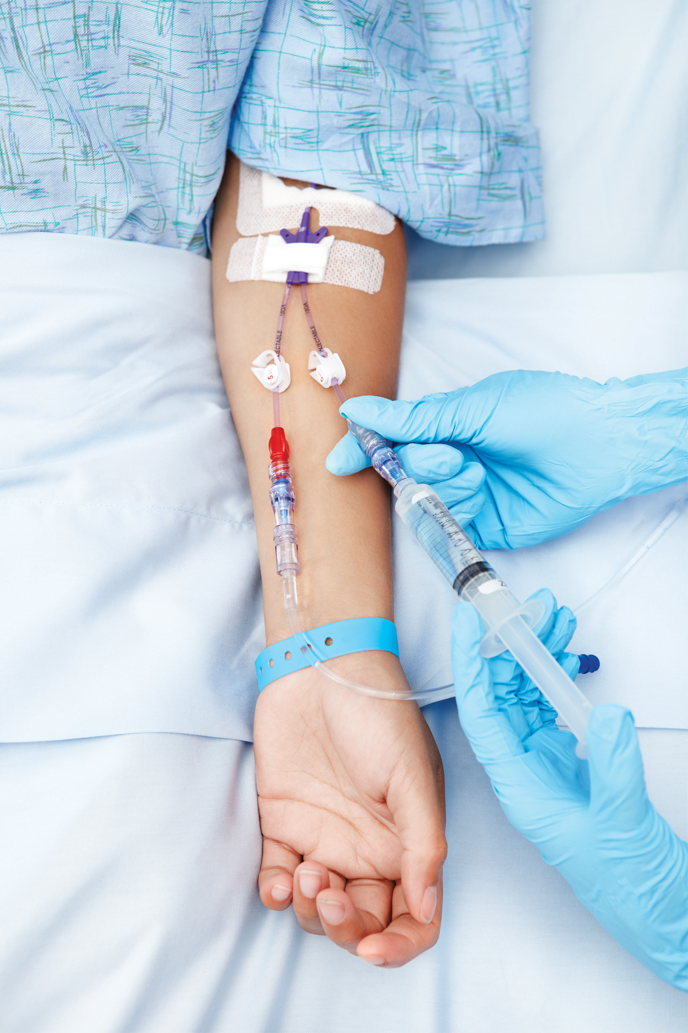
Initial findings from development sites
High quality data
Surgical antibiotic prophylaxis:
Drug
Dose
Timing
Choice of skin antisepsis

Slide 23
SSI: Quality and Safety Markers (QSM)
DHBs have recently been consulted on SSI QSM
Process measures:
Correct dose of recommended antibiotic prophylaxis
Correct timing of antibiotic prophylaxis (0-60 minutes before incision)
Appropriate skin antisepsis
Outcome marker:
Rate of surgical site infection by procedure
QSM link to the ‘Open for better care’ Campaign

Slide 24
‘Open for better care’ campaign
Reducing SSIs is topic two of the national patient safety campaign ‘Open for better care’
The campaign launched in May 2013 with an initial focus on reducing patient falls
Reducing SSIs is the focus of the campaign from mid-October 2013 to March 2014

Slide 25
Why do we need a campaign?
In our health and disability system excellent patient care is delivered
But we know people are still being harmed, sometimes with serious and long-term consequences

Slide 26
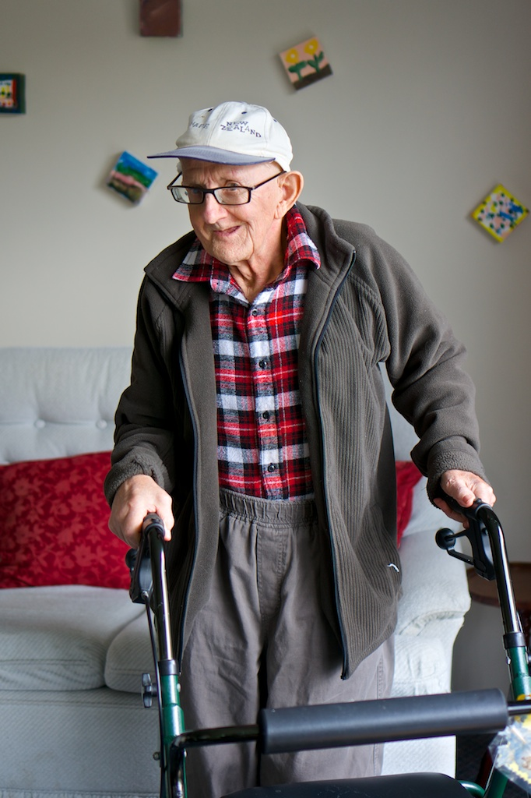
Reducing harm in four areas
Evidence shows we can reduce harm caused by :
falls
surgery
healthcare-associated infections
medication.

Slide 27
Open Campaign audio visual (1min 16 secs)

Slide 28
‘Open for better care’
‘Open for better care’ is about being open to:
acknowledging mistakes and learning from them
working closely with patients and consumers
change, improvement and innovation
using evidence-based practice
supporting an honest, transparent and respectful culture
listening carefully and communicating clearly

Slide 29
References
Alexander J W, et al. Updated recommendations for control of surgical site infections. Ann Surg. 2011, 253; 6:1082-1093.
Anderson DJ, et al. SHEA/IDSA Practice recommendation: Strategies to Prevent Surgical Site Infections in Acute Care Hospitals. Inf Cont Hosp Epid, 2008; 29: S51-S61.
Bratzler R, et al. Clinical practice guidelines for antimicrobial prophylaxis in surgery. Am J Health-Syst Pharm. 2013, 70:195-283.
Broex ECJ, et al. Surgical site infections: How high are the costs? J Hosp Inf, 2009;72: 193-201.
Hawn MT, et al. Timing of surgical antibiotic prophylaxis and the risk of surgical site infection. JAMA Surg. 2013,148;7:649-657.
Jodra VM, et al. Excess length of stay attributable to surgical site infection following hip replacement: A nested case-control study. Inf Cont Hosp Epid, 2006; 27:12.
Merollini, et al. Most relevant strategies for preventing surgical site infection after total hip arthroplasty: Guideline recommendations and expert opinion. AJIC, 2013; 41: 221-6.
Ridgeway S et al, Health Protection Agency England. Infection of the surgical site after arthroplasty of the hip. J Bone Joint Surg; 2005; 87-B; 6: June 2005.
Schweizer M, et al. Effectiveness of a bundled intervention of decolonization and prophylaxis to decrease Gram positive surgical site infections after cardiac or orthopedic surgery: systematic review and meta-analysis. BMJ, 2013;346:f2743 doi: 10.1136/bmj.f2743 (Published 13 June 2013)
Skoufalos A, et al . Improving awareness of best practices to reduce surgical site infection : A multistakeholder approach. Am J Med Qual. 2011, 27; 4: 297-304.
Tanner J, et al. Patient narratives of surgical site infection: implications for practice. J Hosp Inf, 2013, 83 :41-45.
The Joint Commission, Implementation Guide for NPSG.07.05.01 on Surgical Site Infections: The SSI Change Project. 2013.
Thompson KL, et al. Chasing Zero. The drive to eliminate surgical site infections. Ann Surg. 2011, 254;3:430-437.
Tschudin-Sutter S, et al. No risk of surgical site infections from residual bacteria after disinfection with povidone-iodine-alcohol in 1014 cases. A prospective observational study. Ann Surg. 2012;255:565–569.
Society of Healthcare Epidemiologists of America, Practical Healthcare Epidemiology, 3rd edition, 2010, Chapter 15, pp.173-185.
Upton A, Smith P, Roberts SA. Excess cost associated with Staphylococcus aureus poststernotomy mediastinitis. NZMJ 2005;118:1210.
World Health Organization (WHO). Report on the Burden of Endemic Health Care–associated Infection Worldwide. Geneva, 2011.

Slide 30
Questions and answers [The following has been added based on the questions and answers provided during the webinar]
Q.1
How much does the programme expect to save the health sector each year?
Financial benefits from the programme are expected to build steadily as infection rates decrease and the number of surgical procedures included in the programme increases, until by year ten it is estimated that savings from SSIs avoided will be in the region of $4 million each year
Q.2
Are IPC nurses expected to be the key drivers of the programme in DHBs?
No, the SSII programme is engaging with a wide range of DHB stakeholders, and anticipates that infection prevention and control nurses will be working with surgical colleagues, quality and risk staff and senior management to drive the programme in DHBs
Q.3
Have you got any resources for consumers/patients to help them to prevent SSIs?
The Open for Better Care campaign is currently developing a consumer resource outlining ways for consumers and their families/whanau to help prevent SSIs which will be available on the HQSC SSII Programme website
Q.4
What sort of tools and resources is the programme providing to encourage change at a local level?
The SSII programme is providing resources to support best practice including the Surgical Antimicrobial Prophylaxis Guidelines for hip and knee procedures; as well as tools to ensure consistent data collection and accurate reporting of infection rates to inform clinicians and management at the local level and track improvement over time.
Q. 5
Why is the SSII programme promoting clipping not shaving?
Shaving can abrade the skin surface and consequently enhance microbial growth at the surgical site. If it is necessary to remove hair for the surgical procedure, clipping is recommended to reduce the risk of infection.

