Slide 1

Surgical Site Infection:
Surveillance

Slide 2

Outline
This webinar will discuss:
  the role of surveillance in preventing SSIs and improving outcomes for patients
  implementing the surveillance process in DHBs
  surveillance methodology; process and workflow
  data management
  reporting and feedback of SSI data
  how surveillance helps drive and measure improvement

Slide 3

Aim of the SSII programme
  To remove all preventable patient harm resulting from surgical site infections throughout the New Zealand health and disability system
  Goal is 25 percent reduction in SSIs over next three years
  Surveillance plays a key role in achieving this goal

Slide 4
What is surveillance?
Surveillance is a systemic and on-going method of data collection, presentation and analysis, which is then followed by dissemination of that information to those who can improve patient outcomes
In a healthcare setting, surveillance of HAIs can be extremely important in the context of continuous quality improvement as objective data is used to improve patient outcomes.
Guide to the Elimination of Orthopedic Surgical Site Infections, APIC/AORN, 2010

Slide 5
Surveillance enables us to:
Determine baseline rates
Identify areas for improvement
Evaluate interventions
Monitor changes
Feedback results

Slide 6
Systematic surveillance
A systematic SSI surveillance programme includes:
agreed data fields
agreed infection definitions
a consistent approach to data collection, storage, retrieval, analysis and interpretation
consistent reporting of results
use of the information to bring about change.

Slide 7
Surveillance system
With a well designed surveillance system hospitals should be able to use their surveillance data to compare their SSI rates with a benchmark, other hospitals, or with themselves over time

Slide 8
Nationally standardised SSI surveillance
The SSII programme initially involved eight development DHBs which tested and reviewed the surveillance process between March and June 2013
National rollout workshops in July 2013
All 20 DHBs now on board with a standardised approach to surveillance

Slide 9
Play Surveillance SSI Audio Visual
(3 mins 52 secs)

Slide 10
Getting started in your DHB
Surveillance primarily involves infection prevention and control teams and clinical staff
But - creating system-level improvement needs the active support of other stakeholders /leadership

Slide 11
SSI surveillance - who should be involved?
IP & C staff
Clinical microbiologists/infectious disease physicians
Surgeons
Anaesthetists
Clinical nurse specialists; ward and operating theatre staff
Quality managers/clinical audit staff
IT staff
Medical microbiology department staff
Clerical and Admin staff
Executive management

Slide 12
Key roles
SSI coordinator
Facilitates process at local level
Ensures engagement with clinical teams and management
Provide overall coordination and liaison with national SSI project team
To ensure mechanisms are in place for data collection, collation, transfer and dissemination
To provide local support for staff involved in the surveillance process
To facilitate feedback of SSI to local stakeholders
To carry out validation processes to verify data.

Slide 13
Key roles
Surveillance/data collector
To collect the data in accordance with the national project team requirements
To provide the data in a format suitable for uploading onto the web based form.
Data transfer coordinator
To ensure that any electronic format utilised locally complies with the SSI data specifications
To ensure that the data is correctly uploaded onto the web based reporting form.

Slide 14
SSII Surveillance
Focused initially on:
  Total Hip Joint Replacement (THJR)
  Total Knee Joint Replacement (TKJR)
ALL patients who have THJR & TKJR procedures are monitored from the date of surgery up to 90 days post-procedure
Post-discharge surveillance is not included in the SSII programme

Slide 15
ALL patients who undergo procedures …
More than one source of data may need to be reviewed to make sure all eligible procedures are captured
Depending on your DHB:
  Patient management systems
  Operating theatre records
  Emergency theatre records
NB: the denominator is procedures not patients …

Slide 16
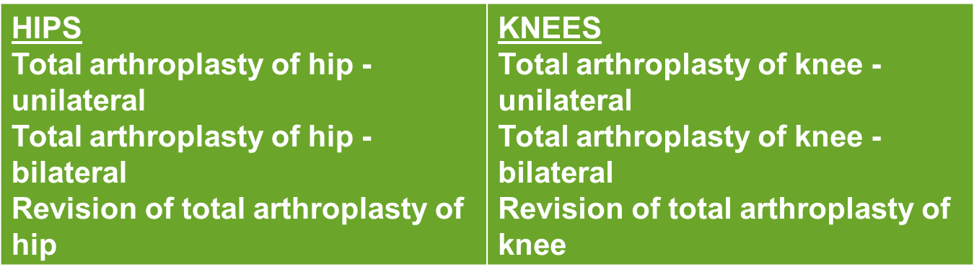
Categories of procedures to be included
All of the ICD 10 codes in these procedure codes must be included (these are all listed in the updated SSI Implementation Manual on pages 11/12):

Slide 17

SSI case finding
To monitor for SSIs you must be confident in the
definitions and diagnoses
Essential to have an automated or manual check of :
  Operating lists
  Active and systematic review of inpatients
  Readmission surveillance
  Microbiology request surveillance
  Positive culture of a significant organism
  from a procedure site

Slide 18

Surveillance - NHSN
The SSII programme uses definitions developed by the US National Healthcare Safety Network (NHSN)
NHSN definitions have been incorporated into most healthcare associated infection (HAI) surveillance systems around the world
International data comparisons are possible but require caution as local practices may differ

Slide 19
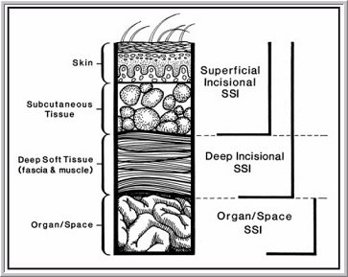
Definitions of SSIs
Superficial
Deep
Organ/space
NHSN Definitions. Centre for Disease Control and Prevention. http://www.cdc.gov/nhsn/index.html

Slide 20
Superficial Incisional SSI
A superficial incisional SSI must meet the following criterion:
Infection occurs within 30 days after the operative procedure
AND
Involves only skin and subcutaneous tissue of the incision
AND
Patient has at least one of the following:
      a. Purulent drainage from the superficial incision
      b. Organisms isolated from an aseptically obtained culture of fluid or tissue from the superficial incision
      c. Superficial incision that is deliberately opened by surgeon and is culture-positive or not cultured
      and
      Patient has at least one of the following signs or symptoms: pain or tenderness, localised swelling, redness or heat. A culture negative finding does not meet this criterion
      d. Diagnosis of superficial incisional SSI by the surgeon or attending physician*
      Attending physician may mean surgeon (s), infectious disease,
      other physician on the case, emergency physician or
      physician’s designee (nurse practitioner or physician’s assistant)

Slide 21
Superficial SSI - notes
Do not report a stitch abscess (minimal
inflammation and discharge confined to the
points of suture penetration) as an infection
Do not report a localised stab wound infection or pin site as an SSI
      Diagnosis of cellulitis by itself does not meet criterion ‘d’ for superficial SSI (d. Diagnosis of superficial incisional SSI by the surgeon or attending physician)
If the superficial incisional site infection extends into fascia and/or muscle layers, report as a deep incisional SSI only

Slide 22
Deep Incisional SSI
A deep incisional SSI must meet the following criterion:
Infection occurs within 30 days (or 90 days after
prosthesis insertion) after the operative procedure
AND
Involves deep soft tissues of the incision (e.g. fascia and muscle layers)
AND
Patient has at least one of the following:
a. Purulent drainage from the deep incision
b. A deep incision that spontaneously dehisces or is deliberately opened by a surgeon and is culture positive or not cultured
And
Patient has at least one of the following signs or symptoms: fever (>38ºC) localised pain or tenderness. A culture-negative finding does not meet this criterion
c. An abscess or other evidence of infection involving the deep incision that is found on direct examination, during invasive procedure or by histopathologic or imaging test
d. Diagnosis of a deep incisional SSI by a surgeon or attending physician*
  *Attending physician may mean surgeon (s), infectious disease, other physician
  on the case, emergency physician or physician’s designee (nurse
  practitioner or physician’s assistant)

Slide 23
Deep Incisional SSI -notes
Classify infection that involves both superficial and deep incision sites as deep incisional SSI
Classify infection that involves superficial incisional, deep incisional and organ/space sites as deep incisional SSI. This is considered a complication of the incision

Slide 24
Organ/Space SSI
An Organ/Space SSI must meet the following criterion:
Infection occurs within 30 days (or 90 days after prosthesis
insertion) after the operative procedure
AND
Infection involves any part of the body, excluding the skin incision, fascia or muscle layers that is opened or manipulated during the operative procedure
AND
Patient has at least one of the following:
a. Purulent drainage from a drain that is placed through a stab wound into the organ/space
b. Organisms isolated from an aseptically obtained culture of fluid or tissue in the organ/space
c. An abscess or other evidence of infection involving the organ/space that is found on direct examination during invasive procedure or by histopathologic examination or imaging test
d. Diagnosis of an organ/space SSI by a surgeon or attending physician*
And
Meets the criterion for a specific organ/space infection**
**in the case of this orthopaedic SSI surveillance
programme this is osteomyelitis or joint infection

Slide 25
Organ/Space SSI -notes
Occasionally an organ/space infection drains through the incision and is considered a complication of the incision. Therefore, classify as a deep incisional SSI
If a patient has an infection in the organ/space being operated on and the surgical incision was closed primarily, subsequent continuation of this infection type during the remainder of the surveillance period is considered an organ/space SSI if the organ/space SSI and site specific infection criteria are met.
Rationale: risk of continuing or new infection is considered to be minimal when a surgeon elects to close a primary wound.

Slide 26
Post-op scenarios – further clarification (CDC 2013)
Invasive manipulation of an implant within 90 day
surveillance period and subsequent SSI e.g. needle
aspiration – attribute to secondary procedure
More than one operative procedure via same incision within 24 hrs – report as original procedure but combine durations for both. Amend wound class if changed
Patient dies in Operating Theatre – do not complete form to exclude from denominator
If dehiscence occurs post discharge or while still an inpatient e.g. following fall, do not report as an SSI
Injury sustained or contamination of wound e.g. incontinence but incision does not open and later develops infection – report as SSI
Skin condition present e.g. dermatitis near incision and subsequent infection – report as SSI
Seeded infection from other site e.g. dental work – report as SSI

Slide 27
Flowchart- web-based system

Slide 28
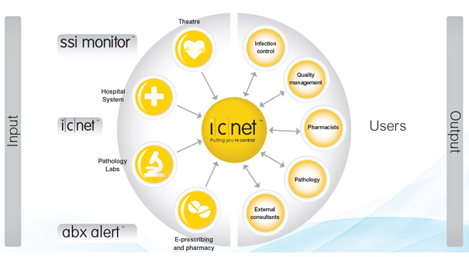
Data collection: ICNet NG

Slide 29
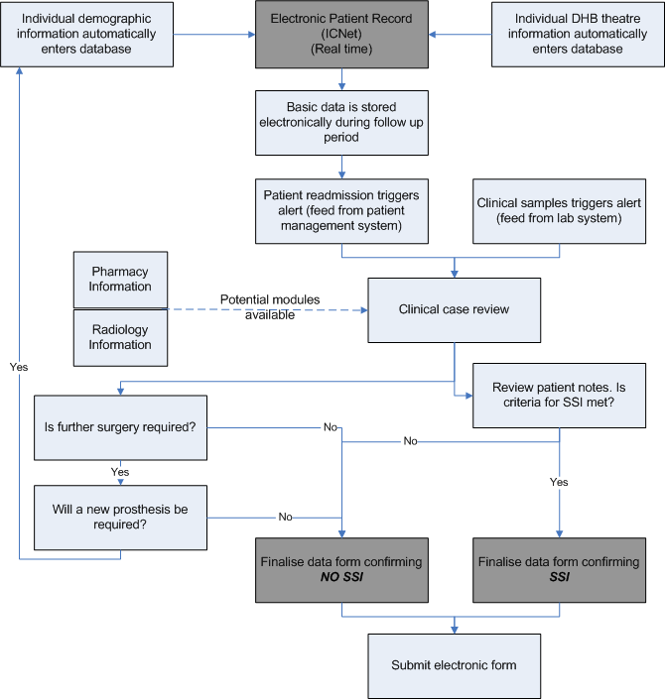
Electronic system - ICNet

Slide 30
Denominator v Numerator
NUMERATOR = Total number of cases which meet the
criteria for SSI
÷
DENOMINATOR = Total number of procedures in the
defined group for SSI surveillance

Slide 31
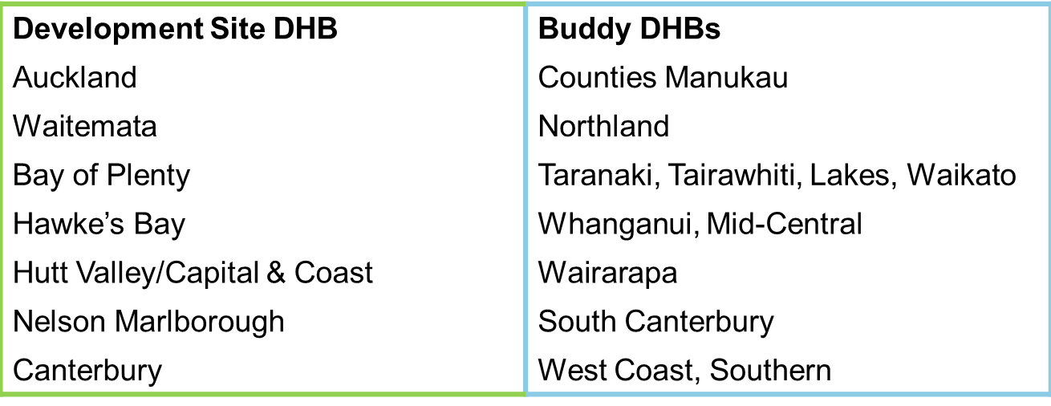
Support – the ‘buddy system’
DHB Development site ‘buddies’ act as coaches, providing support and sharing their knowledge:

Slide 32
Support - networking
Unusual cases (not always black & white)
    Ask the Coordinator
      FAQs
      Network with other ICPs
    User group
    Discuss case scenarios
    Learn other ways to capture & manage data

Slide 33
Case finding
Develop a system to find cases
    Electronic list from theatre
    Check theatre register
Ensure all procedures in group are included
    Check procedure group list if unsure
    Do not include surgery not listed in procedure group
Active prospective surveillance
    Follow-up whilst patient in hospital e.g. visit ward alternate days (Mon, Wed, Fri)
    Retrospective data collection difficult
      Medical notes often missing required information

Slide 34
Case finding
“Internal validation” – system to ensure
all cases included
    Surgical audit – list surgeries, infections, readmissions, etc.
    Health Information Services (medical records) – provide list of patients in nominated group after coding completed
Ensure readmissions captured
    Often readmitted to same surgical ward (check patient list/nurse handover)
    Staff aware to alert ICP
    Surgical audit
    Need to develop system that works at your hospital

Slide 35
Data collection
Complete all required data fields
    Allow risk stratification & inclusion in risk adjusted rates
Complete data form as close to the event as possible
    Don’t leave data collection to the last minute
Do you need to keep hardcopy records?
    ?? 12 months

Slide 36
Missing data
Some data may not be recorded in
medical record:
    May be the first time data required
        ASA, procedure code
  Request from source (if only occasional incident)
    Anaesthetist, surgeon, theatre personnel
  If ongoing issue i.e. system error
    Need to address the source of the issue
    Involve CEO/Executive/Manager if required

Slide 37
Surveillance v clinical definition
Consistency is a MUST!
Consistently apply standardized definitions
Identify all patients meeting the criteria
Enhances the accuracy of data
Ensures the comparability of
the data
        Modifications have implications

Slide 38
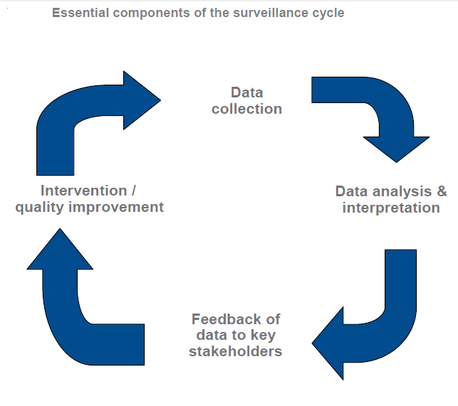

Slide 39
Interpretation of data
Regularly review reports/rates
Determine whether observed differences in rates are meaningful
    Not just due to chance
    p-value
    95% confidence interval
Interpret the data for your audience
    Turn ‘data’ into ‘information’

Slide 40
Feedback data
Provide timely feedback to clinicians
Have clear plan for distributing surveillance information
    Who needs to know?
    Forum
  Present surveillance findings using graphs and easy-to-read tables
    Keep it simple, tailored to audience
  Help stimulate ideas for process improvement

Slide 41
SSII Programme reporting
The following reports are being
developed for all DHBs:
Local - anonymised data comparing the DHB with others
National -
      Cumulative incidence of SSI by DHB and hospital/s
      SSI rates for each procedure with 95% confidence intervals
      Statistical process control chart of SSI rate
      Further reporting options will become available if an IT package is implemented in the DHBs

Slide 42

DHB development sites
Initial report October 2013
High quality data
Surgical antibiotic prophylaxis:
  Antibiotic
  Dose
  Timing
Choice of skin antisepsis
Final report due in December 2013

Slide 43
SSI: Quality and Safety Markers (QSM)
DHBs have recently been consulted on SSI QSM
Process measures:
  Correct dose of recommended antibiotic prophylaxis
  Correct timing of antibiotic prophylaxis (0-60 minutes before incision)
  Appropriate skin antisepsis
Outcome marker:
  Rate of surgical site infection by procedure

Slide 44
Ownership of the results
Surgical team have power to make required changes
  Infection Control Consultant supports surgical team
    Provide up-to-date information
    Highlight issues e.g. antibiotic guidelines, skin antisepsis
    1st hand observation of surgery processes – what should
    occur vs what actually occurs
Follow-up surveillance to determine whether change has occurred
Ongoing surveillance without action can be meaningless

Slide 45
Continued improvement
Surveillance is a key component of continued improvement in SSI rates
Local issues will influence local approaches to data collection – different DHBs working on the same problem will come up with different solutions
Standardised process and timely feedback of results to clinicians has been shown to be an important strategy in reducing SSIs.

Slide 46
Questions:
Q1. Is the Commission working towards establishing a centralised web-based repository for surveillance data that can be accessed by DHBs?
A1. The Commission is working with the National IT Board and the Ministry of Health to look at the potential size of a repository. What we are doing with the SSII programme is the beginning of what could be a bigger system. The success of the SSII programme will be key for getting other government agencies to buy into it. One of the aims we have as a Commission with the ICNet product is greater integration of other systems to cut down the amount of administrative work (involved in data collection, analysis and reporting).

Slide 47
Questions:
Q2. Why has the SSII programme decided to focus on ‘clipping not shaving’ when shaving hasn’t been used in the majority, if not all sites, for a number of years now?
A2. Clipping may be well-embedded in clinical practice but there is excellent data to show that if hair needs to be removed at the surgical site, clipping rather than shaving results in fewer surgical site infections. The programme has chosen to highlight the evidence around hair removal to ensure this practice is followed for all patients. It is also important that patients know not to shave themselves before elective surgical procedures and that any hair removal will be attended to before surgery in the hospital.

Slide 48
Questions:
Q.3 What approach is the SSII programme taking to ensure the engagement of the cardiac surgeons before focusing on cardiac procedures?
A.3 The programme is working to engage with the cardiac surgeons through the Royal College of Surgeons and through meetings with individual surgeons. Before the focus shifts to cardiac procedures the programme will ensure that there is a local ‘champion’ in the DHBs involved to support improvement interventions and help remove barriers to efficient data collection.

