Slide 1
Accelerated Design

Slide 2
How much experience do you have of designing improvement or learning or change events?
1 = minimal experience
5 = highly experienced

Slide 3
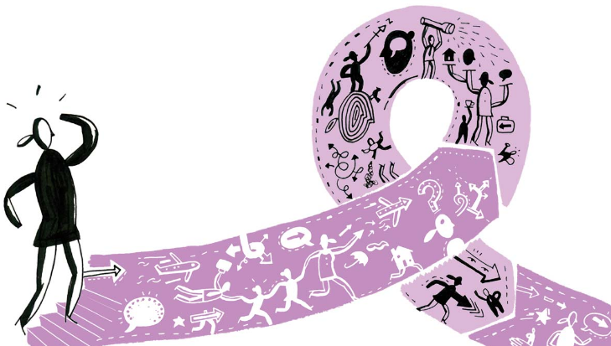
What is Accelerated Design?
A way to get diverse groups of people collaborating, coming together in community to build alignment and ownership, solve complex problems, drive cultural change and get work done
Enable us to do work that would take three or four months using conventional approaches in one or two days
Accelerated design isn’t just a facilitation style – it’s a way of working, thinking, designing solutions and fostering innovation

Slide 4
What is Accelerated Design?
Accelerated Design is an evidence-based approach to change based on a simple premise; people believe in what they design and own what they co-create.
At the heart of the approach are Accelerated Design Events (ADEs). These are events that bring together a group of between 30 and 300 people to work through challenges and issues quickly and develop action. They typically last between one and three days.
Every ADE is unique; it is created to achieve specific outcomes, using a variety of techniques and methods (including environment, facilitation processes, technology, knowledge and collaborative work techniques) that have been shown to create the conditions for large scale change.

Slide 5
When it comes to complex decision making, diversity is more important than ability
When it comes to complex decision making, diversity is more important than ability
Take two groups of individuals and assign to each one some kind of problem to solve. One group has a higher average IQ than the other, and is more homogenous in its composition. One group, say, is all doctors with IQs above 130; the second group doesn’t perform as well on IQ tests, but includes a wide range of people. What Page found, paradoxically, was that the diverse group was ultimately smarter than the smart group. The individuals in the high-IQ group might have scored better individually on intelligence tests, but when it came to solving problems as a group, diversity matters more than individual brainpower
Steven B. Johnson discussing the work of Scott E. Page in Future Perfect

Slide 6
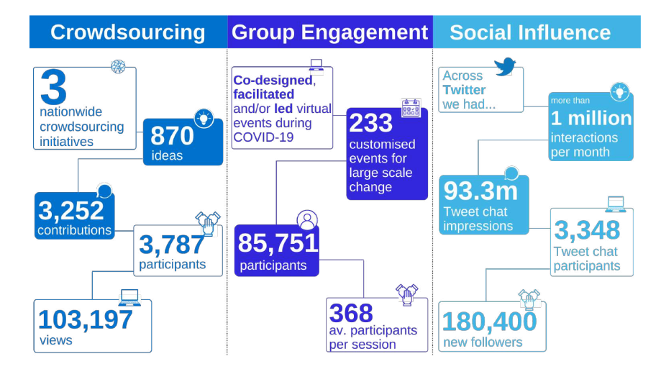
Accelerated design is a core activity

Slide 7
Previous accelerated design events
National leadership development strategy for Primary Care
Facilitating an emerging integrated care system to plan for culture change and new relationships
Planning for improvements in urgent and emergency care across the north of England
Supporting NHS Improvement to design the spread strategy for its national improvement skills and leadership development strategy
Creating a national workforce development strategy for Health Workforce Australia
Building a sense of shared purpose and transformation agenda with Public Health England
Developing strategies to improve the physical health of people who use mental health services
Supporting the NHS Leadership Academy to identify future leadership directions and leadership development needs
Working with 180 frontline ambulance staff from the ten NHS ambulance services to identify operational improvements that can be spread nationwide
National strategy for reducing unwarranted prescribing of psychotropic drugs for people with learning disabilities
Working with key national stakeholders in maternity services to create an aligned approach in response to the Ockenden Review
Creating a joined-up approach regionally and nationally on Community Diagnostic Centres
A commission from the Department of Health and Social Care to develop approaches to child safeguarding outcomes
Bringing together regional and national Covid vaccination leads to plan operational delivery of vaccines at scale
A series of three events for Health Education England with a deliberative community to co-create a strategic framework for a 15 year forward view of the future health and care workforce

Slide 8
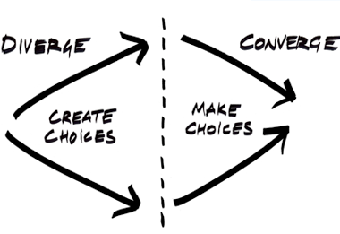

Slide 9
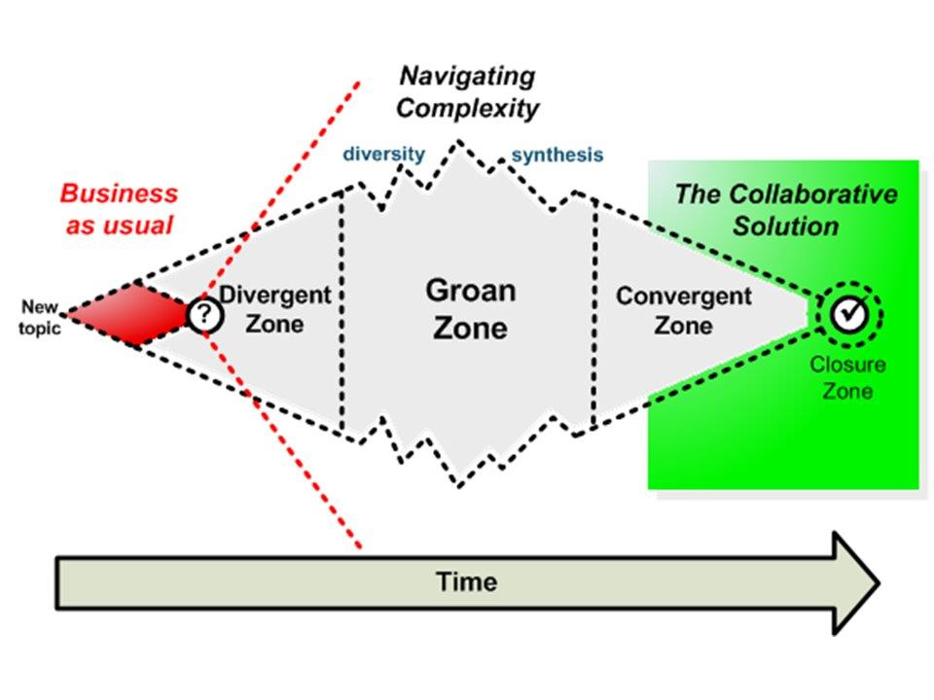
The thinking process for an ADE
Our
starting point
The tricky bit

Slide 10
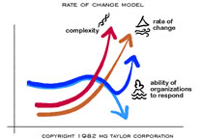
Accelerated design builds on the principles of MG Taylor
The methods were developed over 40 years ago by Matt and Gail Taylor in the USA
ADE methods draw on a broad range of evidence and disciplines, including education, architecture, biology, neurology, psychology and organisation development

Slide 11
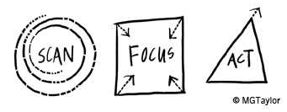
Framework for an accelerated design event
Understand everything that has happened to date
Understand the opportunity to improve things
Create a level starting point for change
Imagine a different future
Think the unthinkable
Identify and test ideas
Narrow down options
Find creative solutions
Uncover and remove barriers to change
Build shared purpose around intention to act
Make definitive decisions
Establish action plans
Agree review process

Slide 12
Sample activities at each stage
Testimony: voice of lived experience
Presentations
Q&A panels
World café
Future mapping
History of the Future
Critical uncertainties
Journalists
Issue analysis
Spectrum mapping
Panarchy
Discovery & Action Dialogue (DAD)
Unconference
Station rounds
Forcefield analysis
“In the shoes of” (personas)
Empathy mapping
Affinity mapping
90 min prototyping
Nine whys
What I Need From You (WINFY)
Leverage points
15% solutions
MoSCoW
Dotmocracy
ABC, 5/30/90 day planning
RACI matrix
20/20 vision
Circle, square triangle

Slide 13
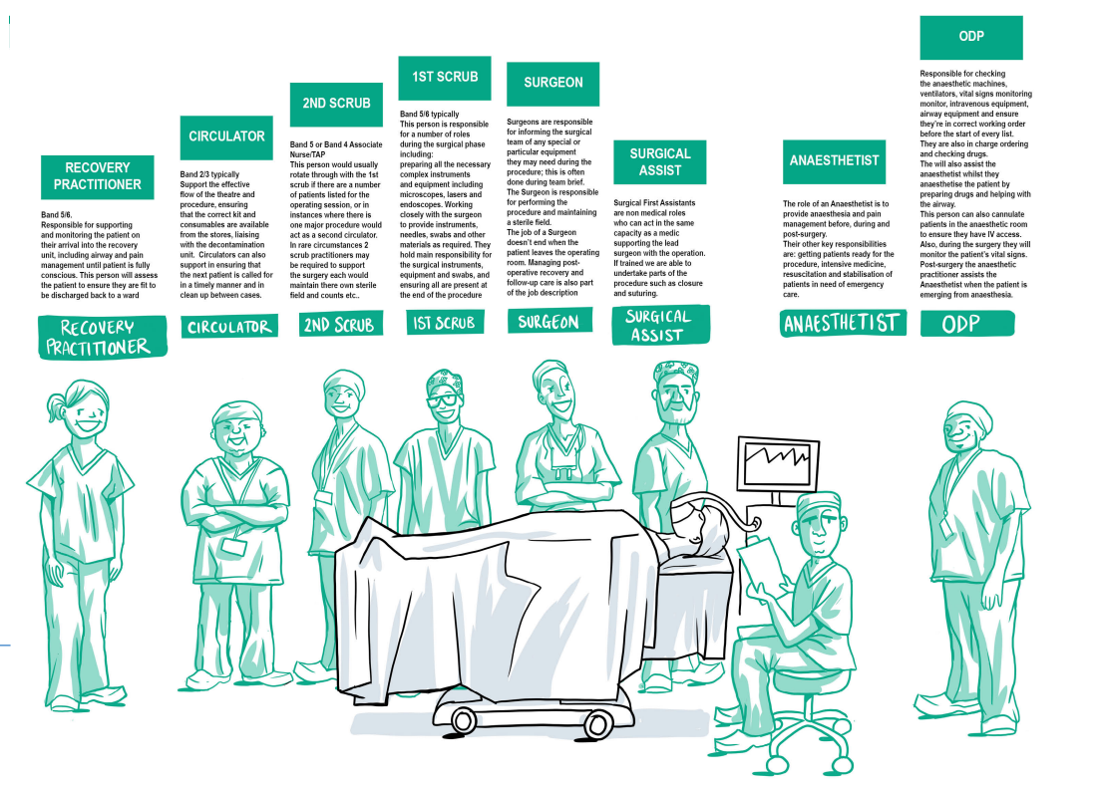
Personas can play a powerful role
Source: A new approach for theatre and post-operative workforce, Ignition event with KPMG

Slide 14
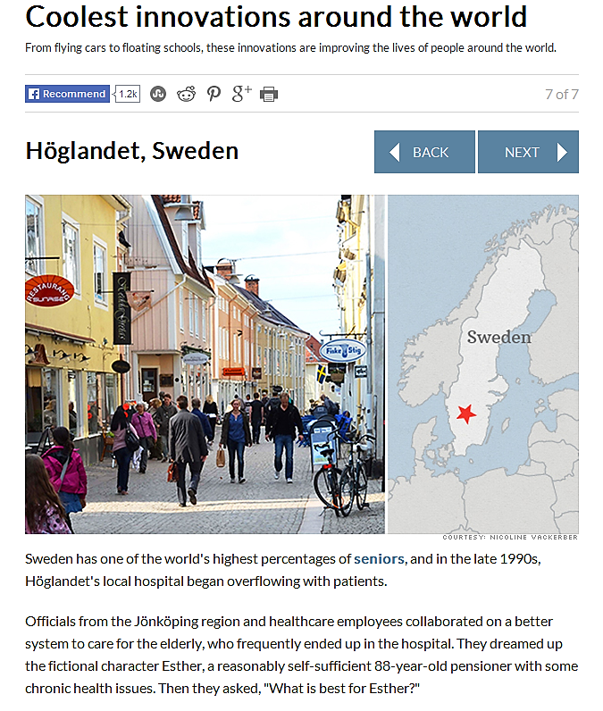
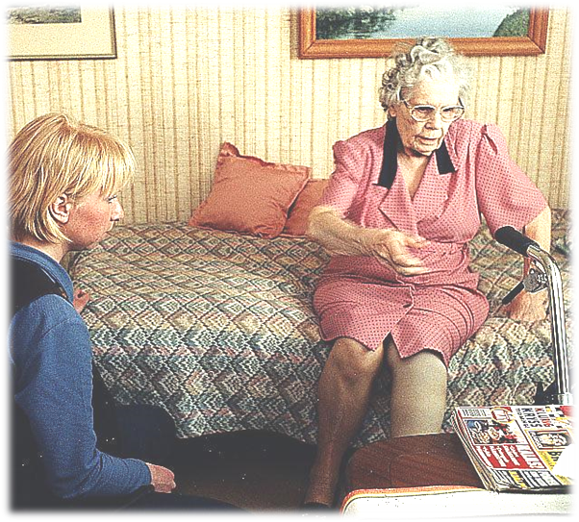
What Is Best For Esther?
Sweden has one of the world’s highest percentages of seniors, and in the late 1990s Höglandet’s local hospital began overflowing with patients.
Officials from the Jönköping region and healthcare employees collaborated on a better system to care for the elderly, who frequently ended up in the hospital.
They dreamed up their fictional character Esther, a reasonably self-sufficient 88-year-old pensioner with some chronic health issues. Then they asked, ”What is best for Esther?”
Notes:
13.00

Slide 15
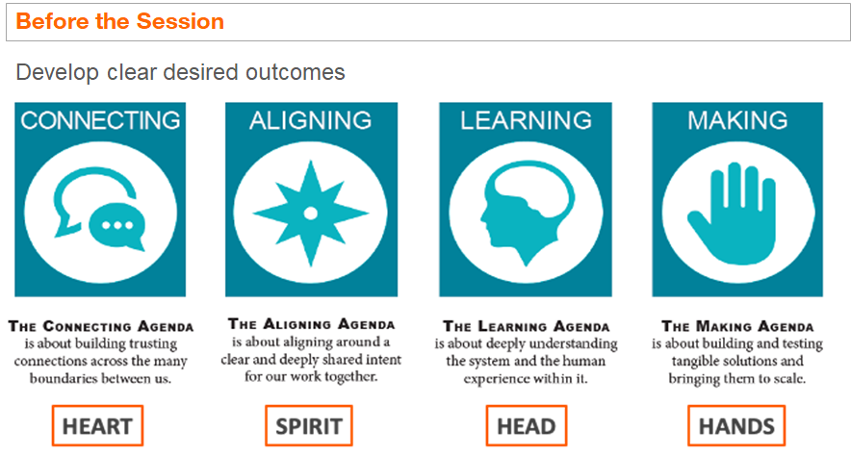
Example ADE: co-creating a learning and improvement system
The aims:
To bring together people from across our system who share our goals for health improvement in order to build a community and co-create a better future
Acknowledge the existing strengths and assets within our system for learning and improvement and connect them up
To enable learning, individually and collectively, based on evidence and our experiences
To come up with practical solutions to our biggest challenges so we are stronger, more effective and better connected than ever before and can move forward together.
Link: cutt.ly/ZZQwFWa or https://cutt.ly/ZZQwFWa

Slide 16
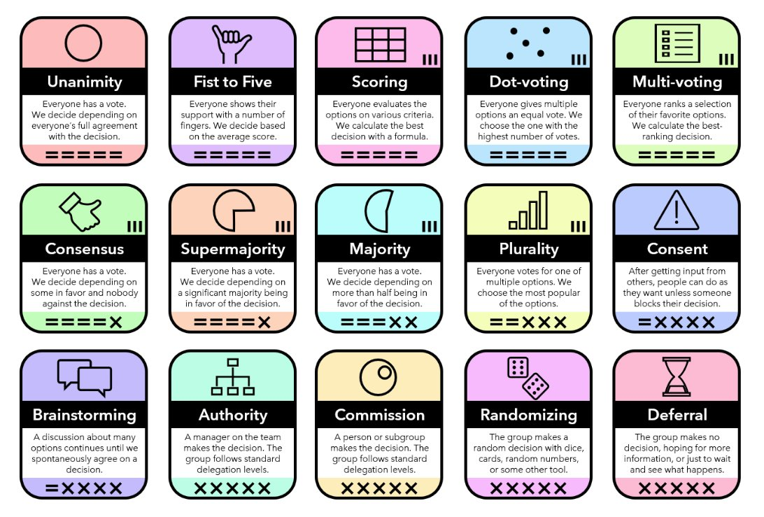
Decision methods
unfix.circle.so/c/downloads/decision-methods

Slide 17
Think two steps down…
Years
Months
Weeks
Days
Hours
Mins
If your goal in the next one month is x, what can you do in the next one day?
To achieve y in four weeks, what can you do in the next four hours?
Source: Paul Plsek

Slide 18
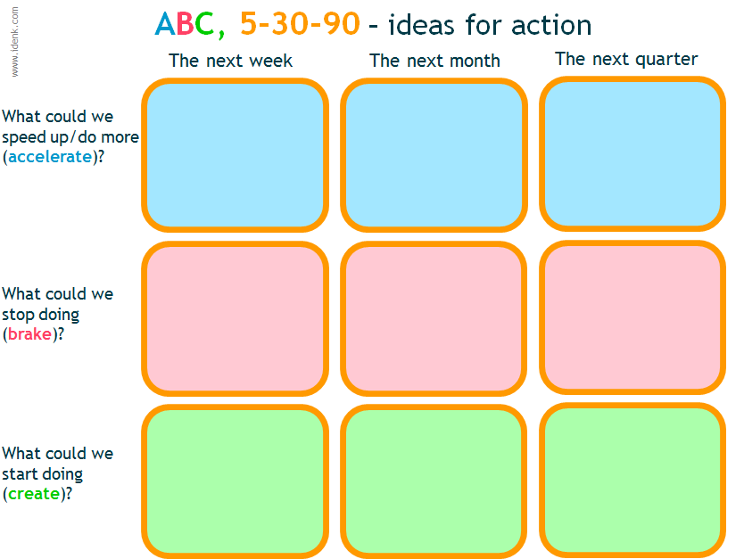

Slide 19
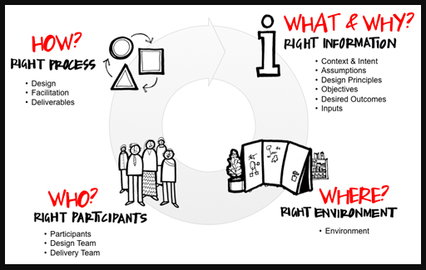
90% of the success is in the planning
Source: MG Taylor

Slide 20
for an ADE
Co-designed
Facilitated
Dynamic
Adaptive
Connective
Playful
Iterative
Integrative
Collaborative
Self-organising
Emergent
Source: The Value Web/ MG Taylor

Slide 21
Factors in designing an accelerated design event
A
D
E
Source: Value Web based on principles of MG Taylor

Slide 22
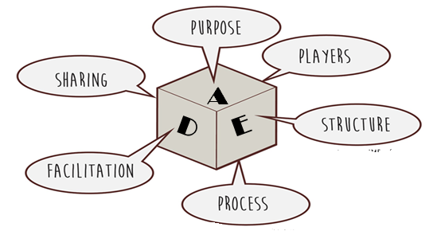
PURPOSE: what change are we trying to make?
What are the aims of the accelerated design event?
What are the objectives and givens?
Who will this serve?
What value will it provide?
What impact do we hope to achieve?

Slide 23
PLAYERS: Who do we need to make the change?
Which contributors should be invited?
to the event
to the design team
To the work post the event
How do we underpin the ADE with co-production?
How do we build diversity into the process?
How do we build a sense of community and belonging?

Slide 24
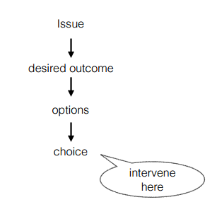
Mark Jaben on the science behind resistance
What NOT to do
Engage people here
But what we do do

Slide 25
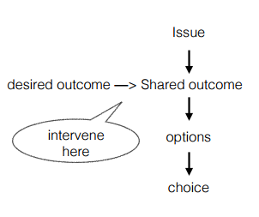
Mark Jaben on the science behind resistance to change
What NOT to do
(but what we usually do)
What TO do
Engage people here
Engage people here
We don’t need buyers (who “buy-in” to change)
We need investors

Slide 26
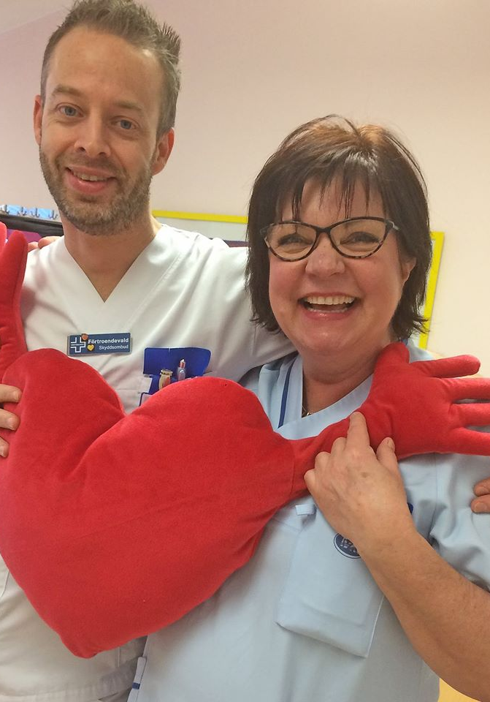
Co aching
Co learning
Co llaborating
Co creating
Co designing
Co producing
Co nnectivity
Together it develops a sense of belonging and community

Slide 27
STRUCTURE: What time, place and planning do we need to support the people towards their purpose?
When will the event happen?
What is its appropriate duration?
How will the venue be configured and organised?
What inputs must be prepared? By whom and when?

Slide 28
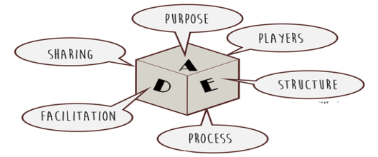
PROCESS: What sequence of interactions will help them achieve their purpose?
What combination of learning modalities (listening, seeing, touching, moving, reflecting) will be most effective and engaging?
Which activities can enable the experience we want to create? How should they be sequenced?
Who are the contributors we need for each activity (facilitator, moderator, panellists, discussion leaders)?
What are the key activities and tasks before the event starts?

Slide 29
FACILITATION: How does the group need to be supported in their work?
What facilitation approach do we need before, during and after the event?
What are the different roles and rules of engagement for the facilitators?
How will the facilitators make visible what needs to be seen?
How will the facilitators manage the event’s energy, environment, technology, inputs, and sharing of outputs?

Slide 30
SHARING: How should the results of the work be reintroduced into the larger system?
How will the team organise to document and share the output after the event?
What deliverables will we produce and with whom will we share them?
Will we use social media and have a hashtag?
How will we use sharing to advance the purpose of the event?

Slide 31
Framework for an accelerated design event
Understand everything that has happened to date
Understand the opportunity to improve things
Create a level starting point for change
Imagine a different future
Think the unthinkable
Identify and test ideas
Narrow down options
Find creative solutions
Uncover and remove barriers to change
Build shared purpose around intention to act
Make definitive decisions
Establish action plans
Agree review process

Slide 32
Roles in accelerated design
At the event:
Facilitator or facilitators
Flow team member
Event director
Writer
Prior to the event
Design team member
Programme manager

Slide 33
Design Team
Up to 15 people
A cross-section of those taking part
Diverse group to co-create the day
4 virtual meetings before the event
1 virtual meeting after the event

Slide 34
Roles in accelerated design
Facilitator | The person who holds the day together, leads the overall process and makes sure that outcomes are achieved
Event Director | Manages all the logistics on the day, organising the practical arrangements, the people and the operations.
Flow team | Make sure that everything that should happen does happen on time, keep the pace of the event, collects outputs& group work for the writers to capture.
Writers | Capture all the outputs of the day (in multi-media) and create a report in real time so that it can be circulated to attendees ideally within 24 hours

Slide 35
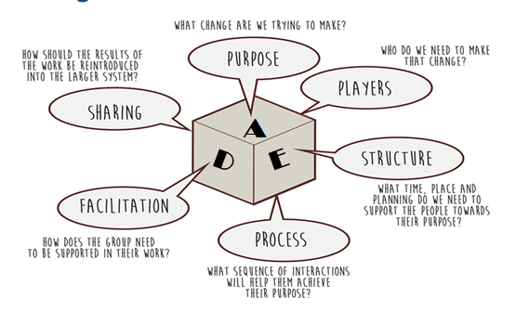
Quick discussion
Think about each of the six elements for the topic you bought with you today
Particularly think about the purpose

Slide 36
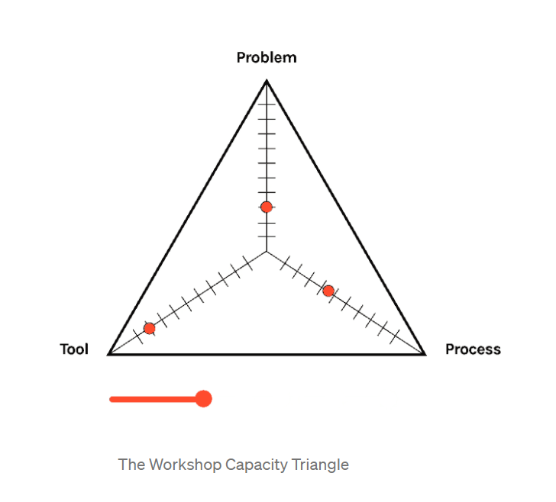
The workshop capacity triangle
What people in the workshop are trying to process at the same time
Problem: the reason we are having the workshop; the issue or problem we want to solve (or opportunity we want to grasp)by bringing people together
Process: the design, flow and agenda that the design team or facilitator has crafted to drive towards the problem
Tool: the “mechanics” of the workshop – the tech and tools if it is virtual- breakouts, polls, whiteboards etc; the activities if it is face to face
The primary elements that workshop participants are juggling at any one time

Slide 37
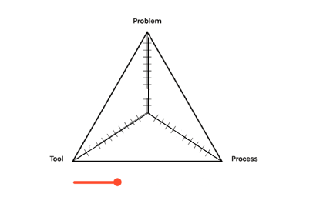
Where are we often focused most?

Slide 38
Where should participants be focused most?

Slide 39
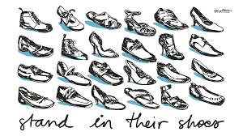
The message
As people who design, facilitate, and support for accelerated design and other events, we need to think critically about how we position our participants for success.
We need to maximise the people, rather than maximise the tools or the tech!

Slide 40
Part B: Create an agenda for a one day event for your topic based on:
Understand everything that has happened to date
Understand the opportunity to improve things
Create a level starting point for change
Imagine a different future
Identify and test ideas
Narrow down options
Find creative solutions
Uncover and remove barriers to change
Build shared purpose around intention to act
Make definitive decisions
Establish action plans
Agree review process

Slide 41
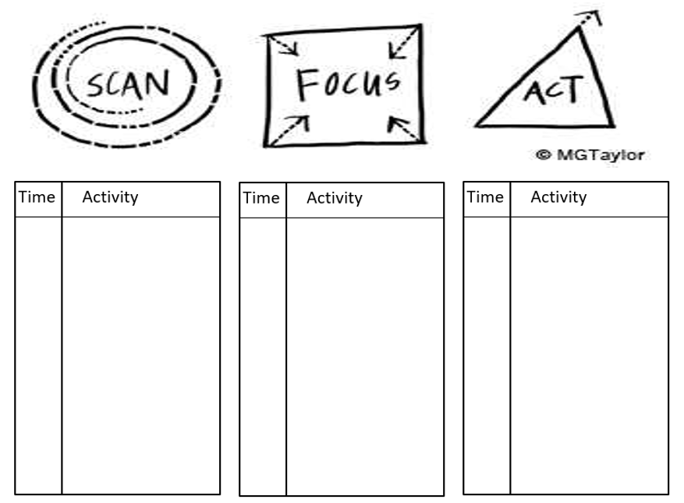
Part B: Create an agenda for a one day event for your topic
On SessionLab:
OR on paper
https://www.sessionlab.com/?inv=kqFR6O4U8czo-eUHAT9eyw
Example on SessionLab:
cutt.ly/QZQowL7 or https://cutt.ly/QZQowL7

Slide 42
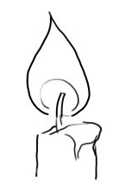
[In designing an event], are you lighting a candle or filling a bucket?
Beth Tener

Slide 43
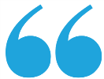
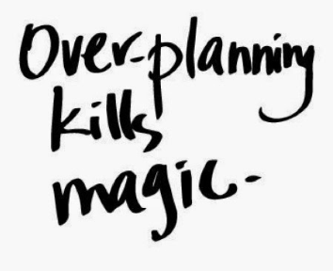
Planned change AND emergence
The minute too much process is imposed, you lose the magic and power of building a movement.
Reid Carpenter

Slide 44
Knowing that workshops
exist to bring the right people to the
same place to solve one problem means that everyone needs to be on the same playing field, that all voices be heard, and that participants focus on the problems and potential solutions
medium.com/ideas-by-crema/the-dangers-of-virtual-workshops-and-the-framework-that-makes-them-exceptional-f611761fabb6
Justin Mertes

