Slide 1
A Pathway to Pae Ora
The importance of engaging with Māori to achieve healthy futures
John Whaanga
Deputy Director-General, Māori Health
PHOTO COURTESY OF NGĀTI WHĀTUA ŌRĀKEI

Slide 2
Overview
The current climate
Te Tiriti o Waitangi
Present examples of partnership with Māori
The future of partnership with Māori

Slide 3
Current state of Māori health and wellbeing
Improvements for Māori across some health outcomes, including life expectancy, childhood mortality, and infectious diseases.
However, significant inequities remain between the health of Māori and the health of other New Zealanders.
Inequities are complex (broader determinants of health, differential access to and quality of services). This includes dealing with intergenerational inequities.
The case for urgent change and the need to do more is clear…

Slide 4
Te Tiriti o Waitangi
As a department of the public service, we have a responsibility to contribute to the Crown meeting its obligations under Te Tiriti o Waitangi.
To enact this, the Ministry of Health has revised and updated its own Te Tiriti o Waitangi and equity position statement.
The text of Te Tiriti, including the preamble and the three articles, along with the Ritenga Māori declaration, are the enduring foundation of our approach.
The principles of Te Tiriti guide the application of our approach.

Slide 6
Implementing Te Tiriti o Waitangi

Slide 7
Our mana expressions of Te Tiriti
We will strive to achieve the following four goals:
Mana Whakahaere
Mana Motuhake
Mana Tangata
Mana Māori

Slide 8
Taking a community engagement approach to develop Whakamaua: Māori Health Action Plan

Slide 9
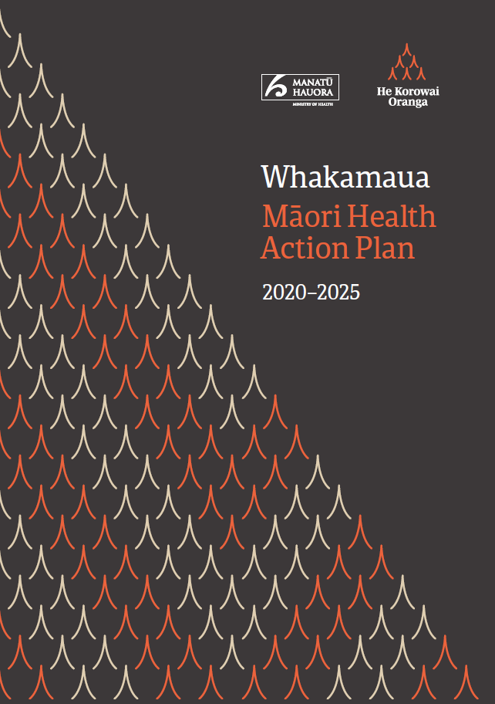
Whakamaua: Māori Health Action Plan 2020-2025
Whakamaua guides the Ministry, the whole health and disability system, and government to give effect to He Korowai Oranga.
It is a living document expected to evolve in collaboration with stakeholders and future Government priorities/reviews.
Well aligned with the direction of the Health and Disability System Review.
Whakamaua means ‘to secure, to grasp, to take hold of, to wear’. It’s also widely associated with the whakataukī used in this plan.
‘Ko te pae tawhiti, whāia kia tata. Ko te pae tata, whakamaua kia tīna – Seek out the distant horizons, while cherishing those achievements at hand.’

Slide 10
July 2020
Launch of Whakamaua
Whatua – Summary Report published as companion document
Developing Whakamaua
February – July 2020
Response to COVID-19
Adjustments to draft action plan to reflect new context
Discussion document built on stocktake of existing feedback from previous engagement.
January - February 2020
Draft action plan tested with key stakeholders
Expert Advisory Group (EAG) made up of Māori academics and researchers, health professionals, and iwi, disability and rangatahi leaders.
September – December 2019
Analysis of engagement feedback – draft summary report
Begin drafting action plan
Pivoted during COVID-19 to lead Māori health response.
August 2019
Four health and disability wānanga
Online survey and written submissions
Ongoing engagement with individual stakeholders
Iterative and collaborative process.
July 2019
Established Expert Advisory Group (EAG)
Established cross-agency group
June 2019
Development of engagement approach and discussion document

Slide 11
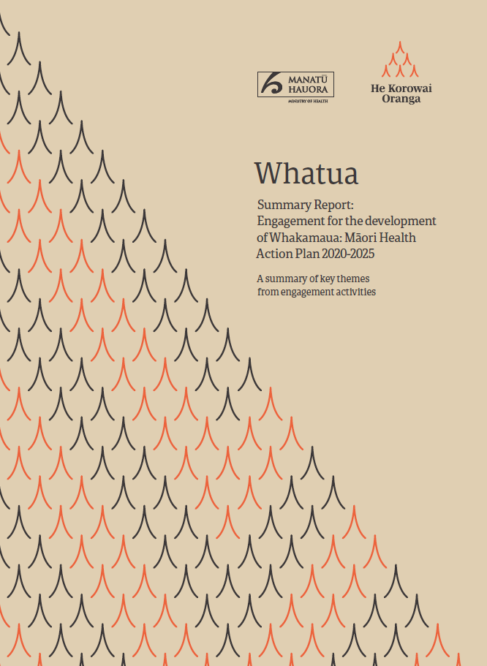
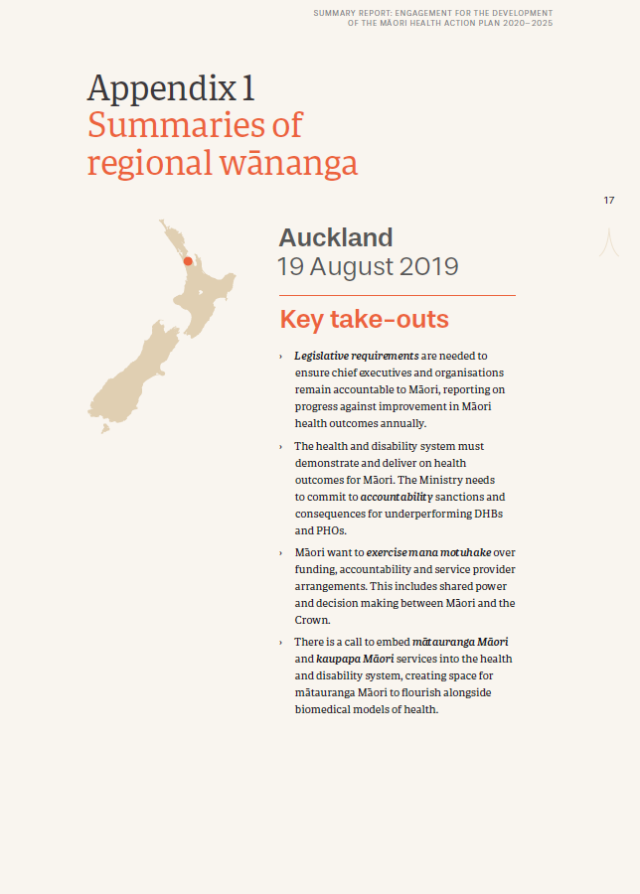
Whatua – Ensuring māori are informing the design of Whakamaua
Whatua means ‘to weave’ or ‘knit’.
Whatua is the summary report that highlights the engagement with Maori that informed the development of Whakamaua.
Although the views expressed across engagement varied widely, there were a number of key themes.
Whatua - Summary Report provides detailed overview of these key themes.
It emphasises the voice of people by focusing on their own words to highlight issues and opportunities.
Also provides the foundation of insights on which Whakamaua was developed.

Slide 12
Whakamaua engagement
Whakamaua has become an engagement mechanism.
We have used Whakamaua to engage with professional groups, providers and iwi across the country.
Whakamaua is a living document, we will continue to add to it.

Slide 13
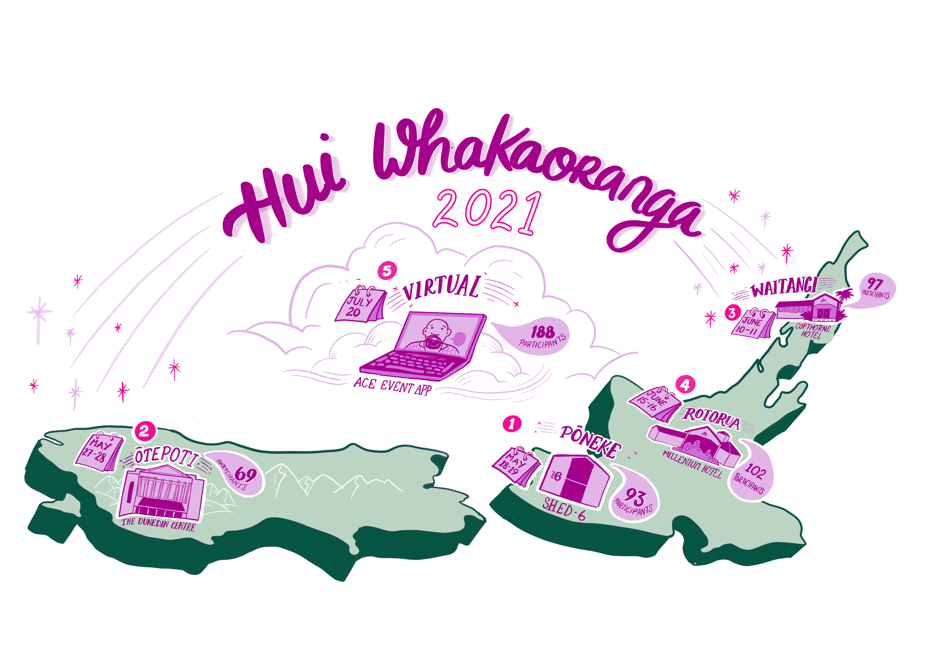
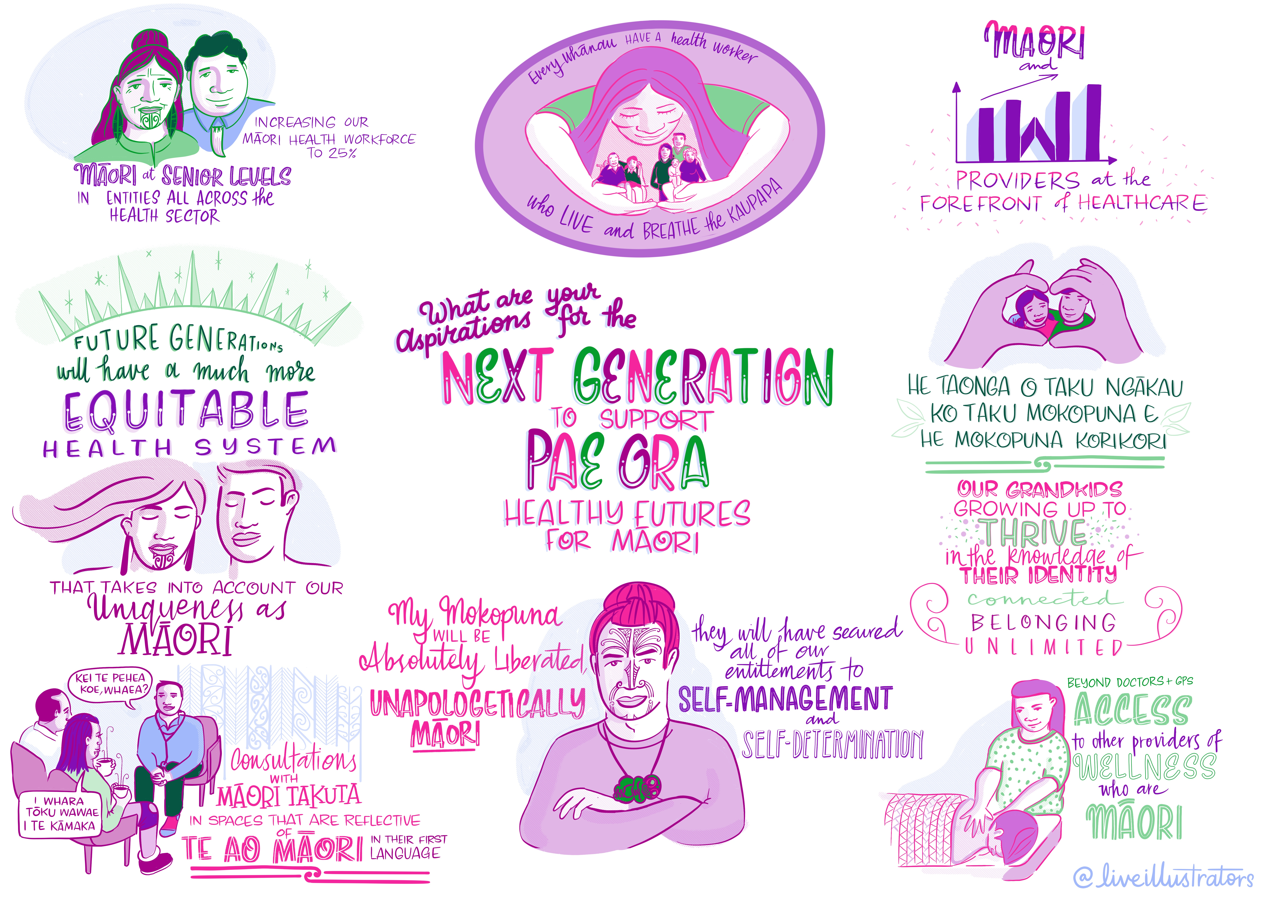
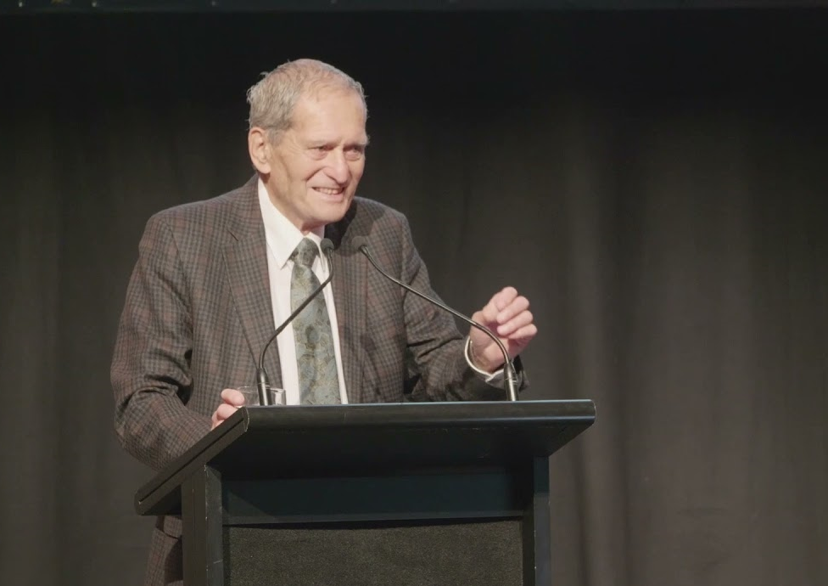
Hui Whakaoranga 2021

Slide 14
The future of Māori Health:
Pae Ora (Healthy Futures) Act 2022
The Pae Ora (Healthy Futures) Act includes provisions which:
Explicitly promote hauora Māori and a commitment to Māori health equity;
Promote Te Tiriti o Waitangi;
Establish and build meaningful Māori-Crown partnerships at all levels of the system;
Enable Māori voices that are driven from the ground up, through Iwi Māori Partnership Boards, and firmly embedded into local and regional priorities, plans and the commissioning of services.
. . . We have stronger provisions and levers for enabling and engaging with Māori to drive the future of hauora Māori.

Slide 15
Future engagement with Māori
Iwi Māori Partnership Boards
Advisory Groups
Whānau, hapū, iwi and hapori
Future Hui Whakaoranga
Professional groups
Māori Providers

Slide 16
Any pātai?
PHOTO COURTESY OF NGĀTI WHĀTUA ŌRĀKEI

