Slide 1
Principles for building community and engagement for large scale improvement

Slide 2
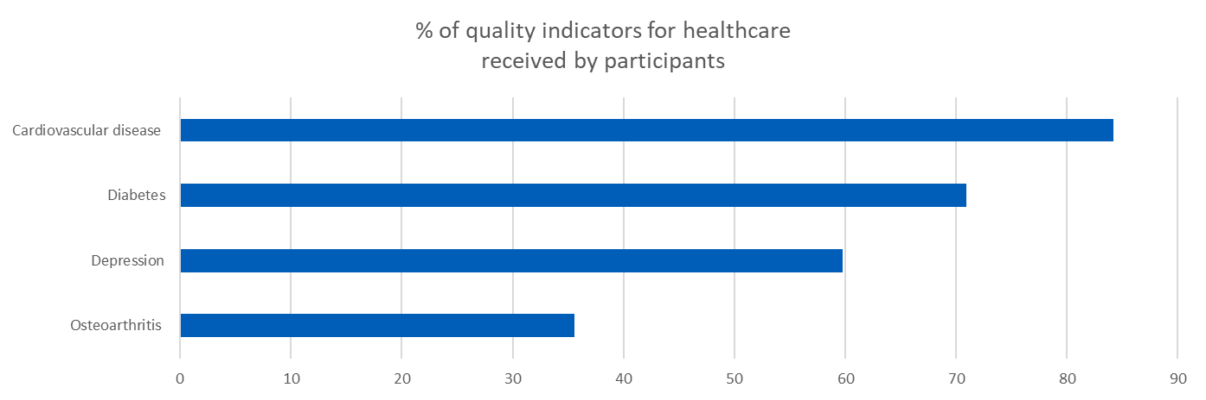


The challenge in numbers
% of quality indicators for healthcare received by participants
Cardiovascular disease
Hardcastle, A.C. et al. The dynamics of quality: a national panel study of evidence-based standards 2015
Diabetes
Depression
Osteoarthritis
0 10 20 30 400 50 60 70 80 90
Healthcare represents a paradox. While change is everywhere, performance has flatlined: 60% of care on average is in line with evidence- or consensus-based guidelines, 30% is some form of waste or of low value, and 10% is harm. The 60-30-10 challenge has persisted for three decades.
Despite impressive gains, notable shortcomings
persist in normalising consistent, high-value, person-centered care. What is primarily missing is not progress in measurement, but progress in results. Changes in culture, investment, leadership, and even the distribution of power are even more important than measurement alone”
D’Avena A, Agrawal S, Kizer KW, et al.: Normalising High-Value Care: Findings of the National Quality Task Force. 2020
Braithwaite and Glasziou May 2020
Notes:
Braithwaite . Glasziou https://bmcmedicine.biomedcentral.com/articles/10.1186/s12916-020-01563-4
Hardcastle, A.C. et al. The dynamics of quality: a national panel study of evidence-based standards. Health Services and Delivery Research. 3(11) April 2015

Slide 3
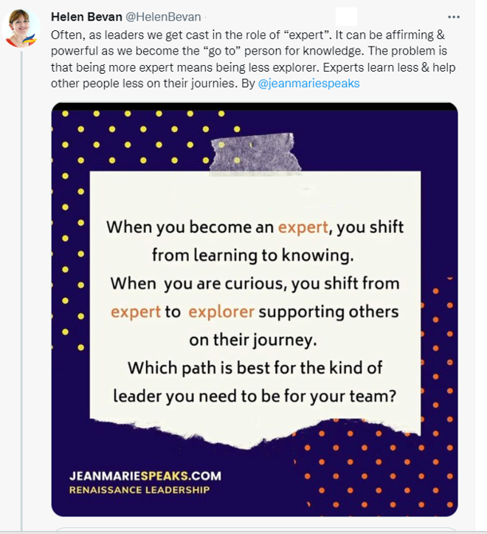
We need to shift from “expert” to “explorer”
Ako: we both teach and learn
Wānanga: learning together

Slide 4
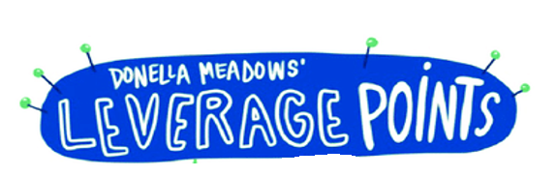
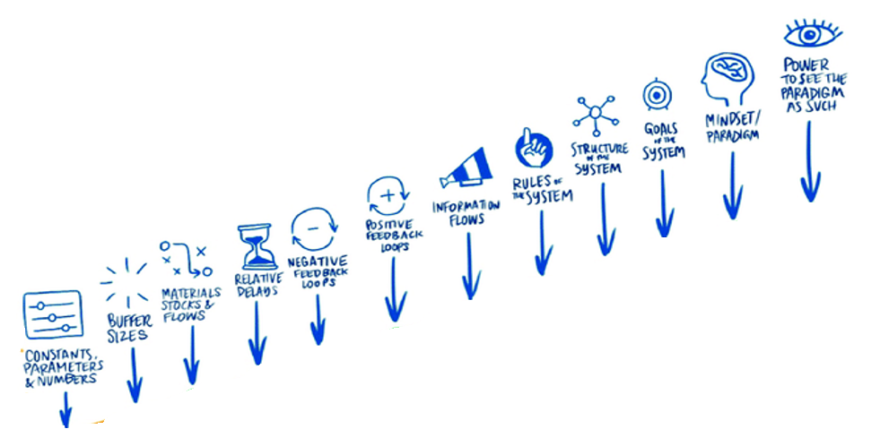
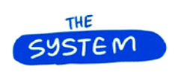



The most powerful intervention is to shift the paradigm
Places to intervene in a system
1
2
3
4
CHANGE THE PARADIGM OR MENTAL MODEL
5
6
CHANGE THE SOCIAL SYSTEM
7
8
9
10
CHANGE PATTERNS/FLOWS OF INFORMATION & BEHAVIOUR
11
Levers in ascending order of effectiveness
12
Source: adapted from
CHANGE THE PROCESS
Via Sasha Karakusevic

Slide 5

Paradigm: A set of assumptions, concepts, values, and practices that constitutes a way of viewing reality (a worldview) for the community that shares them

Slide 6

Quality 3.0 in health and care improvement
Quality 1.0
Quality 2.0
Quality 3.0
Quality 1.0
Thresholds
“How might we establish thresholds for good healthcare service?”
Organisation-wide systems
“How might we use ‘enterprise-wide systems’ for best disease management?”
Coproduction of health
“How might we improve the value of the contribution that healthcare service makes to health?”
Focus:
Logic of making a “service”
Ownership of “health”
Kinship of coproducing people
Integration of multiple knowledge systems
Value-creating system architecture
Focus:
Development of standards
Inspection to assess
Certification
Guidelines
Focus:
Systems, processes
Reliability
Customer-supplier
Performance measurement
A multidimensional quality model: an opportunity for patients, their kin, healthcare providers and professionals to coproduce health. Peter Lachman, Paul Batalden, Kris Vanhaecht 2022 f1000research.com/articles/9-1140

Slide 7



old power
new power
Currency
Held by a few
Pushed down
Commanded
Closed
Transaction
Current
Made by many
Pulled in
Shared
Open
Relationship
Jeremy Heimens, Henry Timms New Power (2018)

Slide 8

What is community?
Community is a group, team, or organisation
where there is high trust, effective communication, equality, respect for differences, and high levels of cooperation. The larger focus of the community is on a vision of the future that can be created together and the actions needed today to get to that future.
Dede Henley

Slide 9
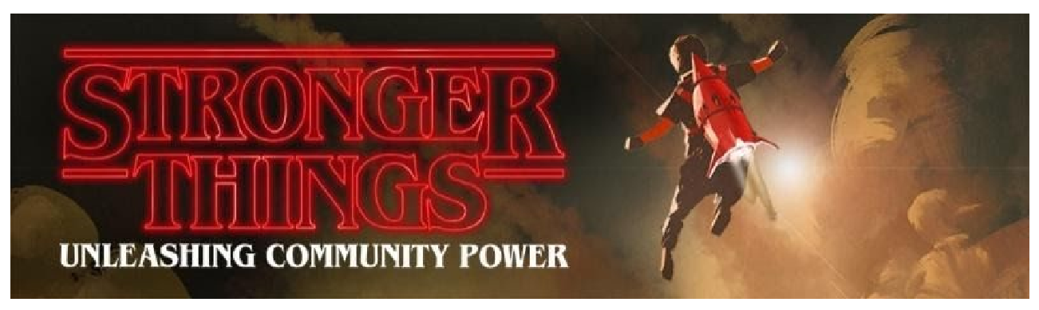

The solution to our most pressing challenges can only be found in our communities
Stronger Things

Slide 10
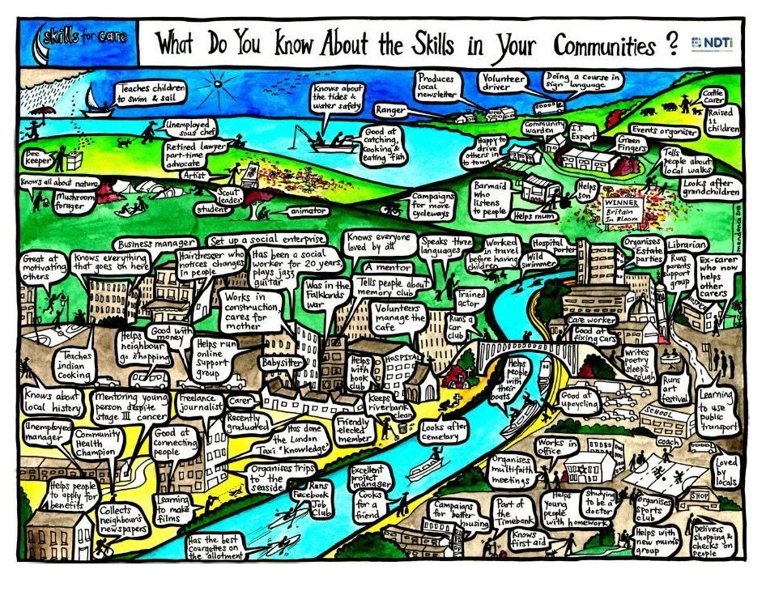

Slide 11

When humans come together and
build authentic relationships, magic happens. A
community exists to allow more magic to happen. It is about
working with real human beings, each with their own story, history,
feelings, hopes and dreams. Ideally the community is as human as the
people in it. We have no way of predicting which relationships will blossom and change the world. Serendipity creates many beautiful
encounters in a community. The ideal community finds
ways to create more serendipitous moments
for its members.
Fabian Pfortmüller, Community Canva

Slide 12

A sense of community
Sense of community is a feeling that members have of belonging, a feeling that members matter to one another and to the group, and a shared faith that members’ needs will be met through their commitment to be together
D McMillan
From Virtual communities for impact https://communitiesforimpact.org/

Slide 13
Four elements to community
A feeling of belonging or membership
Influence: a sense of mattering, of making a difference through the group and of the group mattering to its members.
Reinforcement - the feeling that members’ needs will be met through their membership in the group
Shared emotional connection, through shared purpose and interacting in shared events
David McMillan, David Chavis, Sense of Community: A Definition and Theory

Slide 14
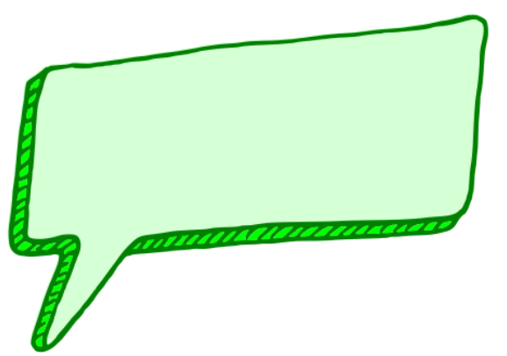
Networks connect;
communities care.
Henry Mintzberg
https://hbr.org/2015/10/we-need-both-networks-and-communities

Slide 15
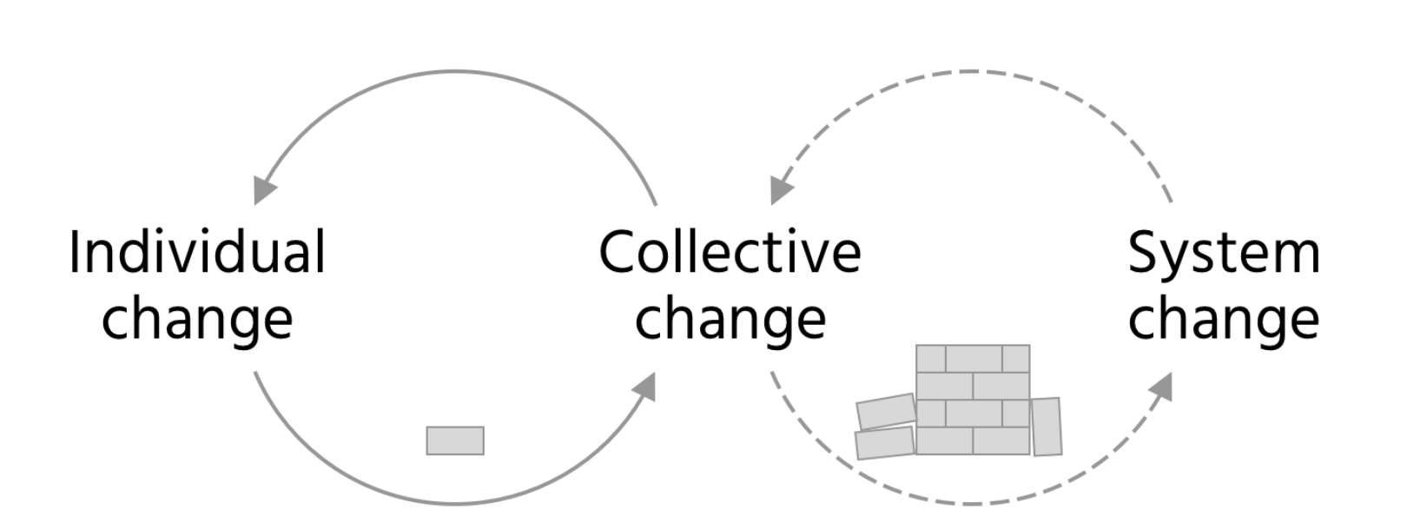
Change is inherently relational: it depends on our ability to work with others to enable it to happen.
In a system.
Helen Bevan and Goran Henriks
“

Slide 16
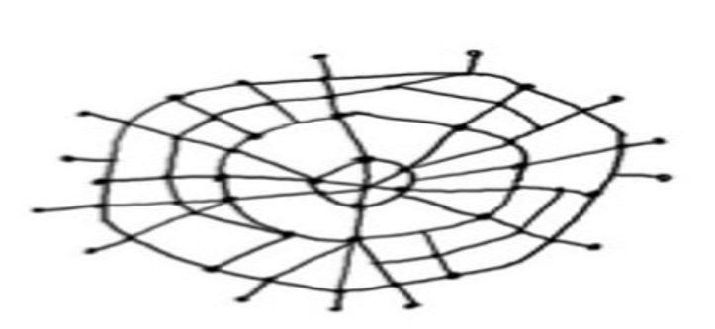
Spread of change happens more through relationships and building of community than any other factor
Evaluation of NHS organisations that undertook comparable improvement initiatives with vastly different outcomes
The difference? The level of social connections between those working to lead improvement
Source: Nicola Burgess, Warwick Business School, evaluation of the partnership between the NHS and Virginia Mason Institute

Slide 17
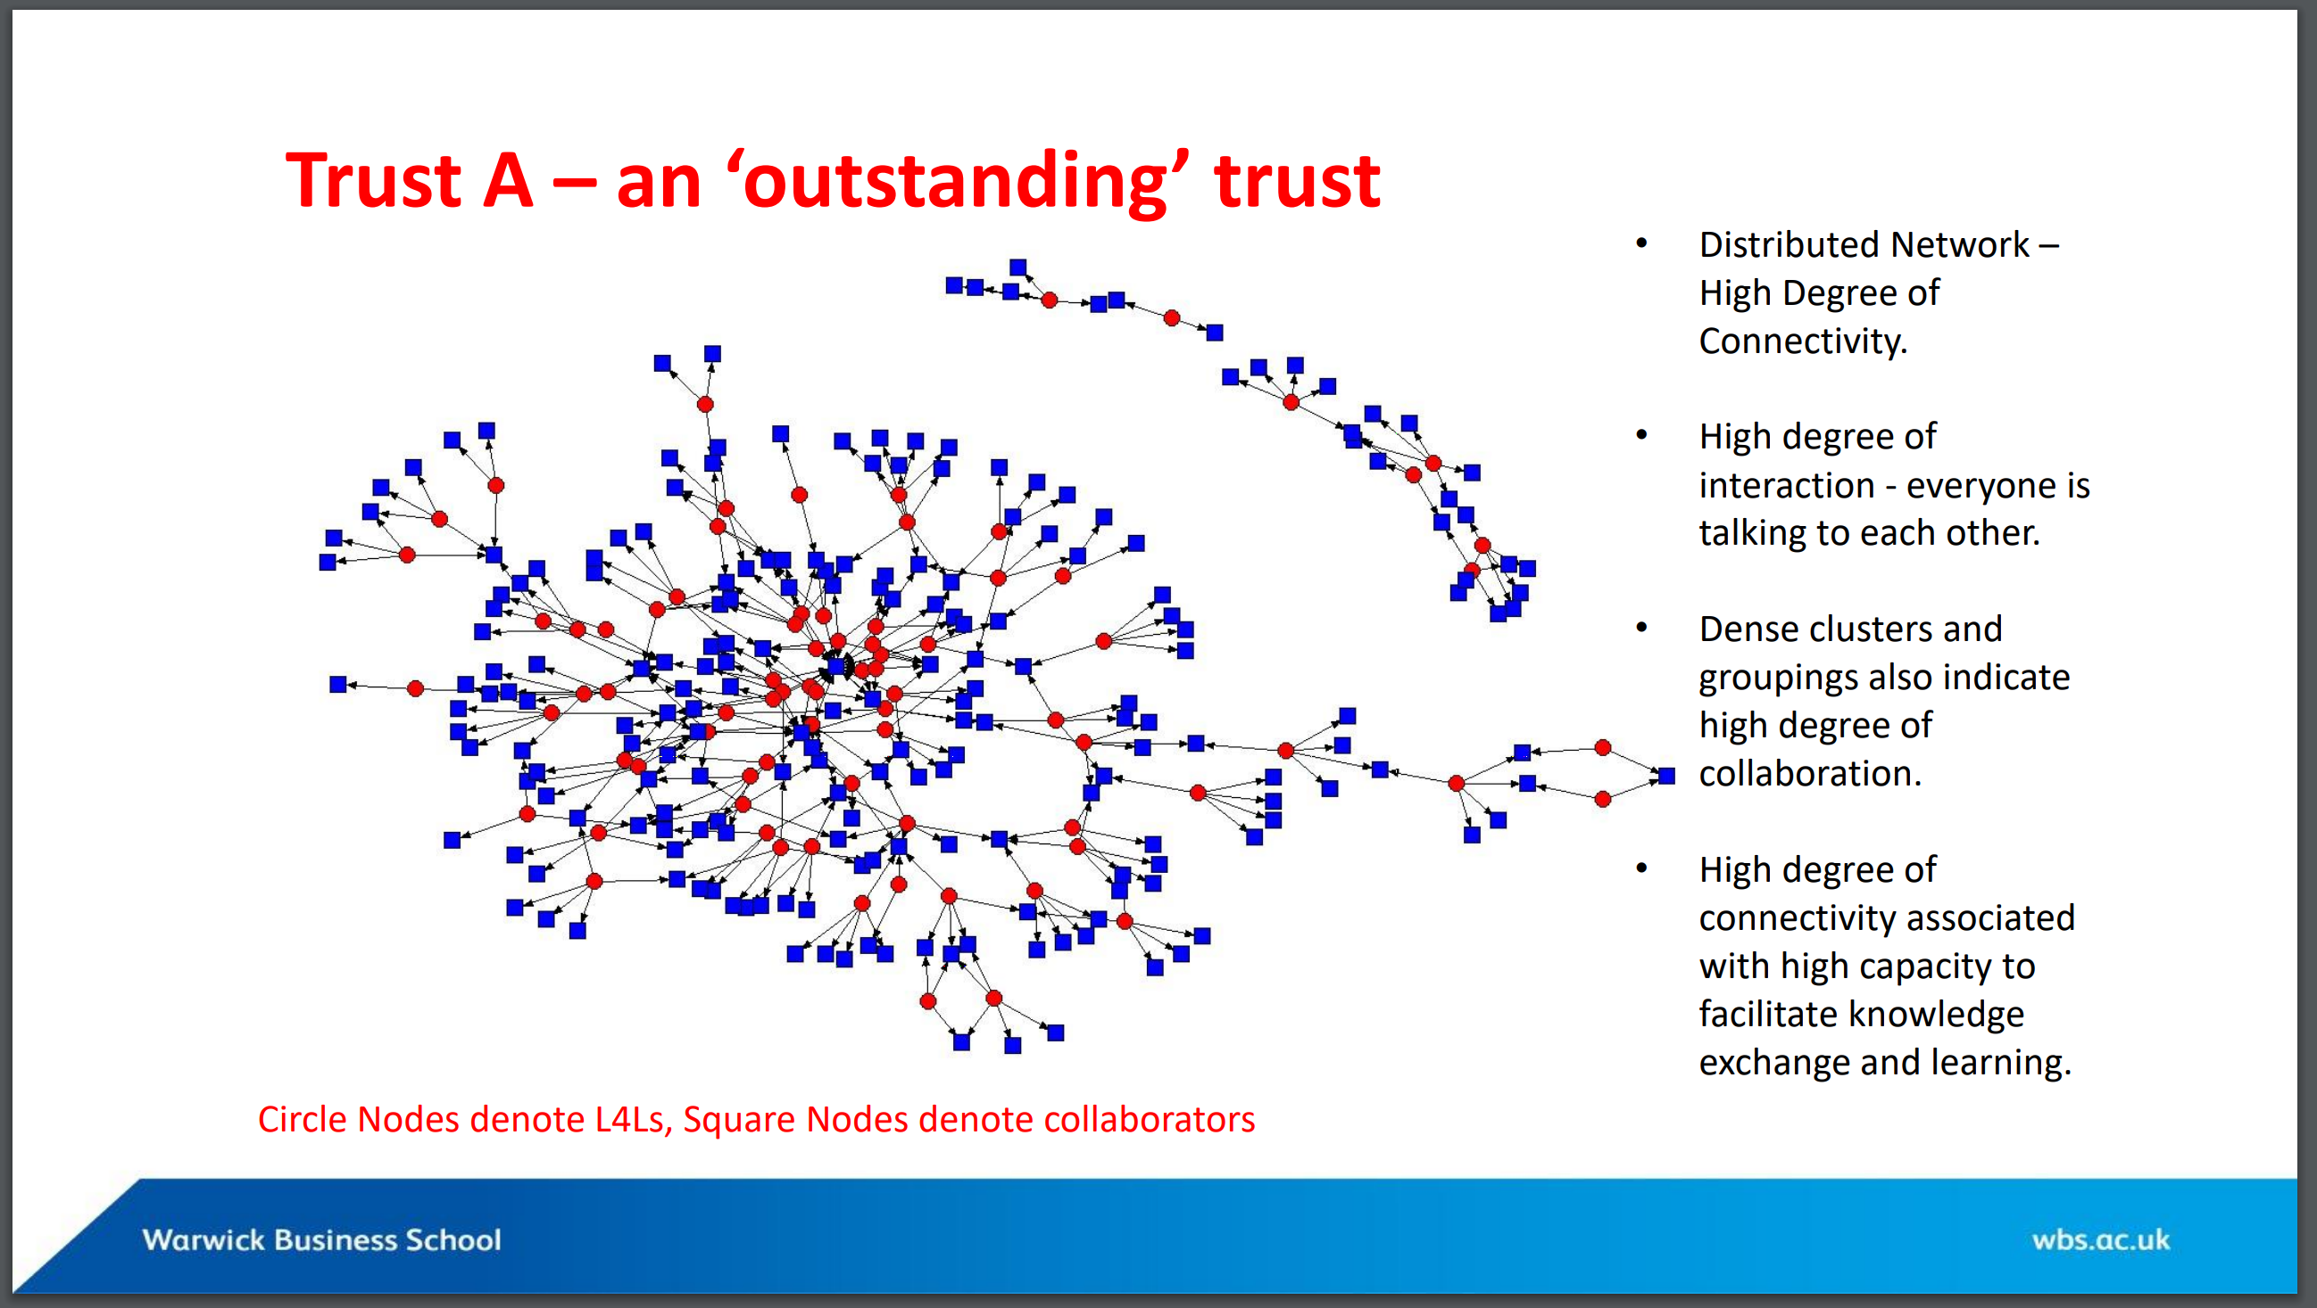
A distributed network with a high degree of connectivity
High degree of interaction – everyone is talking to one another
Dense clusters and groupings also indicate a high degree of collaboration
High degree of connectivity associated with high capacity to facilitate knowledge exchange and learning
Organisation A: “Outstanding”
Source: Nicola Burgess, WBS

Slide 18
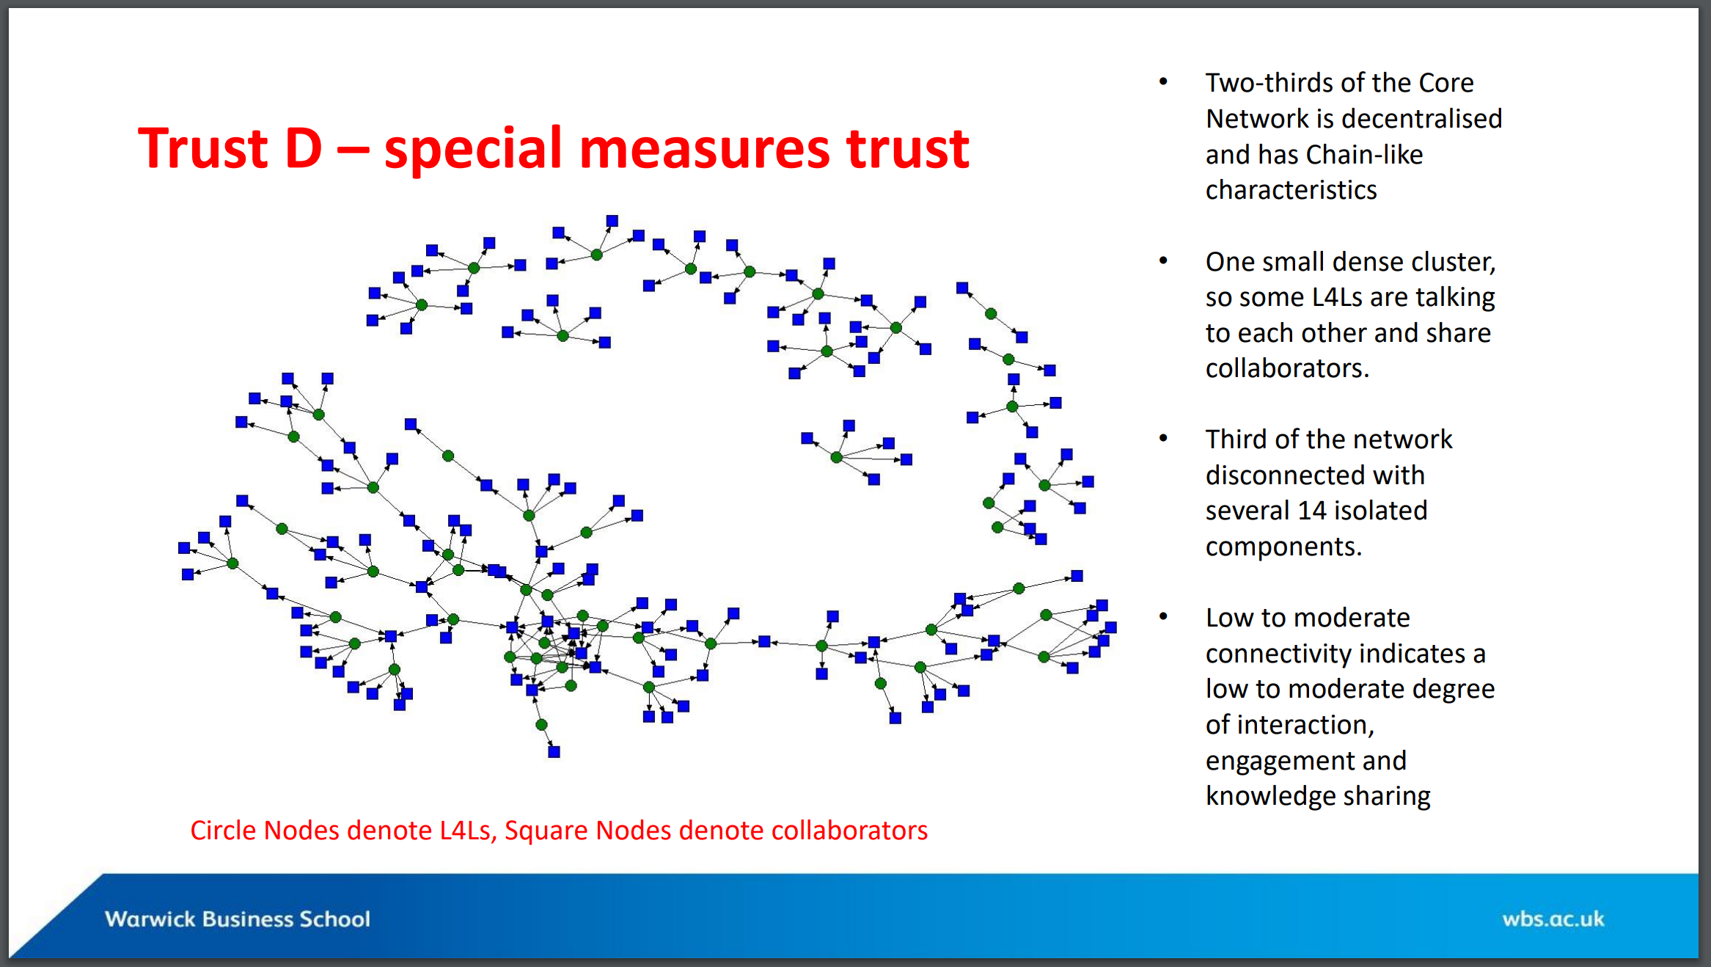
Organisation D: “Special measures”
Two thirds of the core network is decentralised and has chain-like characteristics
Only one small dense cluster
A third of the network is disconnected with isolated components
Low to moderate connectivity indicates low/moderate capacity to facilitate knowledge exchange and learning
Source: Nicola Burgess, WBS

Slide 19

Building a sense of belonging is one of the most critical tasks in leading change
.
Our most recent research into the successful leadership of large-scale complex change, pinpointed a vital ingredient omnipresent in all human systems: our fundamental need to belong – to feel secure, included and part of something significant. If you feel you belong, loyalty follows, and with that the permission for risk-taking and innovation.
Deborah Rowland and Paul Pivcevic
Leading change post pandemic: belonging
https://blogs.lse.ac.uk/businessreview/2022/04/08/leading-change-post-pandemic/

Slide 20
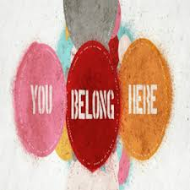
Building belonging:
a critical task for leaders of improvement
How are you creating a sense of belonging so that everyone is seen and valued for our own unique and authentic selves?
Belonging counts more than diversity (the facts) or inclusion (a choice)
When we feel we belong, we thrive, and so do the people around us.
Anita Sands https://anitasands.medium.com/diversity-and-inclusion-arent-what-matter-belonging-is-what-counts-4a75bf6565b5

Slide 21
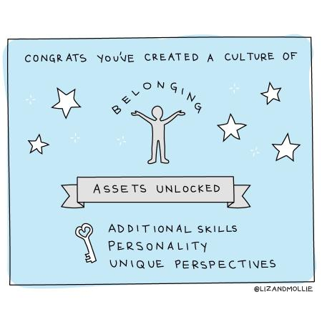
Belonging
A feeling of being accepted, included, respected, listened to and fully involved by those around you: in the team, organisation, improvement initiative, family, network or community

Slide 22
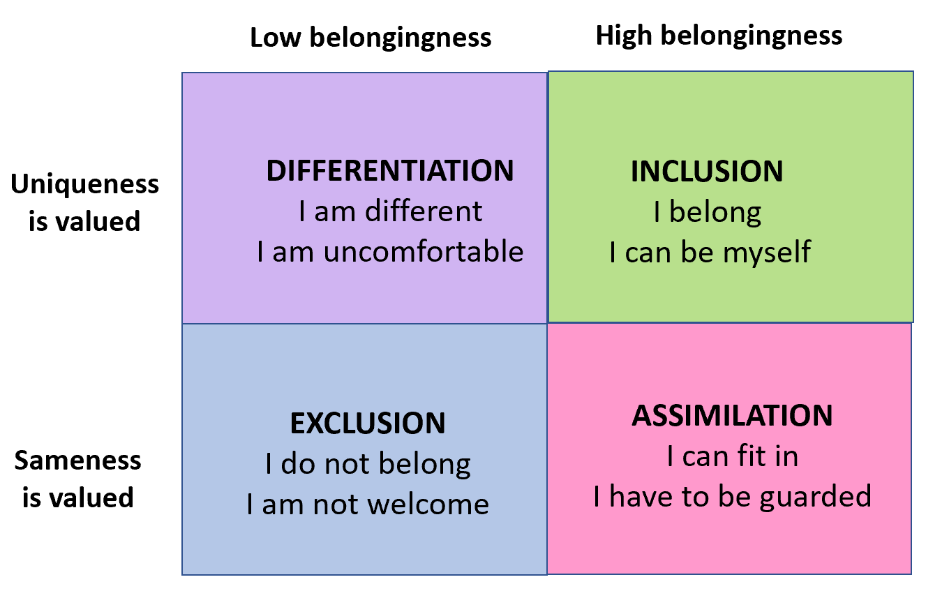
Belonging: aim for the top right box
Sources: Inclusion and Diversity in Work Groups: A Review and Model for Future Research (2010) Lynn Shore and colleagues and Why belonging is such a big issue in business today (2020) Josh Bersin

Slide 23
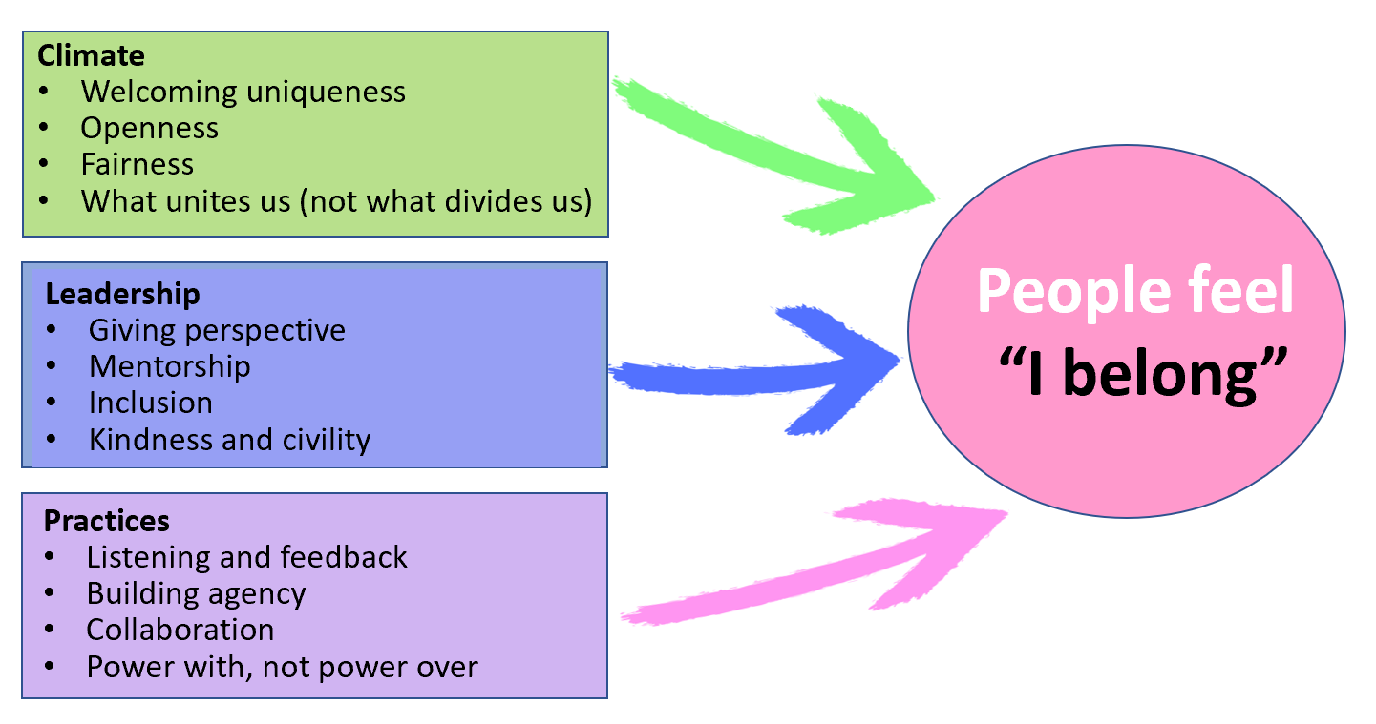
How do we build belonging?
Based on Why belonging is such a big issue in business today (2020) Josh Bersin, with additional content, including from The value of belonging at work (2020) BetterUp

Slide 24
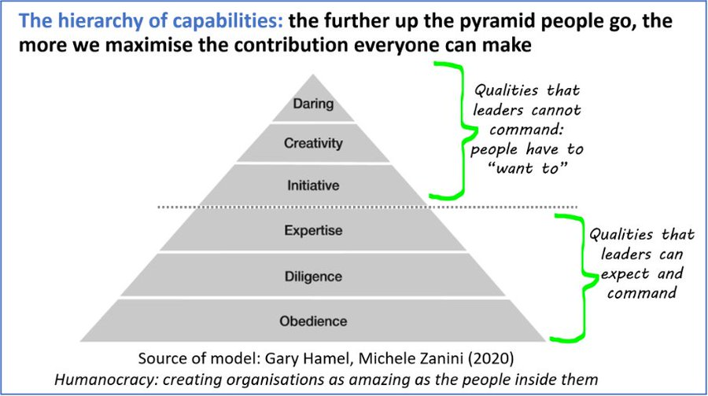

Slide 25
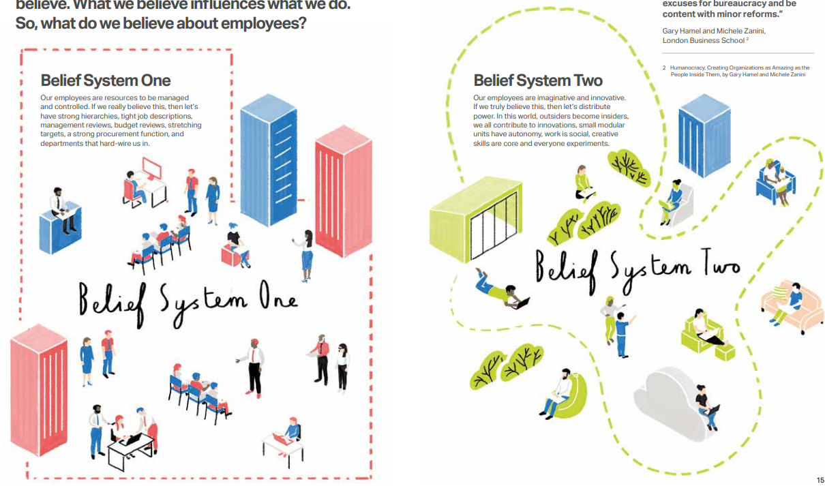
What’s our prevalent belief system?
Belief system one
The people in our teams are resources to be managed and controlled. If we really believe this then let's have strong hierarchies, tight job descriptions, management reviews, budget reviews, stretching targets, a strong procurement function, and departments that hard-wire us in.
Belief system two
The people in our teams are imaginative and innovative. If we truly believe this then let's distribute power. In the world, outsiders become insiders, we all contribute to innovations, small teams have autonomy, work is social, creative skills are core and everyone experiments.
Source:
www.landmarkspace.co.uk/wp-content/uploads/2021/03/2908_The_Human_Organisation_r1.pdf

Slide 27







Ten principles for building a healthy community by Margaret Wheatley
People support what they create
People act responsibly when they care
Conversation is the way human beings have always thought
To change the conversation, change who is in it
Expect leaders to come from anywhere
Focusing on what is working gives us energy and creativity
The wisdom resides within us
Everything is a failure in the middle
Humans can handle anything as long as we’re together
Generosity, forgiveness and love: these are the most important elements in a community
Source of graphic: adapted from WordPress
https://medium.com/together-institute/10-principles-for-healthy-communities-by-meg-wheatley-6466fe1d070d
@HelenBevanTweet a year of Twitter slides 2021 May 2nd

Slide 28
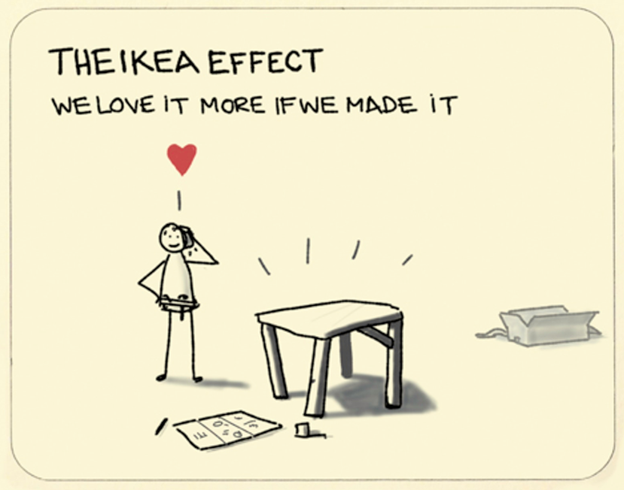
Source: Sketchplanations https://sketchplanations.com/the-ikea-effect

Slide 29
Ten principles for building a healthy community by Margaret Wheatley
People support what they create
People act responsibly when they care
Conversation is the way human beings have always thought
To change the conversation, change who is in it
Expect leaders to come from anywhere
Focusing on what is working gives us energy and creativity
The wisdom resides within us
Everything is a failure in the middle
Humans can handle anything as long as we’re together
Generosity, forgiveness and love: these are the most important elements in a community
Source of graphic: adapted from WordPress
https://medium.com/together-institute/10-principles-for-healthy-communities-by-meg-wheatley-6466fe1d070d
@HelenBevanTweet a year of Twitter slides 2021 May 2nd

Slide 30
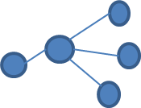


How do we shift our thinking from forecasting to foresight?
FORECASTING
FORESIGHT
Focus on expected future
Identifying a future which is an extension of the present
Estimates what will happen, assuming that past trends will continue to be solid indicators of future happenings
Focus on a range of potential futures
Searching for signs of potential future disruptions at the margins of the current system (“weak signals”)
Expands our thinking about what is possible, helps us determine how we choose to prepare for and shape the future

Slide 31
Nine principles of deliberative engagement
The process will make a difference
The process will be transparent
The process will have integrity
The process will be tailored to the specific context
The process will involve the right number and types of people
The process will treat participants with respect
The process will give priority to participants’ discussions
The process will be continuously reviewed and evaluated to improve future events in the series and the achievement of outcomes
Participants will be kept informed
Source: Involve UK

Slide 32
Nine principles of deliberative engagement
The process will make a difference
The process will be transparent
The process will have integrity
The process will be tailored to the specific context
The process will involve the right number and types of people
The process will treat participants with respect
The process will give priority to participants’ discussions
The process will be continuously reviewed and evaluated to improve future events in the series and the achievement of outcomes
Participants will be kept informed
Process: 250 people were engaged in a deliberative community over through three deliberative events over a nine month period
Source: Involve UK

Slide 33
Building community and engagement for improvement
Three approaches over the next few days:
Accelerated design approaches for complex problem solving
Crowdsourcing and open innovation approaches to hear many voices
Positive Deviance methodology through community

Slide 34
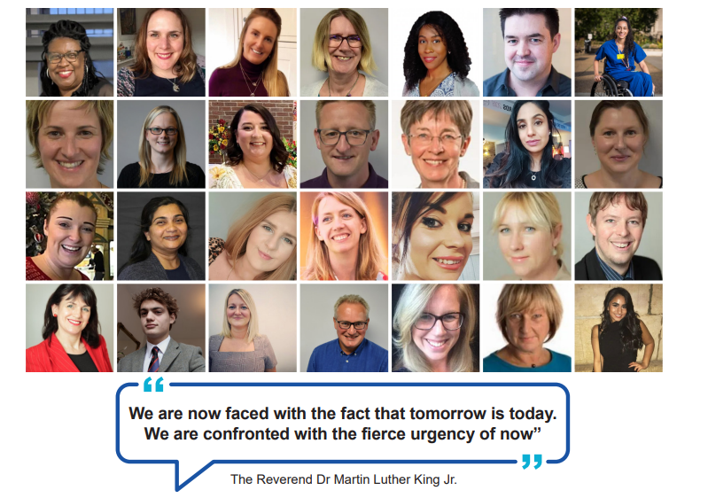
The Horizons NHS team

Slide 35
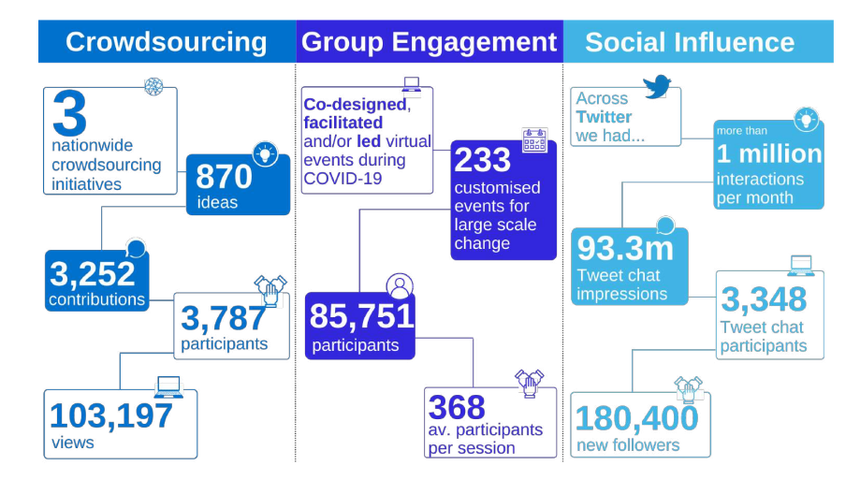
Our reach in a year

Slide 36
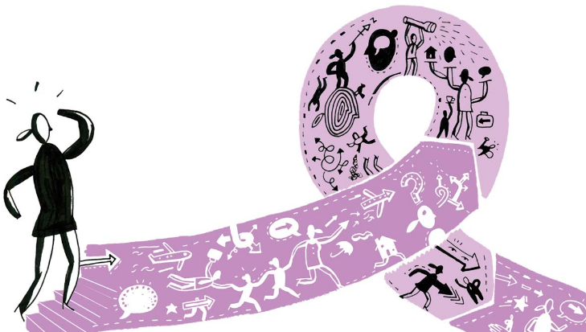
What is accelerated design?
A way to get diverse groups of people collaborating, coming together in community to build alignment and ownership, solve complex problems, drive cultural change and get work done
Usually done through “accelerated design events”, which enable us to do work that would take three or four months using conventional approaches in one or two days
Accelerated design isn’t just a facilitation style – it’s a way of working, thinking, designing solutions and fostering innovation

Slide 37
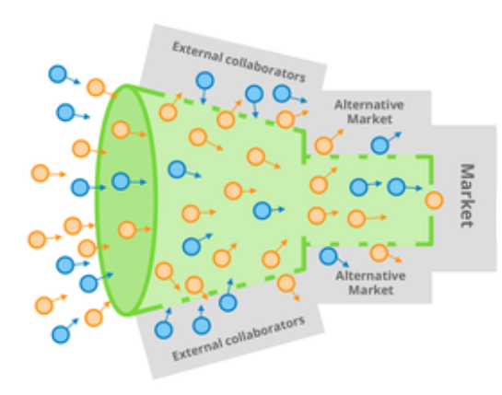
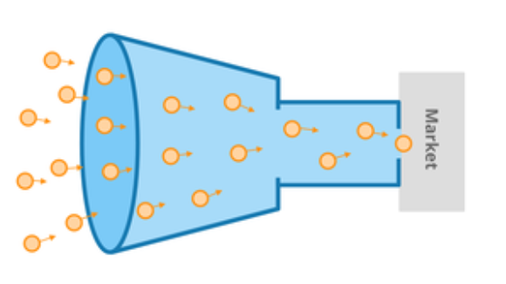
What is crowdsourcing?
The practice of obtaining ideas, solutions or content by getting contributions from a large group of people online. We get large scale engagement by building comunity
Collaborators
The wisdom and experience
of many
Feedback
Small, closed group of “experts”
Solutions
Solutions
VERSUS
Feedback
Collaborators
Typical innovation funnel
Crowdsourced innovation funnel

Slide 38
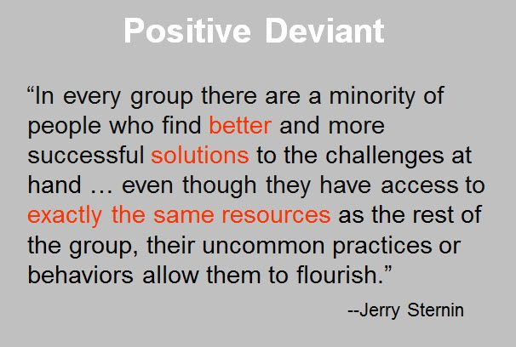
What is positive deviance (PD)?

Slide 39
What we know
We should always lead with aim:
  The aim determines the methodology
  The aim (shared purpose) unites people, methodology doesn’t
  The methodology is critical but in the background
All of these approaches can and should be combined with improvement methodologies
When we work through community, the question “who are our people?” comes before “what is our aim?”
Once you put your toe in the water, you can’t take it out again

Slide 40
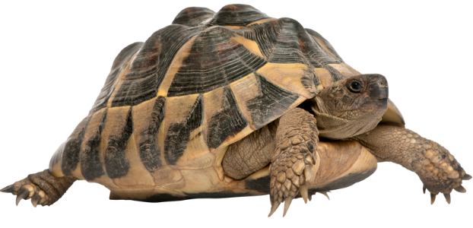
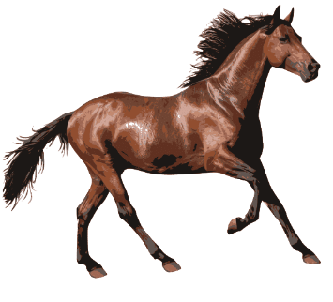
A Dutch proverb
Trust arrives on a tortoise…..
…..and leaves on a horse
simonterry.com/2017/07/31/trust-is-precious/

Slide 41
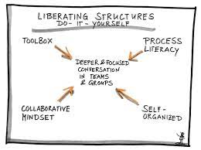
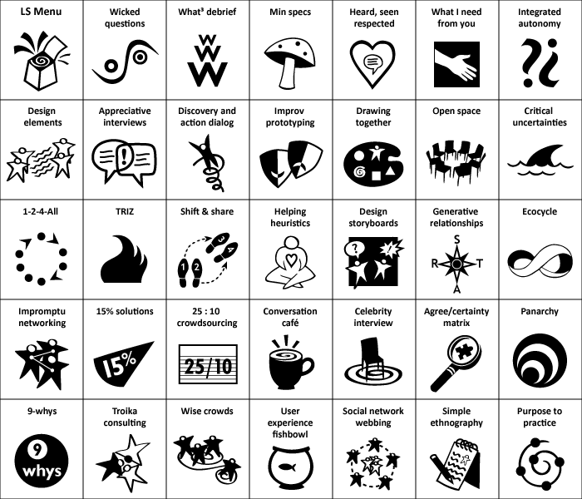
Working with Liberating Structures
www.liberatingstructures.com/ or download the Liberating Structures app

Slide 42
1-2-4-all: What opportunities do you see for building community and engagement for large scale change in your own context?
Start with 1 minute of silent self-reflection on your own;
Take 2 minutes to generate ideas in pairs, building on ideas from self-reflection;
Create groups of four and use 4 minutes to share and develop ideas that you’ve discussed within your pair. Notice similarities and differences.
Take 5 minutes as a table to share insights, ideas and takeaways by asking “What is one idea that stood out in our conversation?”.
Each table will share one important idea via Menti

Slide 43


Slide 44
An after lunch challenge: the one word method
Our theme is "how to engage people who are sceptical about improvement".
Our aim is to create a coherent sentence related to the topic as a table group
The method
  The first person in the group says one word to the topic
  The next person continues with another word
  Eventually the group creates a whole sentence

