Slide 1
Principles of positive deviance with a community

Slide 2
Table task: designing a positive deviance initiative
What we will be doing shortly
Each table will pick a topic to work on.
The group should identify:
the problem to focus on
the community to engage
the process to follow

Slide 3
What is positive deviance (PD)?

Slide 4
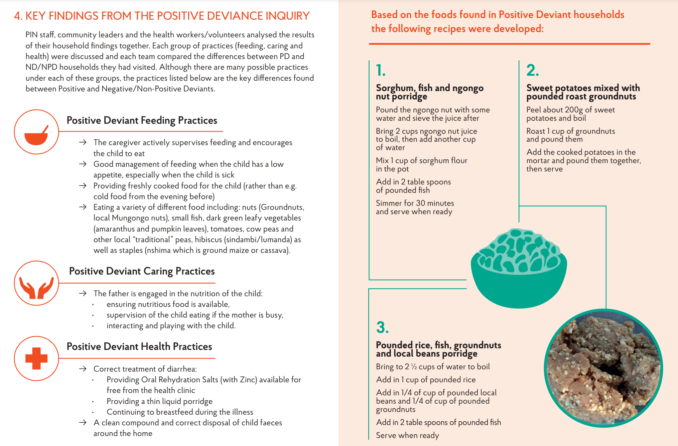
PD started in international development to support local communities but has been widely adopted for other contexts
An example PD project in Western Province, Zambia which led to improvements in nutritional status, knowledge, attitude/caring and feeding practice
Abbreviations: PD = Positive Deviant - poor/very poor households with a child with a well nourished child
ND = Negative Deviant - average/rich households with a malnourished child
NPD = Non-Positive Deviant - poor/very poor households with a malnourished child

Slide 5
Save the Children in Uganda, on a project to address issues facing previously abducted girl soldiers from the Lords Resistance Army in their reintegration into the camps in Pader
The uncommon practices of the positive deviants:
specific negotiating strategies used by girls around condom use
entrusting girls to the care of grandmothers for guidance re behaviour at time of menstrual cycle
boys use of sports and exercise boys avoiding sexually active cliques as principal peer group
boys use of sports and exercise
mothers providing daughters with a small allowance to buy things they need
leaders creating support groups of girls to discuss risks and strategies to avoid unwanted pregnancy
The community identified the problem of unwanted pregnancies as a major concern

Slide 6
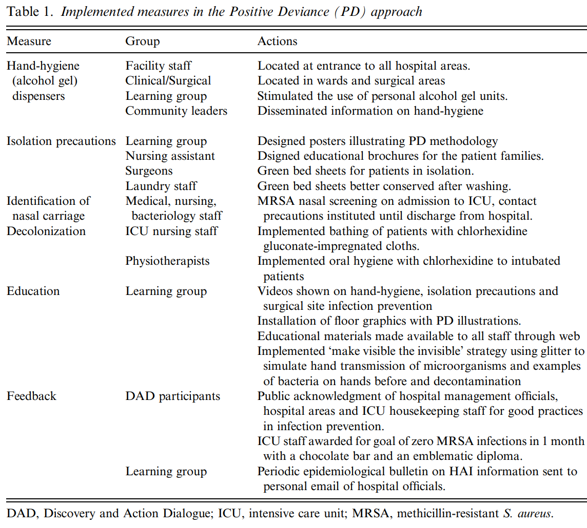
Positive deviance bundle for reduction of MRSA infection

Slide 7
Stages that the community goes through in a PD project
Defining the problem and the desired outcomes, and reframing the problem positively
Determining who are the positive deviants are by using data collection and observation to identify teams that are like us that appear to have overcome the problems we are addressing
1
2
Discovering the uncommon and successful practices and strategies used by the positive deviants identified in stage 2 through inquiry methods
3
Designing opportunities to spread knowledge in practice throughout the community
4

Slide 8
Guiding principles for a PD project
The community owns the entire process.
All individuals or groups who are part of the problem are also part of the solution - “don’t do anything about me without me.”
The community discovers existing uncommon, successful behaviours and strategies (PD inquiry).
The community designs ways to practice and amplify successful behaviours and strategies and unleashes innovation.
Community members recognise that “someone just like me” can get results, even in the worst case scenarios (social proof).
PD emphasises practice instead of knowledge - the “how” instead of the “what” or “why.” The PD mantra is: “You are more likely to act your way into a new way of thinking than to think your way into a new way of acting
The community creates its own benchmarks and monitors progress.
PD facilitation is based on deep respect for community, its members, and its culture, focuses on interactive engagement and capacity to let the community lead.
The PD process expands existing networks and creates new ones.
Source: adapted from Tufts University Basic field guide to the positive deviance approach

Slide 9
Systematic reviews suggest international nurses face a challenging integration process when recruited to work in the UK. Creating the conditions where they feel a strong sense of belonging, can do their best work and build their careers is critical. ……..
……..#StayandThrive has had a positive impact across two geographical regions. The community includes 11 integrated care systems and 41 NHS organisations. These organisations employ 9800 international nurses which account for 25% of international nurses employed nationally.
…..As a result the community is retaining more international recruits (leaver rates are below national average, January 2022), offering better support, delivering enhanced experience, better understanding and appreciating the breadth and diversity of experience which will lead to enhanced patient outcomes.

Slide 10
Stages that the community goes through in a PD project
Defining the problem and the desired outcomes, and reframing the problem positively
Determining who are the positive deviants are by using data collection and observation to identify teams that are like us that appear to have overcome the problems we are addressing
1
2
Discovering the uncommon and successful practices and strategies used by the positive deviants identified in stage 2 through inquiry methods
3
Designing opportunities to spread knowledge in practice throughout the community
4

Slide 11
The #StayandThrive bundle: What organisations that create the conditions for international recruits to thrive do:
Create strong foundations
Supply detailed welcome packs prior to arrival
Develop managers on how to welcome international recruits and support their cultural needs
Co-create individualised cultural passports for all recruits
Develop programmes in home countries so PIN obtained on arrival
Map skillset and qualifications at initial interview
Make new recruits welcome
Present individualised welcome pack
Offer buddy system
Welcome event with senior leaders, departmental teams, faith leaders in community venue
Integration visits into the local area, inc tourist attractions, supermarkets, banks, schools etc
Build belonging
Cultural awareness for all managers
Work collaboratively with diaspora groups
Establish shared decision making councils/international colleague forms/ networks etc
Engage directly with local community to support integration of whole family
Maximise personal and professional growth
Hold career clinics for international colleagues
Train recruitment teams on cultural nuances of how candidates present
Run leadership development programmes aimed at internationally recruited colleagues
Provide wellbeing support appropriate to cultural needs
Build a data-driven learning system
Role model and showcase career success

Slide 12
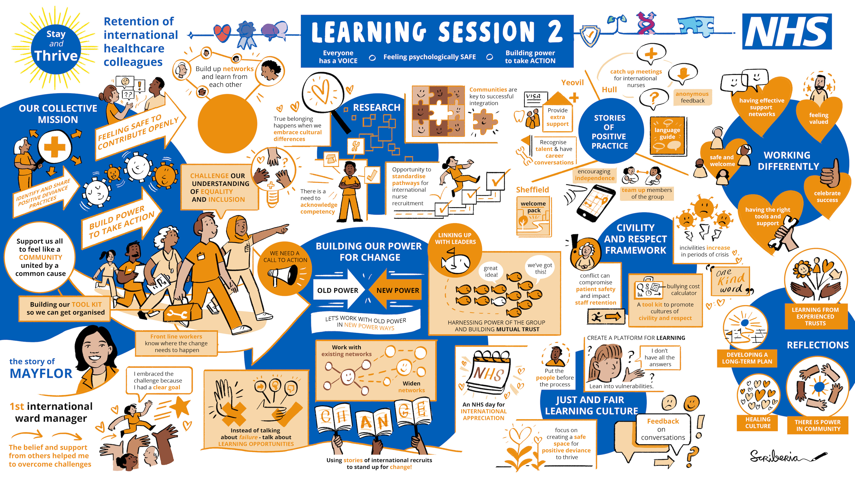

Slide 13
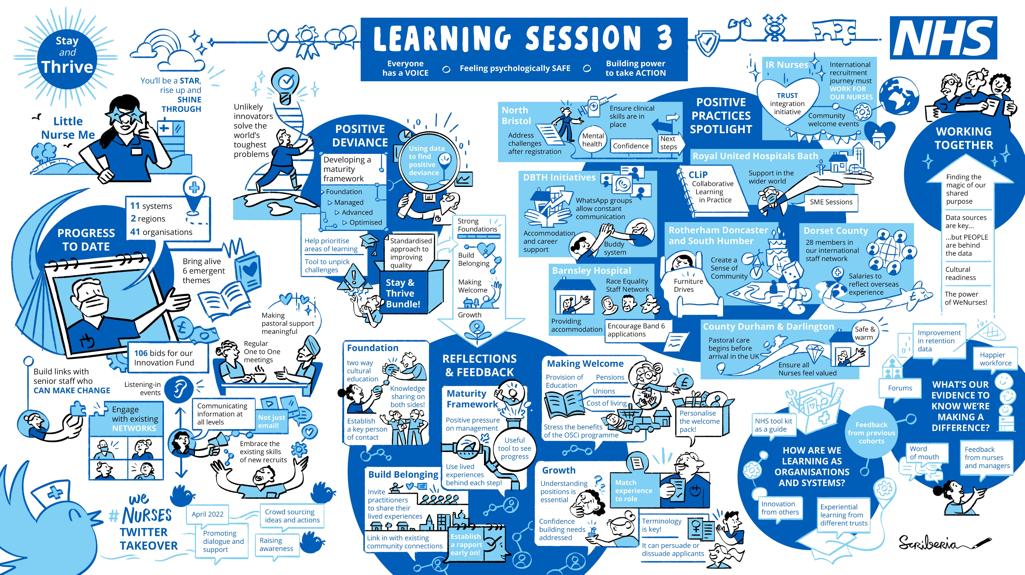

Slide 14
Stages of maturity in a learning community
4. Thrive
3. Drive
Power
Agency
Impact
Agility
2. Share
1. Connect
Who is out there?
Creating connections, a safe space, shared purpose, interests, sense of belonging for our members
What is going on?
Our members are sharing, problems, knowledge, ideas, situations, lessons
How do we change things?
Solving problems & challenges for our members.
Bringing resources, processes & other ways of change to the system
Why don’t we?
Being a powerful voice & source for positive change, embedded across the whole system, fuelled by shared goals & values
Source: Helen Bevan and Na’eem Ahmed
Based on models from Simon Terry and Liz Maddocks Brown (Source4Networks)

Slide 15
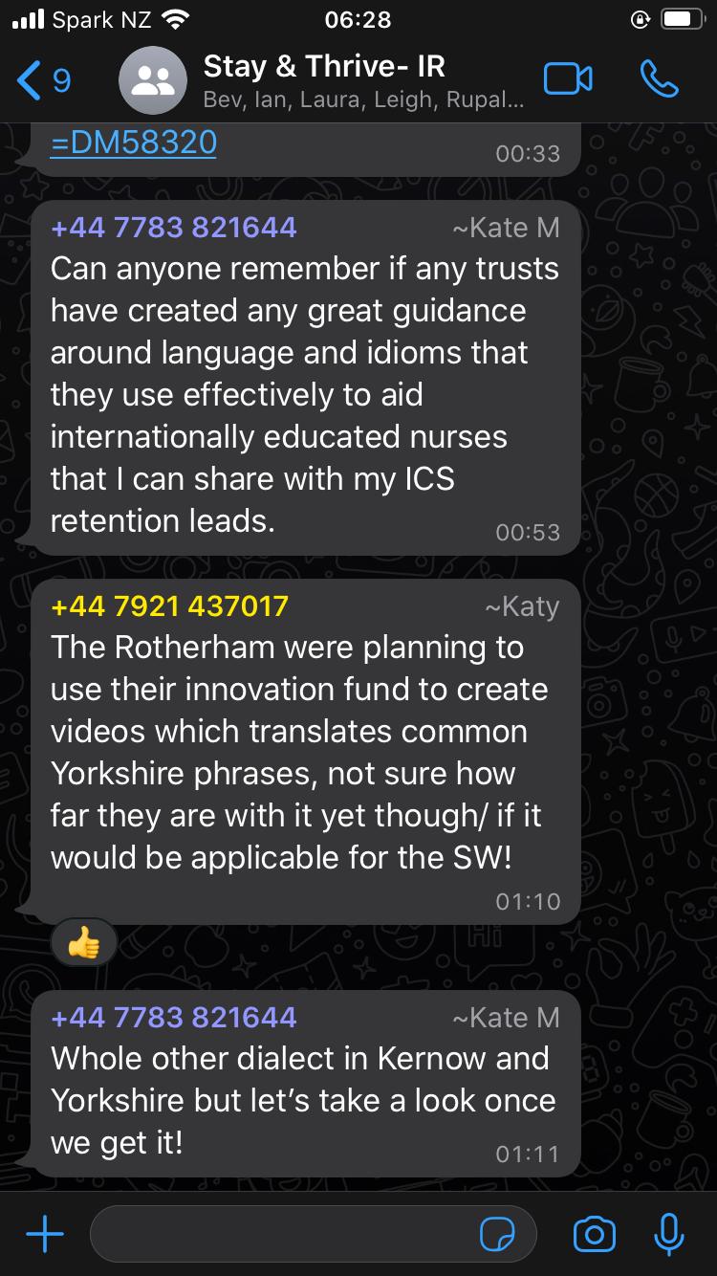
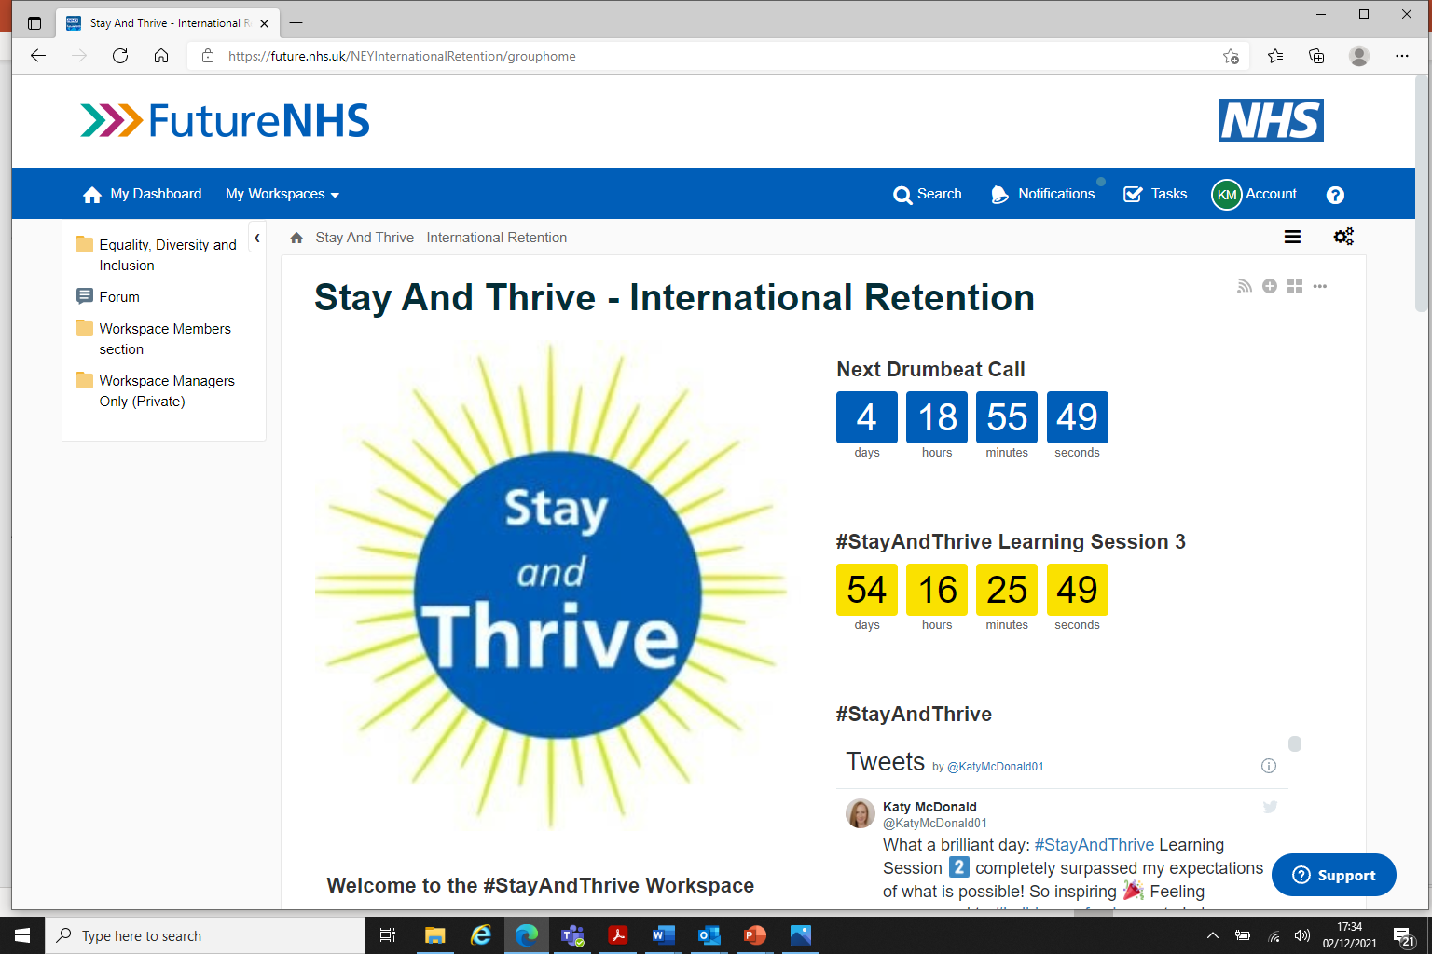
#StayAndThrive –International Retention Workspace and WhatsApp group

Slide 16
“Classic” approach to change | Positive deviance approach to change
Leader as driver of change Ownership and momentum for change come from those at the centre or top of the system | Leadership as inquiry The leader facilitates the search and the community own the quest for change
Outside in Experts identify and help spread best practices | Inside out The community identifies pre-existing solutions and amplifies them
Deficit based Leaders and experts break down common problems into parts and recommend best-practice solutions. The implication: “Why aren’t you as good as your peers?” | Asset based The community identifies and implements solutions practiced by those who succeeded against the odds
Driven by logic Participants think into new ways of acting | Driven by learning Participants act into a new way of thinking
Vulnerable to rejection Resistance arises from ideas imported or imposed by outsiders or senior leaders | Open to replication Wisdom is tapped within the community which leads to less negative reaction or resistance

Slide 17
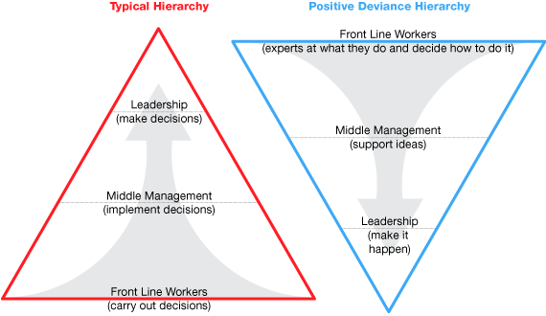
People who use services and frontline people
People who use services and frontline people
(carry out, and are impacted by, decisions)
Source: James Caldwell 418QE

Slide 18
Examples of PD in clinical settings
Alzunitan, M., Edmond, M., Alsuhaibani, M., Samuelson, R., Schweizer, M., & Marra, A. Positive deviance in infection prevention and control: A systematic literature review. Infection Control & Hospital Epidemiology, 1-8, 2020
Baxter R, Taylor N, Kellar I, et al A qualitative positive deviance study to explore exceptionally safe care on medical wards for older people. BMJ Quality & Safety. 28. 2018.
Huges, L. Sheard, L. Pinkney, L. & Lawton, R. Excellence in elective hip and knee surgery: what does it look like? A positive deviance approach. Journal of Health Services Research and Policy. 2020
Lawton R, Taylor N, Clay-Williams R and Braithwaite J. Positive deviance: a different approach to achieving patient safety. BMJ Qual Saf 3: 880– 883. 2014
Létourneau, J. Alderson, M. & Leibing, A. Positive deviance and hand hygiene of nurses in a Quebec hospital: What can we learn from the best? American Journal of Infection Control, 2017
O’Hara J, Grasic K, Gutacker N, et al. Identifying positive deviants in healthcare quality and safety: a mixed methods study. J R Soc Med; 111: 276–291. 2018
Mannion R and Braithwaite J. False dawns and new horizons in patient safety research and practice. Int J Health Policy Manag; 6: 685–689. 2017
Topmiller, M., Kieber-Emmons, A.M., Shaak, K. et al. Identifying Bright Spot Counties for Appropriate Diabetes Preventive Care: A Geospatial, Positive Deviance Approach. J Primary Prevent 41, 431–443, 2020.

Slide 19
Examples of PD in people settings
Hølge-Hazelton, B, Berthelsen, CB. Leading unique cultures in departments with low turnover of nurses. A positive deviance approach study. J Nurs Manag. 28: 1207– 1214. 2020
Hølge-Hazelton, B, Berthelsen, CB. Why do nurses stay? A positive deviance study of nurse turnover, European Journal of Public Health, Volume 30, Issue Supplement_5, September 2020
Longhini, J, Papastavrou, E, Efstathiou, G, et al. Strategies to prevent missed nursing care: An international qualitative study based upon a positive deviance approach. J Nurs Manag. 2021; 29: 572– 583.
Mertens, W. & Recker, J. Positive deviance and leadership: An exploratory field study. In Bui, T & Sprague Jr, R (Eds.) Proceedings of the 50th Hawaii International Conference on System Sciences. University of Hawaii, pp. 214-223. 2017
Toscos T, Carpenter M, Flanagan M, Kunjan K, Doebbeling BN. Identifying Successful Practices to Overcome Access to Care Challenges in Community Health Centers: A “Positive Deviance” Approach. Health Services Research and Managerial Epidemiology. 2018

Slide 20
Table task: designing a positive deviance initiative
Each table will pick a topic to work on.
The group should identify:
the problem to focus on
the community to engage
the process to follow

Slide 21
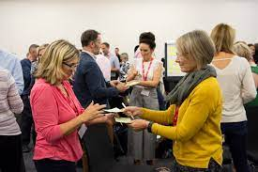
Using 25/10 Crowdsourcing to identify the afternoon topics
On your index card, write your idea for a topic we should discuss this afternoon on our theme of “engaging people and building community for improvement”
Await further instruction!

Slide 22
Go to the table with the topic you most want to work on
Table | Topic
1
3
4
6
7
9
11
12
13
15
Table | Topic
16
17
18
20
21
22
24
25
27
29

Slide 23
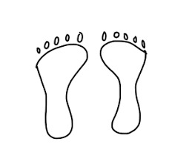
4 principles and a law for this session
Principles:
Whoever comes to the discussion are the right people
Whatever happens is the only thing that could have happened.
When it starts is the right time
When it's over it's over
The Law is known as the Law of Two Feet:
"If you find yourself in a situation where you are not contributing or learning, move somewhere where you can."

Slide 25
Revise the table list and put it here
Table | Topic
1
3
4
6
7
9
11
12
13
15
Table | Topic
16
17
18
20
21
22
24
25
27
29

Slide 26
15% Solutions: what you have the freedom and resources to do NOW
15% solutions: any first step or solution that you can do without approval or resources from others and that is entirely within your discretion to act.
It is something that you can start right now if you want to.
Changing the flow of the river by moving a few rocks
Unleashing “snowball change” by starting with what you have the freedom and resources to do
There is always something you can do now

Slide 27
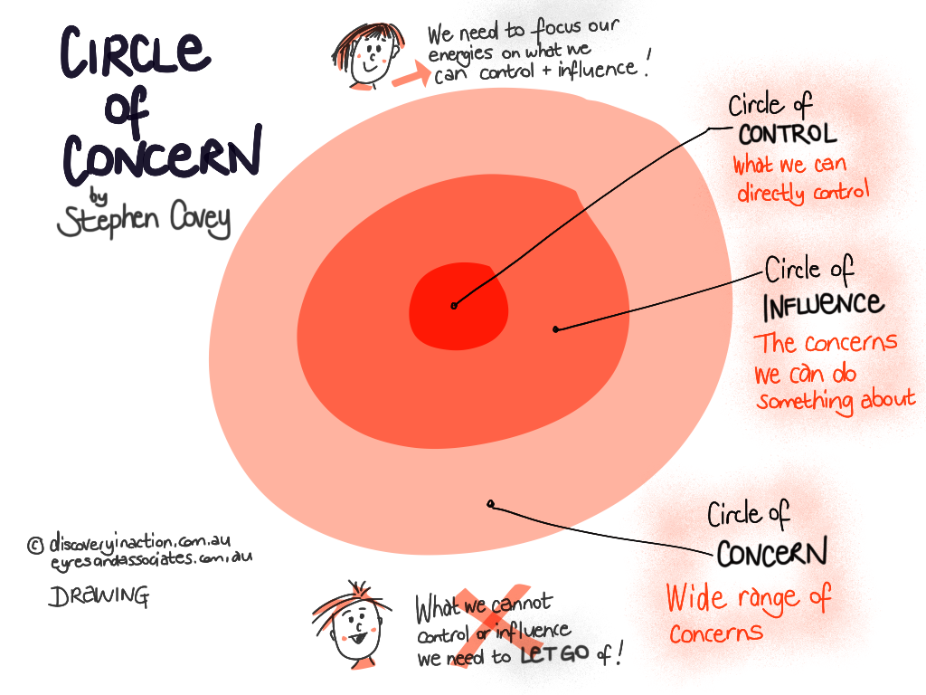
Focus on the things that we are able to control or influence
Focus our energies on what you CAN control and influence
Don’t focus on what you cannot control or influence
What we can control
What we can influence
What’s outside of our control

Slide 28
15% Solutions: what you have the freedom and resources to do NOW
First alone, generate your own list of 15% Solutions. 3 mins
Work in a trio
provide a consultation to one another (asking clarifying questions and offering advice). 4 min. per person and one person at a time

Slide 29
Commitments
Using the image cards you chose yesterday, write some commitments to yourself on actions you will take as a result of this workshop.
Share your actions with others on the table

Slide 30
