Slide 1
National Medication Chart Review 2020
Patient safety and capability team
Notes:
Ehara taku toa i te toa takitahi engari, he toa takitini.
My successes are not mine alone, they are ours – the greatest successes we will have are from working together.
Tēnā koutou and welcome to this introduction to the revised edition of the national medication chart.
The Commission commenced a utility review of the National Medication Chart (NMC) suite in 2019. The last review was completed in 2014, with an amendment to the oxygen prescribing section in 2016. Regular review means that the chart design continues to evolve to meet the needs of current practice.
The medication charts are used in inpatient settings to record the medicines prescribed and administered to a patient, along with any allergies and adverse reactions from medicines.
The Commission supports a suite of five national medication charts (NMCs):
• Day Stay Chart
• 8-Day Chart
• 8-Day Chart (scannable)
• 16-Day Chart (long stay)
• 16-Day Chart (long stay scannable)

Slide 2
Safety
Standardisation
Reduce medication errors
Notes:
Why do we have a national medication chart?
The suite of national medications charts (hereinafter referred to as NMC) were introduced to reduce medication errors, and improve patient safety, through the standardisation of paper-based medication charts used in Aotearoa hospitals.
The design of the NMC was the result of an eight-year development phase involving many health professionals. The charts are supported by a user guide and Medication Charting Standard.
The NMCs are extensively used across the sector, in all DHB hospitals, and some hospices and private hospitals. The Commission’s preference is for electronic prescribing systems.

Slide 3
Feedback process
NMC users
Feedback on the existing chart
NMC committee
Review of feedback
Feedback to the sector
Notes:
For the review of the NMC, an interdisciplinary committee was established. The purpose of the committee was to undertake a review of the utility of the NMC suite as part of the three-yearly review process. We would like to thank the NMC committee for their active participation in the development of the revised suite of charts.
NMC users were invited to provide feedback on the utility of the existing NMCs. We received 98 responses from both DHB hospitals and non-DHB users. All initial feedback was considered by the NMC committee, and a revised 'NMC_8-Day chart with proposed changes’ was drafted and circulated in October 2019 for further feedback.
Following further submissions, the recommended and approved changes to the 8-day chart were finalised and the full NMC suite was re-designed to reflect these changes and align with the 8-Day chart.
Implementation was due to begin in late 2019; however, extra time for feedback and consideration, and then the impact of COVID-19, delayed this further. It was also necessary to seek clarification for the oxygen prescribing section and this again affected the timing of implementation. Following consultation with Dr Alex Psirides, Dr Alan Davis, Dr Iwona Stolarek and the wider Committee, this issue has now been resolved.
This presentation provides a summary of the main changes to the 8-day NMC.
Where possible, each slide shows an example image and refers to the page or pages of the chart that are affected. For further details please refer to the NMC user guide, which has been updated to reflect the changes to support the implementation phase. This is available on the Commission’s website.

Slide 4
ID label panel
Page 1
The ID label panels are now enclosed with a border to encourage the correct alignment of the name label without covering other information on the chart.
The number of required ID labels has been reduced to two (on pages 1 and 2), with one on the IV fluids page (which only needs to be applied if IV fluids / additives are prescribed).
Notes:
Page 1
The ID label panels are now enclosed with a border to encourage the correct alignment of the name label without covering other information on the chart.
The number of required ID labels has been reduced to two (on pages 1 and 2), with one on the IV fluids page (which only needs to be applied if IV fluids / additives are prescribed).

Slide 5
Special Care Required
Page 1
The special care required box has been moved to the top of the front page. This allows the special care alerts to be visible when prescribing, administering or reviewing medicines.
Notes:
Page 1
The special care required box has been moved to the top of the front page. This allows the special care alerts to be visible when prescribing, administering or reviewing medicines.

Slide 6
Supplementary Charts
Page 1
The supplementary charts box remains on the front page; with the addition of an extra ‘Other’ checkbox.
This allows the alerts about supplementary charts being in use to be visible when prescribing, administering or reviewing medicines.
Notes:
Page 1
The supplementary charts box remains on the front page; with the addition of an extra ‘Other’ checkbox.
This allows the alerts about supplementary charts being in use to be visible when prescribing, administering or reviewing medicines.

Slide 7
Medicine Reconciliation
Page 1
A medicine reconciliation section has been added to the front page. The first two boxes are to identify if discrepancies have been found and when they are reconciled, and the last box is for when no discrepancies are identified. This section should be signed by the person doing the medicine reconciliation and full details added to the sample signatures section.
Notes:
Page 1
A medicine reconciliation section has been added to the front page. The first two boxes are to identify if discrepancies have been found and when they are reconciled, and the last box is for when no discrepancies are identified. This section should be signed by the person doing the medicine reconciliation and full details added to the sample signatures section.
(Feedback during the review included a recommendation to have something on the chart itself to highlight that a medicine reconciliation had been completed.)

Slide 8
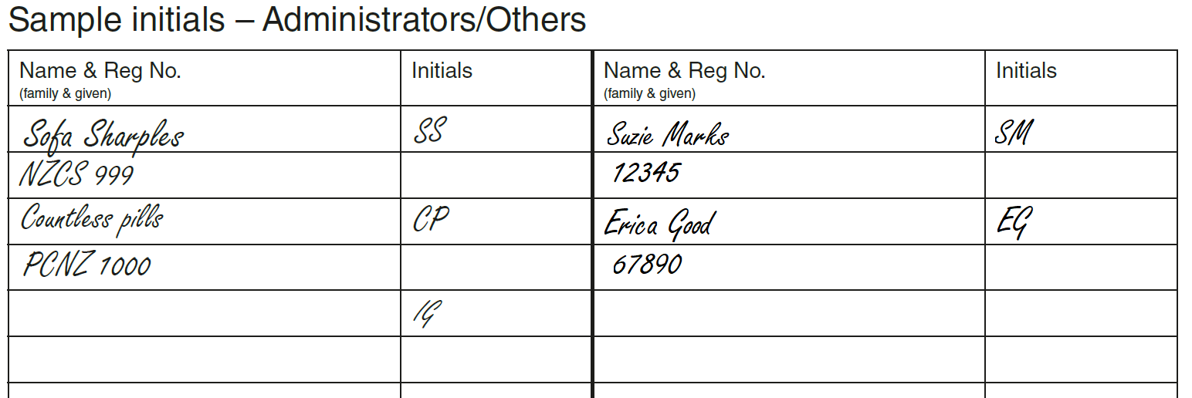
Sample signatures and initials
Page 1
These sections have been reconfigured to give more lines for administrators’ initials.
For prescribers, the registration number ‘Reg No’ column has changed to contact number ‘Contact No’. Inclusion of the registration number has been added to the ‘name’ column.
The signature information can be completed over two lines of the chart; a stamp can be used in this section.
Notes:
Page 1
These sections have been reconfigured to give more lines for administrators’ initials.
For prescribers, the registration number ‘Reg No’ column has changed to contact number ‘Contact No’. Inclusion of the registration number has been added to the ‘name’ column.
The signature information can be completed over two lines of the chart; a stamp can be used in this section.

Slide 9
Allergies & Adverse Reactions
Page 2
The allergies and adverse reactions boxes have been combined into a single source, on page 2. This placement allows the allergies & adverse reactions to be visible when prescribing, administering or reviewing medicines.
There is no need to distinguish between an allergy and an adverse reaction on the revised NMC.
Recording of a clinician’s signature assigns accountability for the information and the date shows how current the information is.
There is also a reminder on the fluids and infusions page (last page) of the NMC to refer to page 2 for information on allergies and adverse reactions.
Notes:
Page 2
The allergies and adverse reactions boxes have been combined into a single source, on page 2. This placement allows the allergies & adverse reactions to be visible when prescribing, administering or reviewing medicines.
There is no need to distinguish between an allergy and an adverse reaction on the revised NMC.
Recording of a clinician’s signature assigns accountability for the information and the date shows how current the information is.
There is also a reminder on the fluids and infusions page (last page) of the NMC to refer to page 2 for information on allergies and adverse reactions.

Slide 10
Verbal Orders
Page 3
This section has been enlarged to accommodate documentation of three verbal orders.
Notes:
Page 3
This section has been enlarged to accommodate documentation of three verbal orders.

Slide 11
Oxygen Therapy & Medical Gases
Page 3
The ‘Target Saturations’ box has been moved to the bottom of page 3 and shaded pink to make it more obvious (and to keep the ‘Once Only’ medicines together).
The parameters have been updated to 88-91% and 92-96% and wording has been added for guidance.
Notes:
Page 3
The ‘Target Saturations’ box has been moved to the bottom of page 3 and shaded pink to make it more obvious (and to keep the ‘Once Only’ medicines together).
The parameters have been updated to 88-91% and 92-96% and wording has been added for guidance and we have referenced the guidelines from the Thoracic society in the user guide: https://www.thoracic.org.au/journal-publishing/command/download_file/id/34/filename/TSANZ-AcuteOxygen-Guidelines-2016-web.pd

Slide 12
The dose boxes
The wording ‘Dose range if needed’ has been removed from the ‘Dose’ box in all sections except in the ‘As Required (PRN) Medicine’ sections on pages 4 to 7.
Notes:
The wording ‘Dose range if needed’ has been removed from the ‘Dose’ box in all sections except for the ‘As Required (PRN) Medicine’ sections on pages 4 to 7. (The previous inclusion of that instruction encouraged some prescribers to add a dose range when a single dose should have been specified.)

Slide 13
As Required (PRN) Medicines
Pages 4 to 7
An extra page has been added, giving space for additional PRN medicines.
PRN ‘Indication’ and ‘Max dose/24hrs’ fields have been bolded to provide emphasis.
Notes:
Pages 4 to 7
An extra page has been added, giving space for additional PRN medicines.
PRN ‘Indication’ and ‘Max dose/24hrs’ fields have been bolded to provide emphasis.

Slide 14
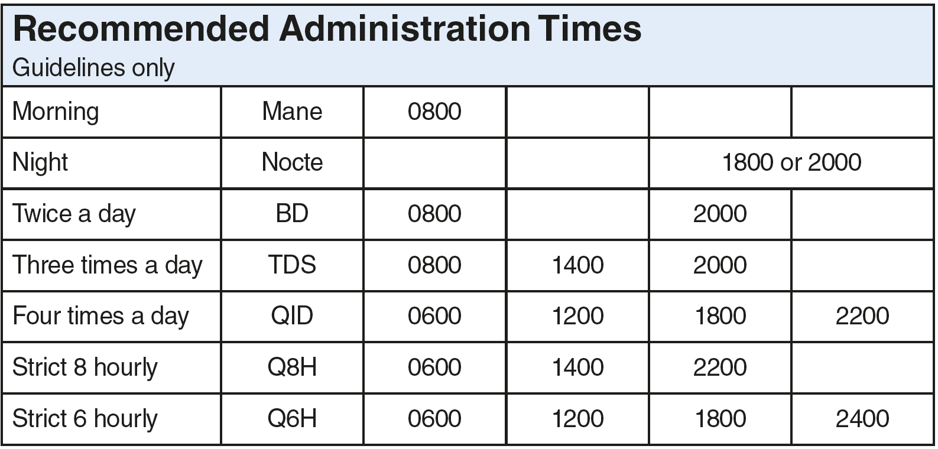
Recommended Administration Times
Page 15
The ‘Recommended Administration Times’ box is now on the top of page 15.
Notes:
Page 15
The ‘Recommended Administration Times’ box is now on the top of page 15.

Slide 15
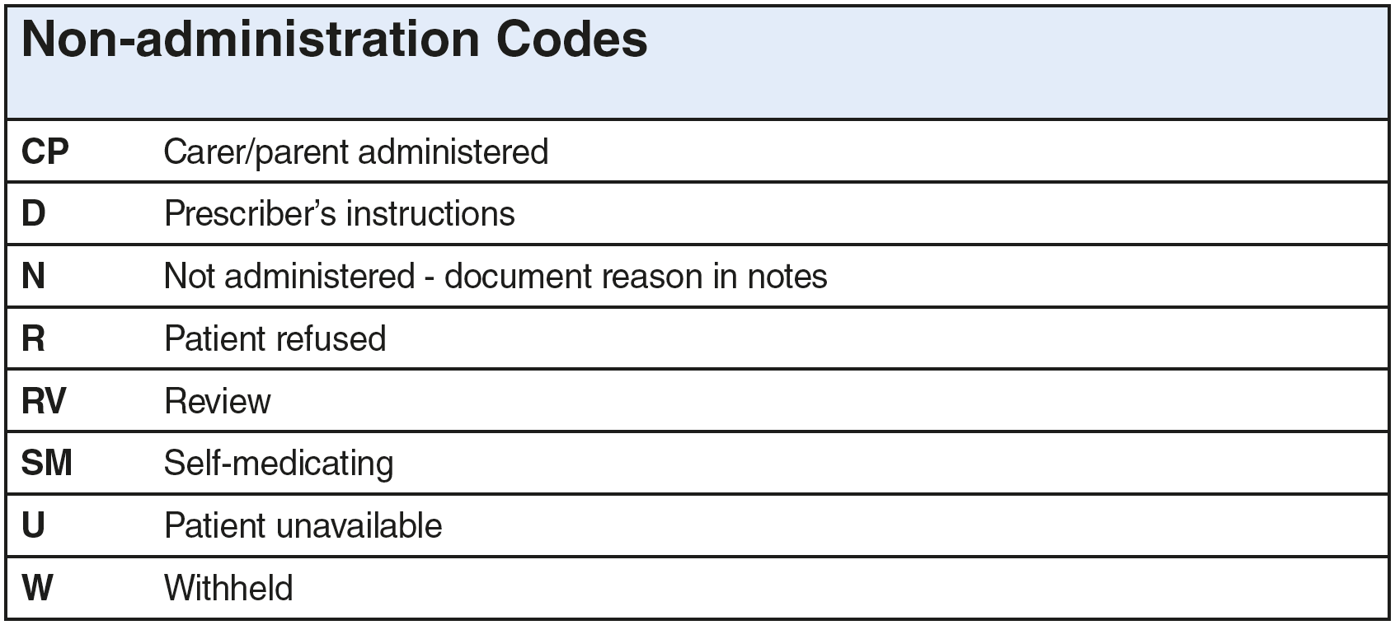
Non-administration Codes
Page 15
New codes have been added ‘W’ for ‘withheld’ , ‘RV’ for ‘review’, ‘U’ for ‘patient unavailable’.
Notes:
Page 15
New codes have been added: ‘W’ for ‘withheld’, ‘RV’ for ‘review’, ‘U’ for ‘patient unavailable’.

Slide 16
Intravenous fluid prescription
Page 16
The ‘Intravenous and subcutaneous fluid prescription and infusion record’ section has been reconfigured.
The ‘Completion/Time/Actual Vol’ columns have been removed, and a reminder to complete a fluid balance chart added.
A continuation sheet for intravenous fluid prescription and infusion records will be available.
Notes:
Page 16
The ‘Intravenous and subcutaneous fluid prescription and infusion record’ section has been reconfigured.
The ‘Completion/Time/Actual Vol’ columns have been removed, and a reminder to complete a fluid balance chart added.
A continuation sheet for intravenous fluid prescription and infusion records will be available.

Slide 17
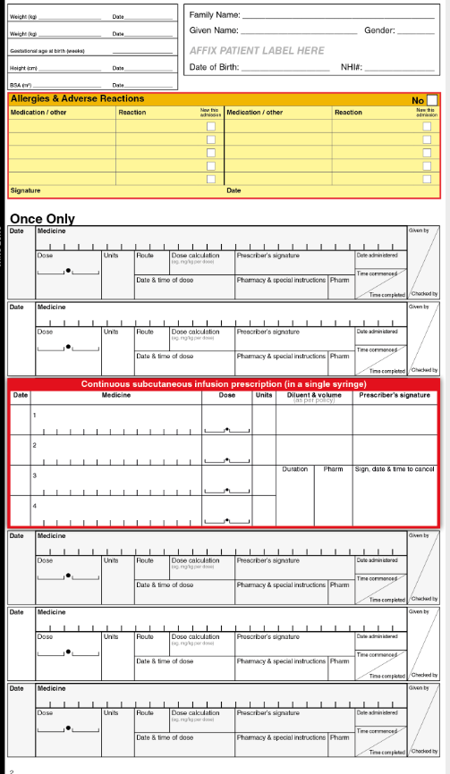
Subcutaneous Charting Sticker
A subcutaneous charting sticker has been introduced for optional use. Subcutaneous medication can now be prescribed in the regular section of the NMC using a sticker template. This is to be placed across two regular medicines rows for multiple medicines. The sticker has rows for up to four medicines to be prescribed in a single syringe.
The continuous subcutaneous infusion prescription sticker can also be placed on the fluid and infusion prescription page (last page of the chart) if that is preferred (see your local policy for guidance).
Notes:
A subcutaneous charting sticker has been introduced for optional use. Subcutaneous medication can now be prescribed in the regular section of the NMC using a sticker template. This is to be placed across two regular medicines rows for multiple medicines. The sticker has rows for up to four medicines to be prescribed in a single syringe.
The continuous subcutaneous infusion prescription sticker can also be placed on the fluid and infusion prescription page (last page of the chart) if that is preferred (see your local policy for guidance).

Slide 18
Removal
The Venous Thromboembolism (VTE) prevention section has been removed.
Rationale:
the NMC is not the appropriate place to document a clinical assessment
different specialties have different VTE prophylaxis protocols
alternative assessment tools are in place (eg, the pre-surgical checklist)
the section is not relevant for all specialties (eg, neonates, paediatrics, mental health).
Notes:
The Venous Thromboembolism prevention section has been removed.
The rationale for this is:
the NMC is not the appropriate place to document a clinical assessment
different specialties have different VTE prophylaxis protocols
alternative assessment tools are in place (eg, the pre-surgical checklist)
the section is not relevant for all specialties (eg, neonates, paediatrics, mental health).

Slide 19
Thank you
Notes:
Kia ora! Thank you for listening to and viewing this presentation.
The NMC suite is supported by the user guide and the Medication Charting Standard, both of which are available on our website. A PDF version of these slides and commentary is also available on our website.
Kia whakairia te tapu
Kia wātea ai te ara
Kia turuki whakataha ai
Kia turuki whakataha ai
Haumi e. Hui e. Tāiki e!
Restrictions are moved aside so the pathway is clear to return to everyday activities, enriched and unified.

